Slide 1

Meet the Teacher
Japan Class 2023
Teacher: Miss Callender
TA: Mrs Hayes
Student teacher: Miss Hook
PPA cover: Mrs Callender and Senorita Bell
Japan: japan@stmarysprimarypulborough.co.uk

Slide 2
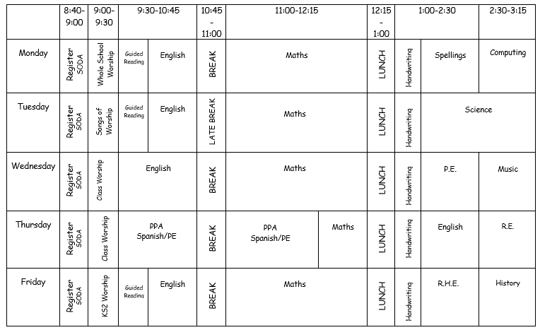

Slide 3
Break and Lunch
Children will have their playtime at 12:15 and then eat their lunch in the hall at 1:35.
Sign up for hot school meals at the Office.
Fruit/healthy snack can be brought in for break times.
Please note that we are a nut-free school.
Water bottles are kept in the classroom and can be accessed at all times – please ensure these are named.

Slide 4
Homework
Log in details have been shared via email.
The half termly homework grid is on Google Classroom. Submit electronically or bring it to school.
One piece of homework completed per week. Choose from: English, Maths, Science and Art/DT.
Tasks explore our topics: ‘Into the Unknown’ and ‘Princes, Peasants and Pestilence.’
Maths: TT Rockstars and Maths with a Mouse – little and often!
By Year 5 and 6, it is imperative that the children know their multiplication and division facts. Quick recall will help them in many areas of their Maths learning this year. Please encourage them to keep practising.

Slide 5
Reading Logs and Spellings
Reading logs are checked daily by Mrs Hayes and me.
Children do not need to record every day, but they do need to bring it to school.
3 x per week at a minimum.
Please encourage personal comments – see page 3 of the logs for prompt questions.
Accelerated Reader and MyOn: online platform for reading. Please encourage children to complete the relevant quiz once they have finished their book.
Weekly spellings are tested on Monday. Spelling books remain in school and word lists will be uploaded to Google Classroom.

Slide 6
Behaviour: Rewards and Sanctions
At St Mary’s, we believe in praising positive behaviour and hard work.
Dojo Champion and Star of the Week
Star Worker Board for recognition
School Celebrations: Happy Book and vine leaves for our Christian values.

Slide 7
Behaviour: Rewards and Sanctions
Behaviour Policy: found on our school’s website.
Underpinned by our school Golden Rules.
Follows a restorative approach – ‘community classroom.’
Children may receive a timeout if they have been persistently disruptive or broken a Golden Rule.
Communication with parents if a child has had a difficult day or received a timeout.
E-safety is currently being covered in Computing.

Slide 8
Uniform -Trainers are not part of school uniform.
Children require a full P.E kit which should be brought to school on Monday and taken home on Friday.
Please ensure that all uniform is labelled clearly.
Children should not wear jewellery to school.
Walking home: please send a letter or an email to provide consent if you would like your child to walk home independently.
Photography permission slips (internet/website)
Parents’ Evenings: to take place via School Cloud: Tuesday 7th and Thursday 9th November
PE: Outdoor Games – Thursdays (hockey and netball).
Swimming – Wednesday/Thursday up until half term (weather permitting).
Second session of the week will be Gymnastics after half term (Wednesday).
RHE: Sex Education Information Evening – right after this meeting.
Class assembly: November 30th 9:00am
Year 6 SATs – week beginning 13th May.
SATs Information Meeting for parents will be held in the Spring term.

Slide 9
Any queries or concerns, please email me on
japan@stmarysprimarypulborough.couk

