Slide 1

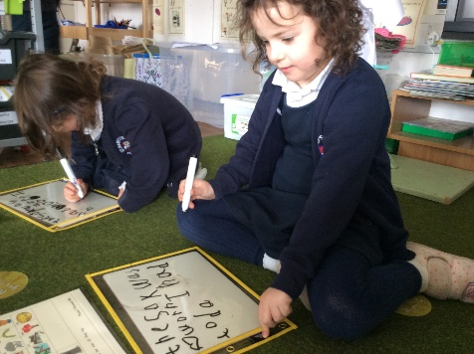
Year One
Phonics Screening Check
A Guide for Parents

Slide 2
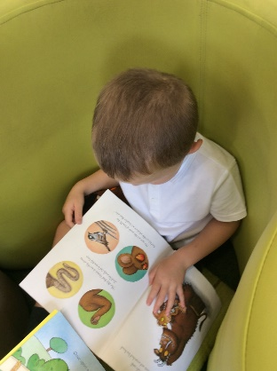
1
What is Phonics?
2
What is the Phonics Screening Check?
3
Contents of the Phonics Screening Check.
4
What Happens During the Screening?
5
Pseudo Words (Nonsense words)
6
Reporting to Parents
7
How Are the Results Used?
8
How Can I Help My Child at Home?
next page

Slide 3
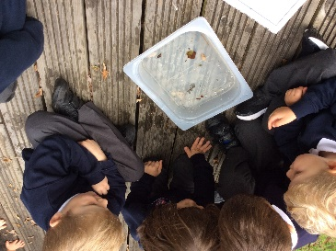
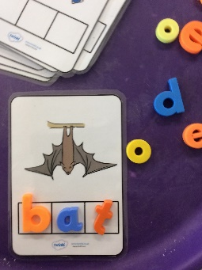
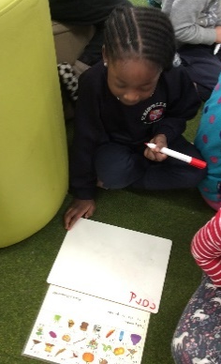
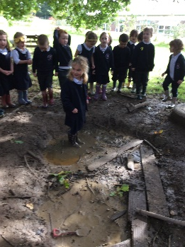

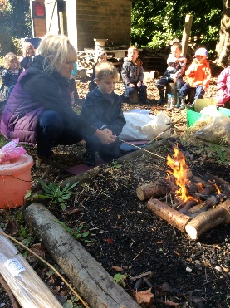

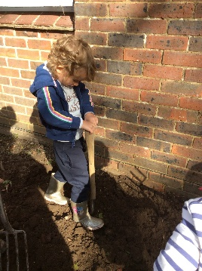
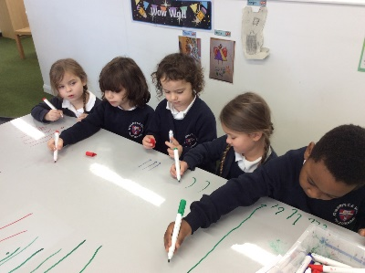


What is Phonics?
Children begin to learn phonics (sounds) in Early Years, discriminating between sounds in nursery and linking these to letters in Reception.
Once children begin learning sounds, these sounds are used orally to identify and make words. They will then begin to learn the letters which make each of the sounds and these are used to read and spell words.
St. Mary’s Phonic Scheme – songs, actions, images.
menu
next page

Slide 4
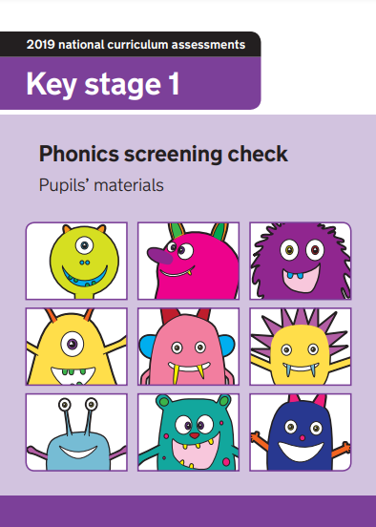
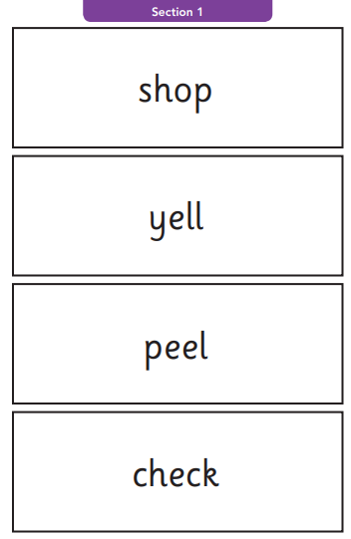
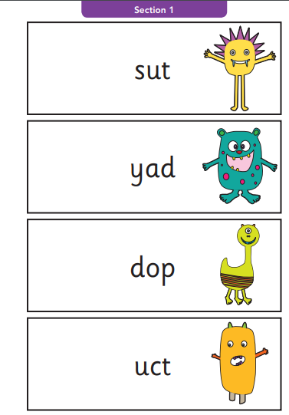
What is the Phonics Screening Check?
Children in Year 1 throughout the country will all be taking part in a Phonics Screening Check during the same week in June. Children in Year 2 will also take the check if they did not achieve the required result when in Year 1 or they have not taken the test before.
The Year 1 Phonics Screening Check is not a formal test, but a way for teachers to ensure that children are making sufficient progress with their phonics skills to read words and that they are on track to become fluent readers who can enjoy reading for pleasure and for learning.
menu
next page

Slide 5
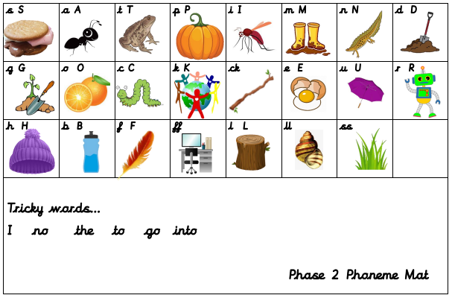
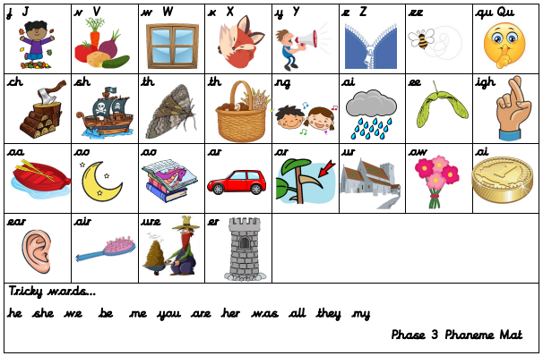
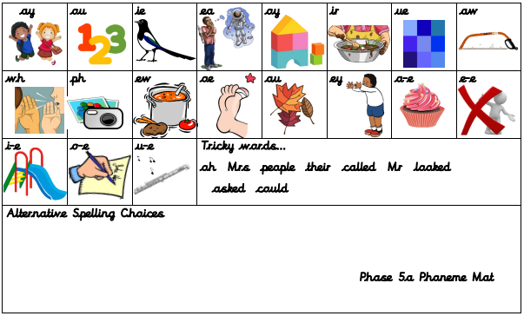
Content of the Phonics Screening Check.
Section 1
The words in section 1 will have a variety of simple word structures (for example CVC, VCC, CCVC and CVCC) using:
single letters (a, b, c, d, e, f, g, h, I, j, k, l, m, n, o, p, q(u), r, s, t, u, v, w, x, y, z)
some consonant digraphs (ch, ck, ff, ll, ng, sh, ss, th, zz)
frequent and consistent vowel digraphs (ar, ee, oi, oo, or)
Section 2
The words in section 2 will have a variety of more complex word structures (for example CCVCC, CCCVC, CCCVCC and two syllable words) with some:
additional consonant digraphs (ph, wh)
less frequent and consistent vowel digraphs, including split digraphs (a-e, ai, au, aw, ay, ea, e-e, er, ew, i-e, ie, ir, oa, o-e, ou, ow, oy, ue, u-e, ur)
trigraphs (air, igh).
menu
next page

Slide 6

What Happens During the Test?
The test contains 40 words. Each child will sit one-to-one and read each word aloud to a teacher. The test will take approximately 10 minutes per child, although all children are different and will complete the test at their own pace. The list of words the children read is a combination of 20 real words and 20 pseudo words (nonsense words).
These are words that are phonically decodable but are not actual words with an associated meaning e.g. brip, snorb. Pseudo words are included in the test specifically to assess whether your child can decode a word using phonics skills and not their memory.
menu
next page

Slide 7
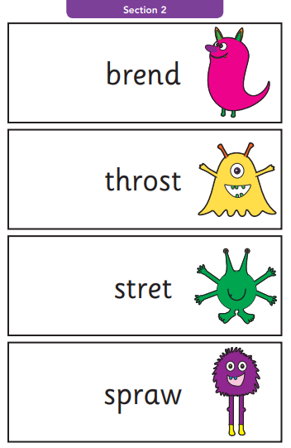
Pseudo Words (Nonsense or Alien Words)
The pseudo words will be shown to your child with a picture of an alien. This provides the children with a context for the pseudo word which is independent from any existing vocabulary they may have. Pseudo words are included because they will be new to all pupils; they do not favour children with a good vocabulary knowledge or visual memory of words.
menu
next page

Slide 8
Reporting to Parents
The check is not about passing or failing, but checking that appropriate progress is being made. If children do not reach the required standard then the class teacher will be in touch to discuss plans and offer additional, tailored support to ensure that your child can catch up. Children progress at different speeds, so not reaching the threshold score does not necessarily mean there is a serious problem. Your child will re-sit the check the following summer term.
By the end of the summer term all schools must report each child's results to their parents. They will also confirm if the child has met the standard threshold. Children who do not achieve the expected level will retake the test when they are in Year 2.
menu
next page

Slide 9
How Are the Results Used?
At St. Mary’s we assess and track the children’s progress throughout the year for all children in EYFS and Key Stage 1 and also those who continue to work on their knowledge of phonics as they move through Key Stage 2.
Targeted support is put in place to promote a ‘Keep Up’ rather than ‘Catch Up’ culture. If your child is having difficulties with gaining and applying phonic knowledge it is very likely this will have already been discussed at Parents Evenings prior to this screening taking place.
Results from the check will be used to add to the above by schools to analyse their own performance and for Ofsted to use in inspections.
DfE does not publish school-level results for the phonics screening check.
menu
next page

Slide 10
How Can I Help My Child at Home?
Play lots of sound and listening games with your child.
Read as much as possible to and with your child – an additional information sheet on ‘Moving through the new Phonics Reading Scheme’ is available on the school website (Curriculum: Phonics)
Encourage and praise – talk about the phonemes they have blended correctly, have another look at the other phonemes together.
Be detectives – hunt for digraphs and trigraphs in words before reading them.
If your child is struggling to decode a word, help them by encouraging them to say each sound in the word from left to right. Use the chop and blend action as you do this.
Syllables – additional information sheet about the importance of these and how to identify them, available on the school website (Curriculum: Phonics)
Blend the sounds by pointing to each one, e.g. /c/ in cat, /p/ in pat, /ng/ in sing, /ee/ in been. Next move your finger under the whole word as you say it.
Discuss the meaning of words if your child does not know what they have read.
menu

