Slide 1

‘Meet the Teacher’
Hello and Welcome to Thailand Class!
Mrs Gowland and Mrs Martin-Wells – Class Teachers
Mrs Ansell – Teaching Assistant

Slide 2
In EYFS and Key Stage 1:
Our priority is meeting the needs of our children – whichever class they are in.
Your child will get the required ‘diet’ for their year group – but also a diet that is tailored to their need – this may look different for children in different classes.
Classes may work completely independently… sometimes.
Classes may work with the class next door… sometimes.
Children may do things with other children in their year group – thus mixing with other classes or doing similar activities… sometimes.
For example: at Christmas, UK will work with Thailand on a performance and India will work with Italy on a different performance – each child will be included.
You may hear that children who are in another class, but are in the same year group as your child, are doing something different from your child – don’t worry! Refer to point 1!
We will try our best to communicate clearly with you.
Please do use Thailand email to contact us.
thailand@stmarysprimarypulborough.co.uk

Slide 3
Curriculum
Thailand class is a mix of both Year 1 and EYFS. The transition from EYFS to Year 1 through more focused group learning with the Teachers and Tas. EYFS are welcome to have a go if they are interested.
Forest School every Thursday for all of Thailand.
After Christmas, EYFS will have Forest School every Wednesday with UK class.
Mrs Dunstall will cover PPA in our Class on a Thursday for half the day (alternating between morning and afternoon each week).
PE (Year 1s and EYFS, if they choose) – every Monday

Slide 4
Thailand class - Reading
As the timetable is flexible, so too is the schedule for hearing readers and how we hear them (we do group guided reading too). This is why it is important that Reading Records are always available for classroom use every day of the week.
Please read with your child every day if at all possible. Leave comments sharing anything that your child has struggled with and highlighting what they have done well. Please do write any direct quotes.
If you are interested in coming to help hear
readers, we’d love to have you. Please
speak to the office who will help arrange a
DBS check.

Slide 5
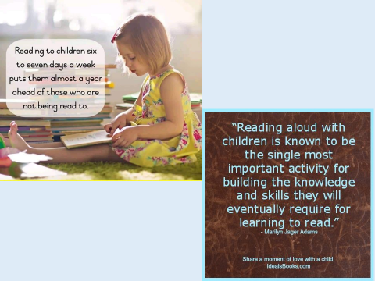

Slide 6
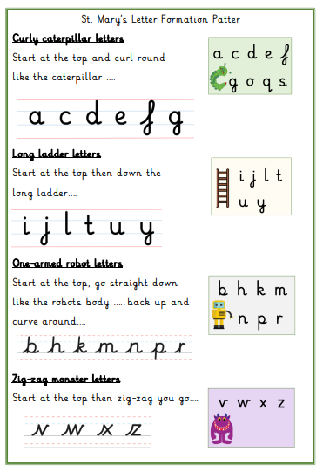
Handwriting
As a school we have been developing our cursive handwriting policy, which has both lead ins and lead outs.
We all continue to
learn this new policy
from Reception to
Year 6.

Slide 7
School Uniform
Please make sure all uniform is labelled, including P.E. kits and coats.
If you notice the name is starting to wear off, please could you re-write it so we know who items belong to.
Children should be wearing sensible black school shoes (no black trainers) at all times. If there is a problem and they need to wear trainers for medical reasons, please let us know.
Navy blue round neck (school) jumpers should be worn. Hoodies and tracksuit tops are not
acceptable as school uniform.
Please make sure uniform follows school policy.

Slide 8
What to bring to school
PE kits should be brought in every Monday and taken home each Friday to be washed.
Book bags/rucksacks – the children bring home letters, books, etc, all week and need their bags to carry everything.
Current reading book and reading record should be in school every day to allow them to be monitored.
Lunch.
Water bottle – named where possible.

Slide 9

Water bottles and fruit
All children should have a water bottle to keep in class should they be thirsty during our Explore and Learn sessions. We keep water bottles over by the sink. Children are also provided with a drink with their hot lunches.
At morning break, the children are encouraged to take a piece of fruit for a snack. Children may bring fruit from home or have a piece of school fruit.

Slide 10
Our Behaviour Policy
In Thailand class, we follow both our Golden Rules and Class Charter every day. We have high expectations of how we should behave in order to learn.
Good behaviour, including good listening is rewarded with dojo points. This is further reinforced through our RHE lessons and class assemblies.
We like to focus on positive behaviour and may send your child to share their work with Mrs Copus or Mrs Hatcher, they will also get a special Headteacher sticker!
Every week, the child with the most dojo points will be given a ’Dojo Champion’ certificate. We also do a STAR of the WEEK for outstanding learning and attitude to learning too.
Gentle reminders and a restorative approach
are undertaken to address any poor behaviour.

Slide 11
Health and Safety
Please can you check your child for head lice (nits) on a weekly basis. Catching head lice is very common among young children and can be easily treated using products purchased from your local chemist. Ways to try to avoid catching them –Tying back long hair where possible. Should your child contract head lice, it is recommended the whole family are treated to prevent them spreading.
All children MUST take earrings out for P.E. lessons and long hair should be tied back at all times. We as staff are not permitted to help children remove earrings. Should you be thinking about having your child’s ears pierced, it is recommended you do this over the summer holidays so that they may be removed easily when they return to school in September.
P.E. is part of the National Curriculum and ALL children from Year 1 must participate.

Slide 12

Helpers
All help is much appreciated!
Reading
Forest Schools
Weeding the garden!
Walks around the village.

Slide 13
Any Questions?
If there is anything that you are curious or concerned about, please do email me on our class email address.
thailand@stmarysprimarypulborough.co.uk
Thank you for coming!
Lovely to meet you all!

Slide 14
Dates to Remember
Forest School
- Whole class- every Thursday until Christmas
- EYFS only - every Wednesday after Christmas
Six Weeks in Meeting 18th October 9am
(EYFS only)
INSET Friday 20th October
Half Term – Friday 20th October to Friday 27th October, returning Monday 30th October
Year 1 class assembly (No EYFS this time) Thursday 14th December 9am

Slide 15
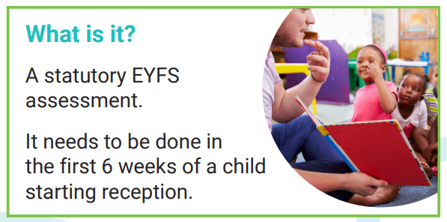



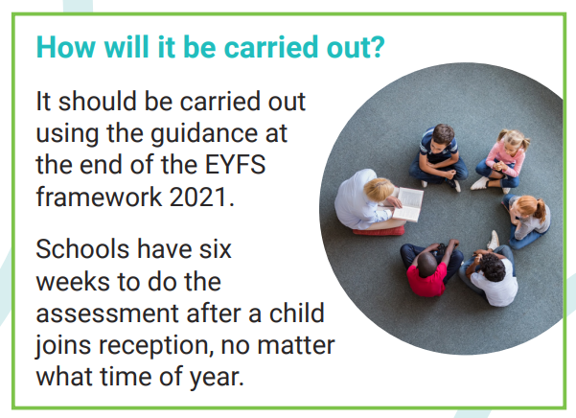
https://assets.publishing.service.gov.uk/government/uploads/system/uploads/attachment_data/file/1182374/2023_Information_for_parents_reception_baseline_assessment_WEBHO.pdf

