Slide 1

SEND Tea and Chat
Monday 6th December 2021
SENDCo- Mollie Wilkins

Slide 2


St Mary’s Vision

Slide 3

What are Special Educational Needs?
“A child or young person has SEN if they have a learning difficulty or disability which calls for special educational provision to be made for him or her. This is if he or she:
• has a significantly greater difficulty in learning than the majority of others of
the same age, or
• has a disability which prevents or hinders him or her from making use of
facilities of a kind generally provided for others of the same age in
mainstream schools or mainstream post-16 institutions”
The difficulty or disability may relate to:
Communication and interaction
Cognition and Learning
Social, Emotional and Mental Health
Sensory or physical conditions
SEND Code of Practice 0-25 years, January 2015

Slide 4

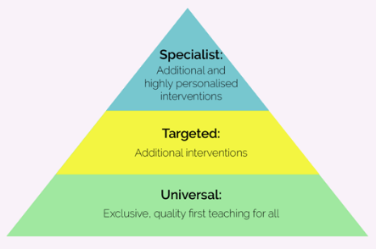
The Graduated Approach
2 years behind peers= Individual Learning Plan (ILP)
4 years behind peers= Education Health Care Needs Assessment (EHCNA) for and Education Health Care Plan (EHCP)
Monitoring Form
If a child does not make adequate progress despite consistent teaching, move to the next level.

Slide 5
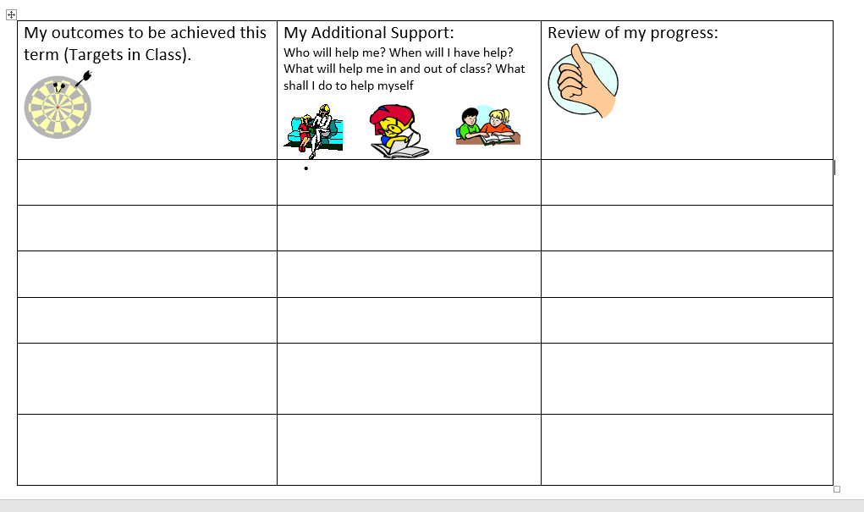
Individual Learning Plans (ILPs)

Slide 6
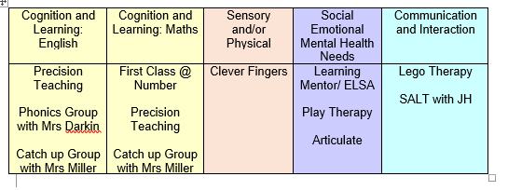
Provision for Children with SEND
Teacher and TA support:
‘Helicoptering’ support to develop independence
Resources:
Coloured overlays, sound buttons, pencil grips, wobble cushions, screens, fiddle toys, assistive technology
eg. Speech to text/ text to speech
Interventions
Outside Agency Support:
Speech and Language Therapy, Child Development Centre, School Nursing Team, Learning and Behavioural Advisory Team, Autism and Social Communication Team, CAMHS, Occupational Therapy, West Sussex Inclusion Team

Slide 7
Any questions, worries or concerns (no matter how big or small!) please do contact me.
office@stmarysprimarypulborough.co.uk

