Slide 1
Science Photography Competition 2023
Looking for signs of Spring
Good photograph with good composition

Slide 2
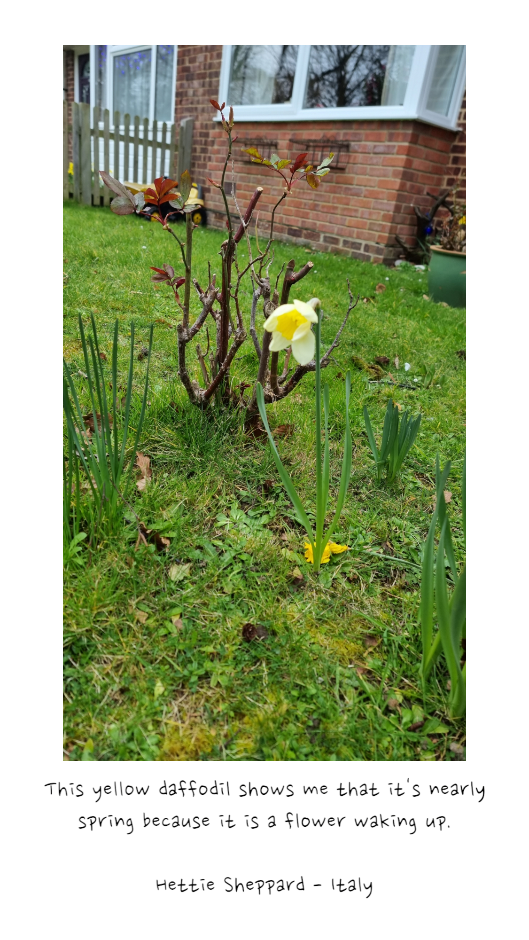
KS 1

Slide 3
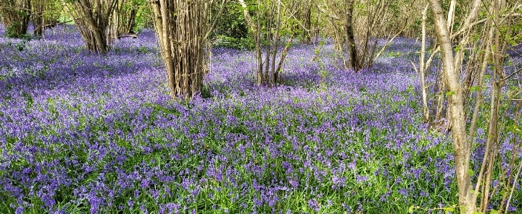
Charlotte Green - It makes me think of spring because I like bluebells in the bluebell woods at my grandma and grandpa's farm.

Slide 4
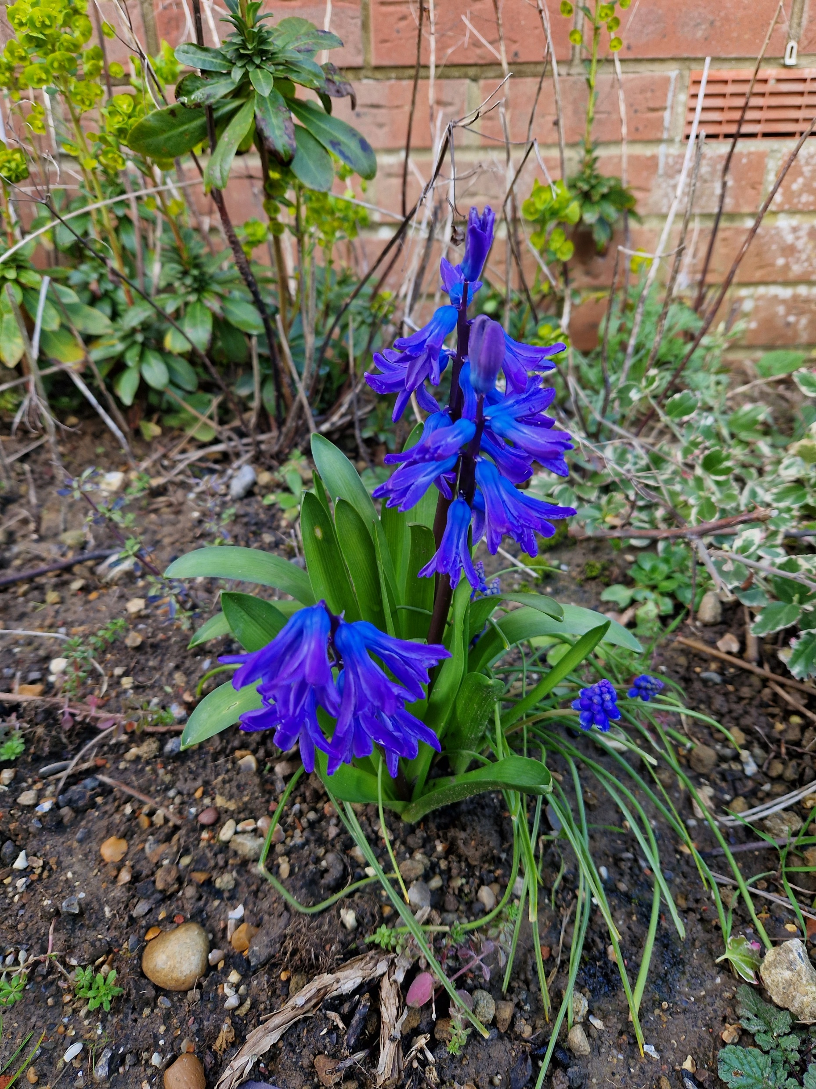
Leah Reilly - Italy class.
This is a sign of Spring because it's a bulb growing and we are learning about bulbs in our class at the moment.
Judging comments – KS2 – Second Place
Strong use of colour to illustrate a Spring bulb with clear focus. Well done

Slide 5
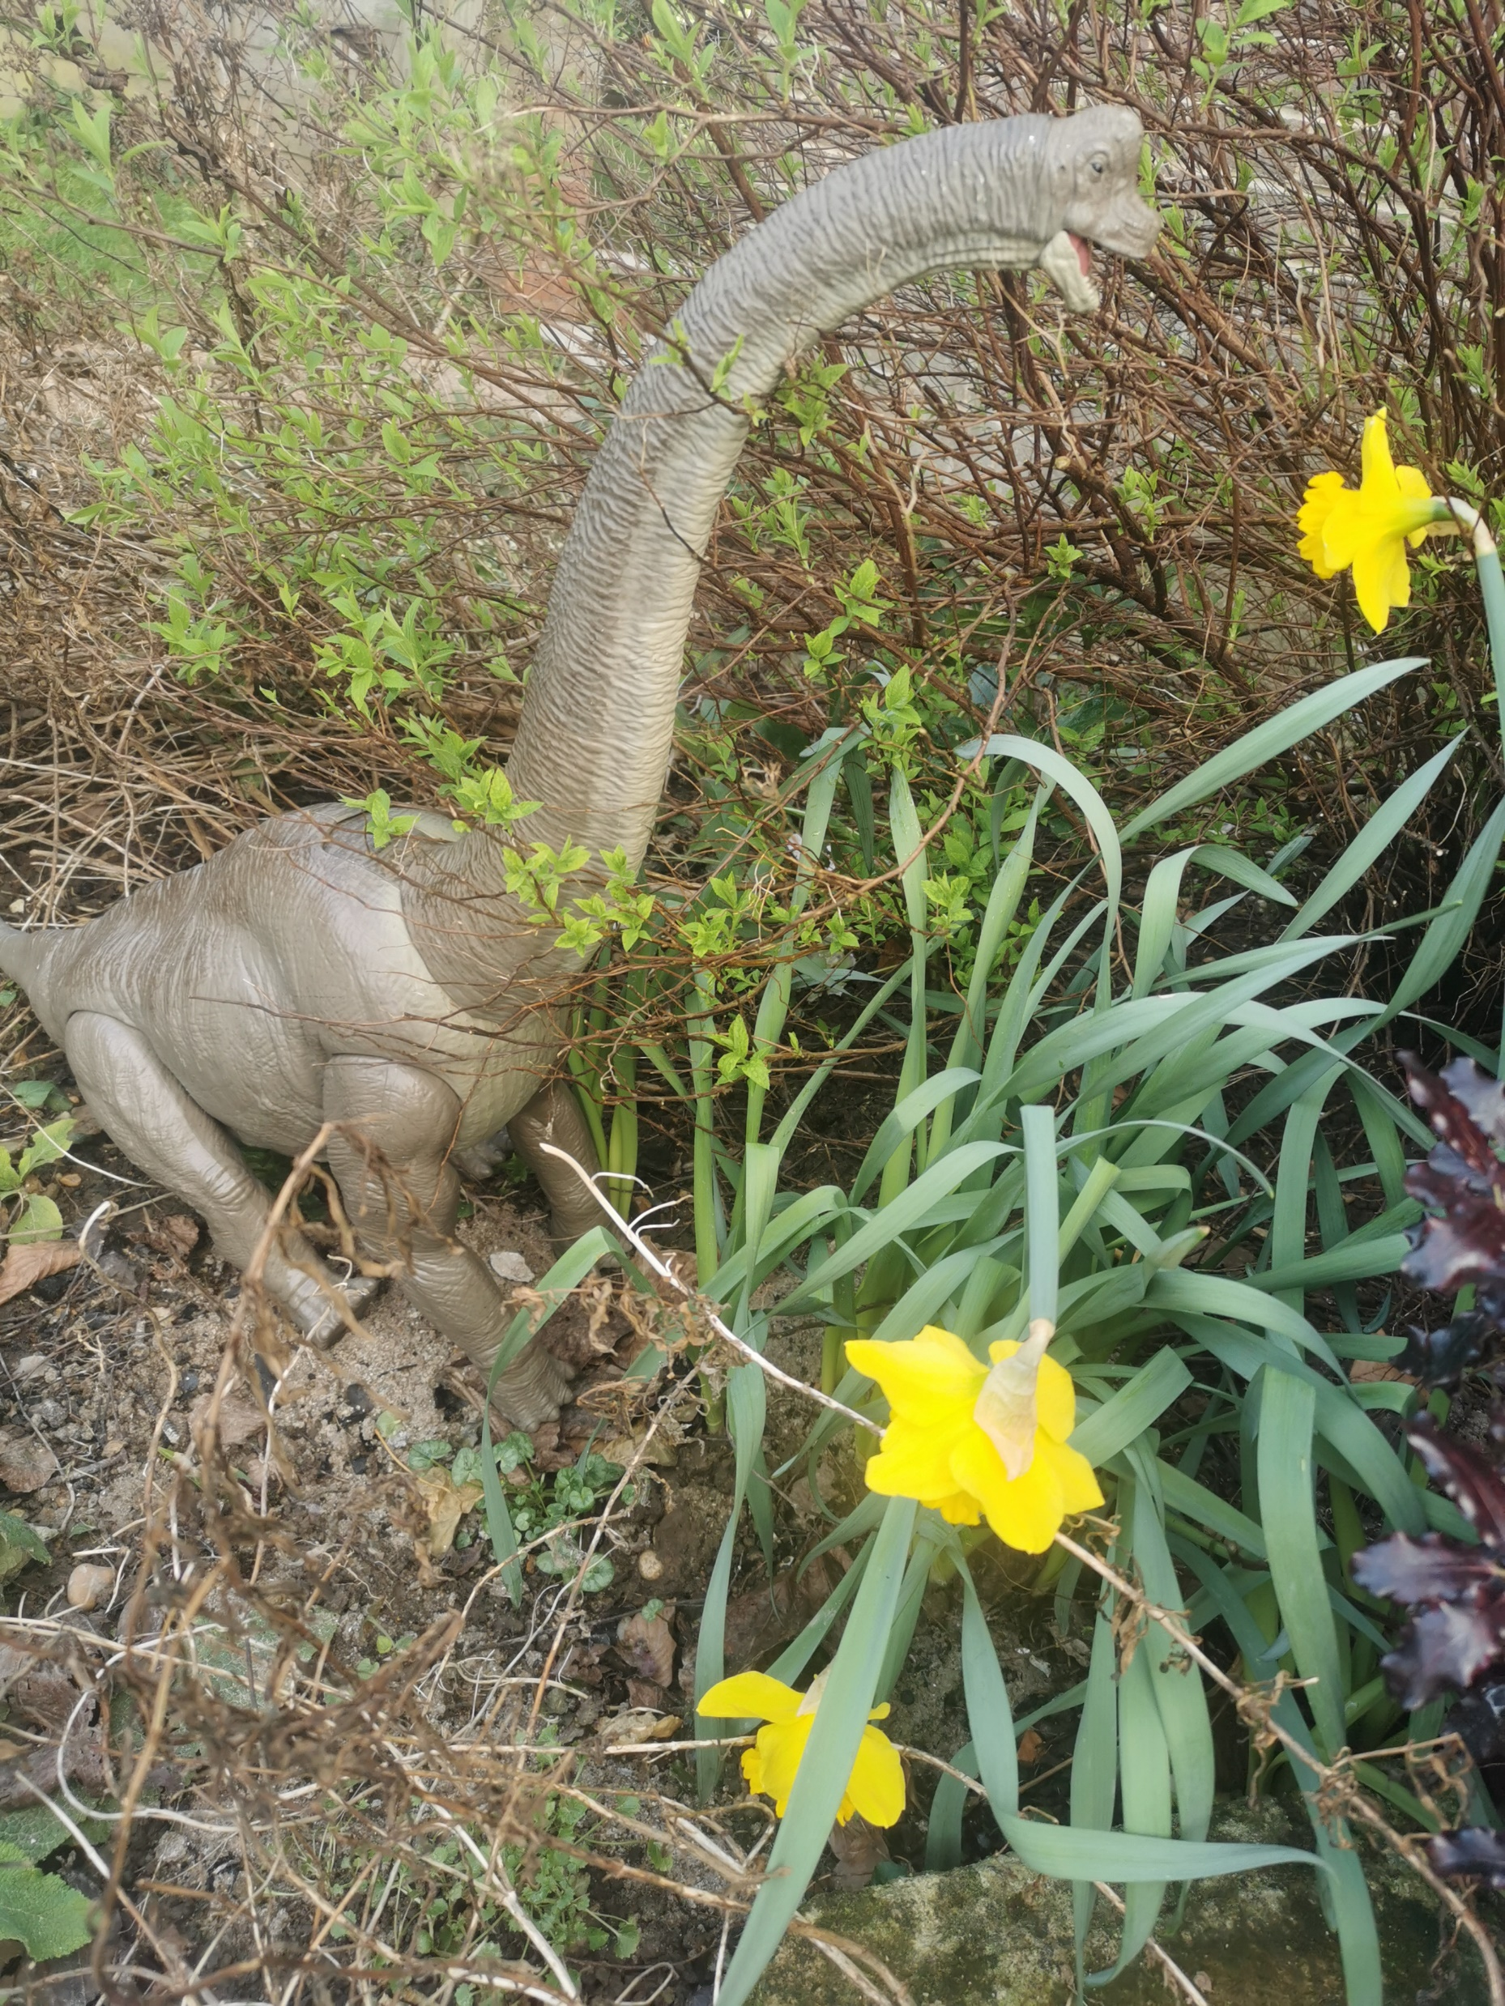
Ben Franklin – Italy Class
‘The flower reminds me of Spring because it came back to life after dying over winter. Just like Jesus came back to life at Easter.'
He added the dinosaur for extra interest, ‘as our garden isn't very Spring-y yet.’

Slide 6
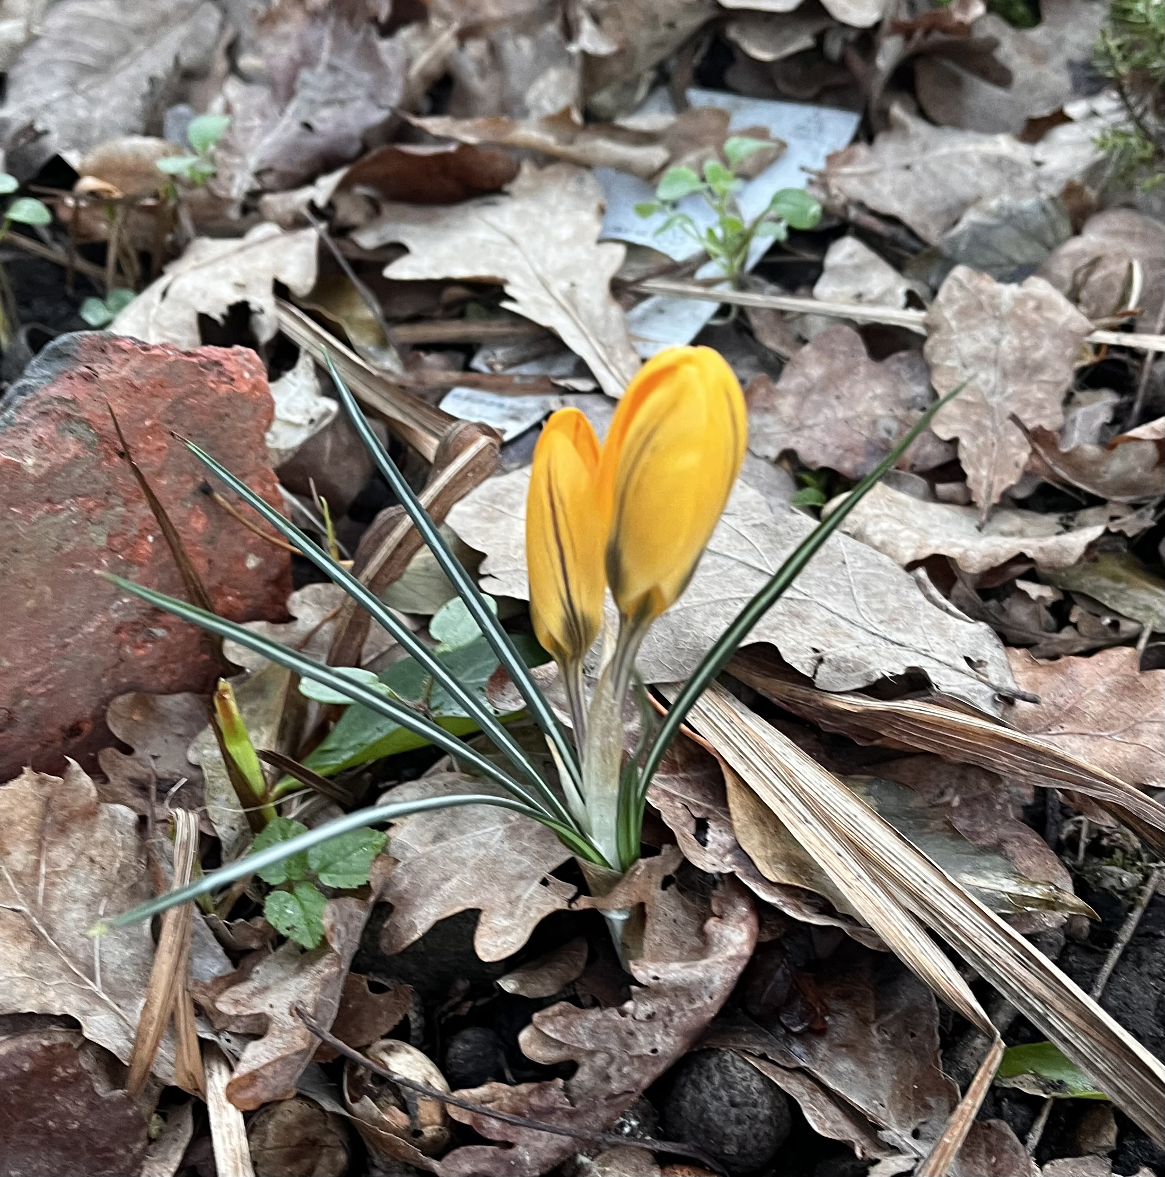
Rafferty Seaford says it reminds him of Spring because the flower is blooming.
Judging comments – KS 1 First Place
Good composition making great use of dull winter leaf cover to contrast with the fresh new Spring shoots. Good framing and focus. Well done

Slide 7
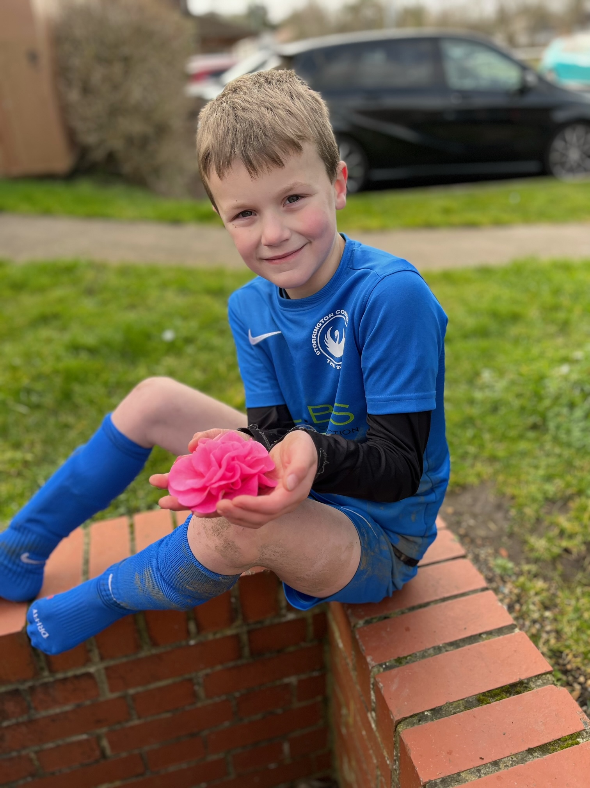
Jaxon Shepherd
India Class
New flowers remind me of spring

Slide 8
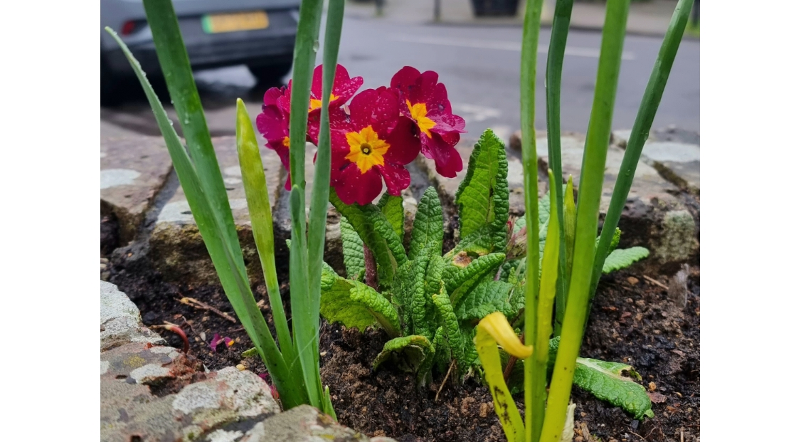
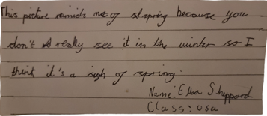
KS 2
Judging comments – KS2 First Place
The selection of a polyanthus for the main subject is a good choice for Spring. This is nicely framed with other Spring shoots with good foreground focus. Well done

Slide 9
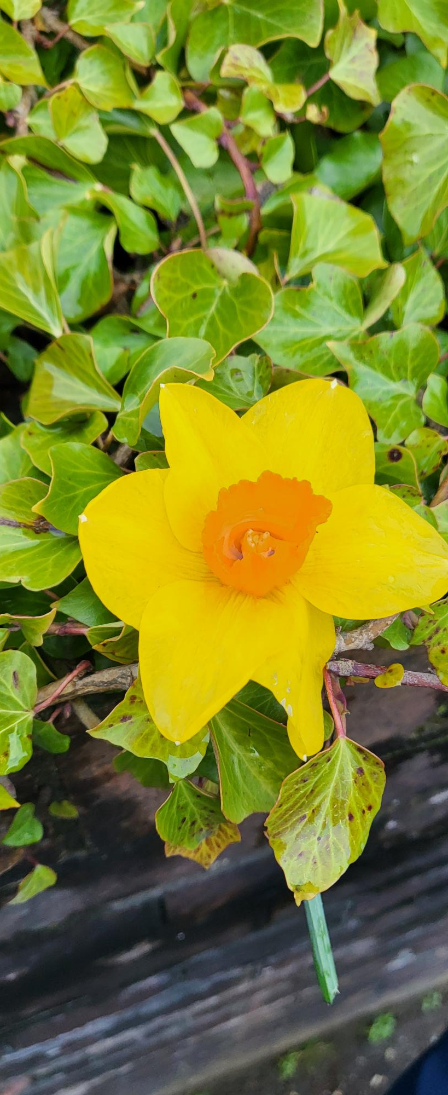
Ivy Dean – Sierra Leone

Slide 10
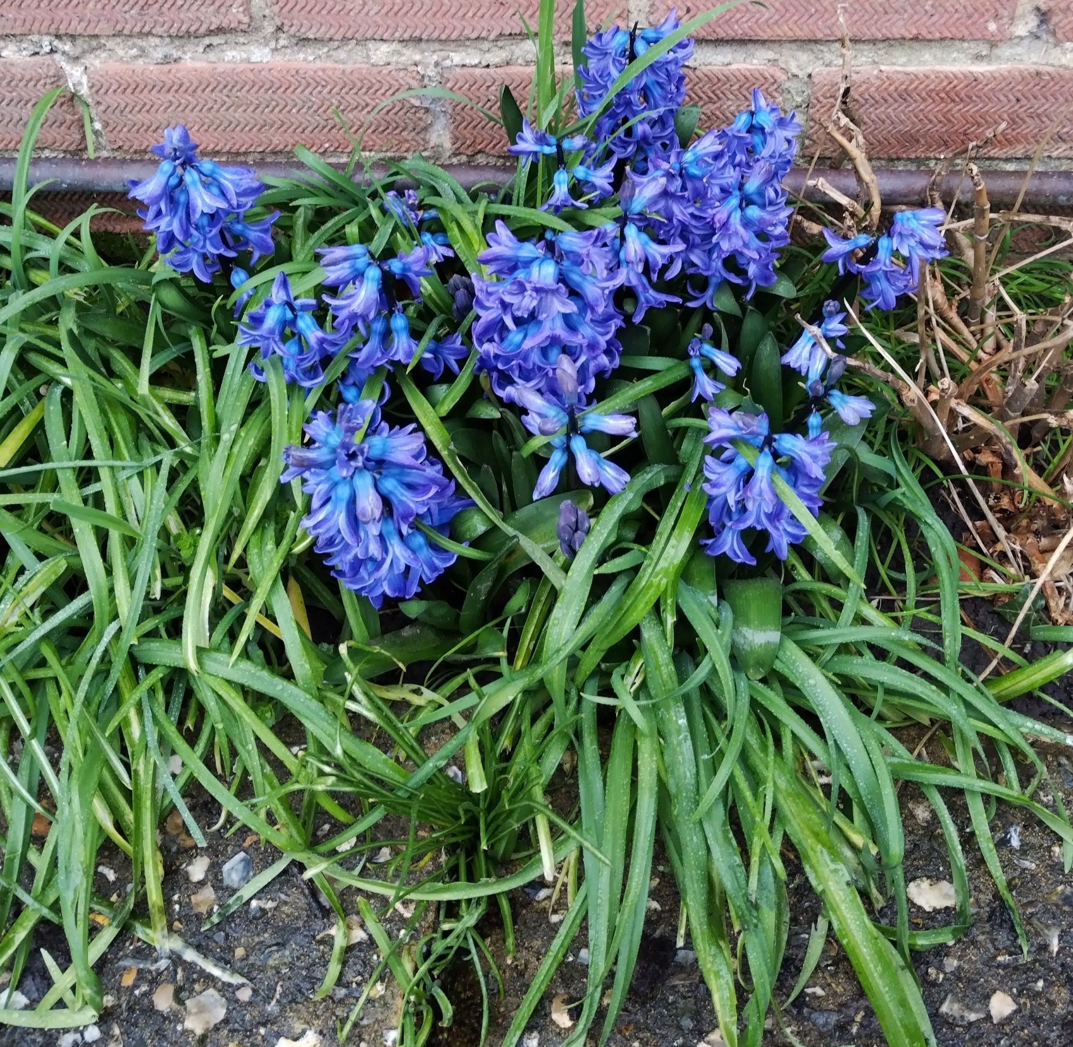
Matthew Green - 'These flowers make me think of Spring as flowers grow in Spring. I like the colour'.
Sierra Leone Class

Slide 11
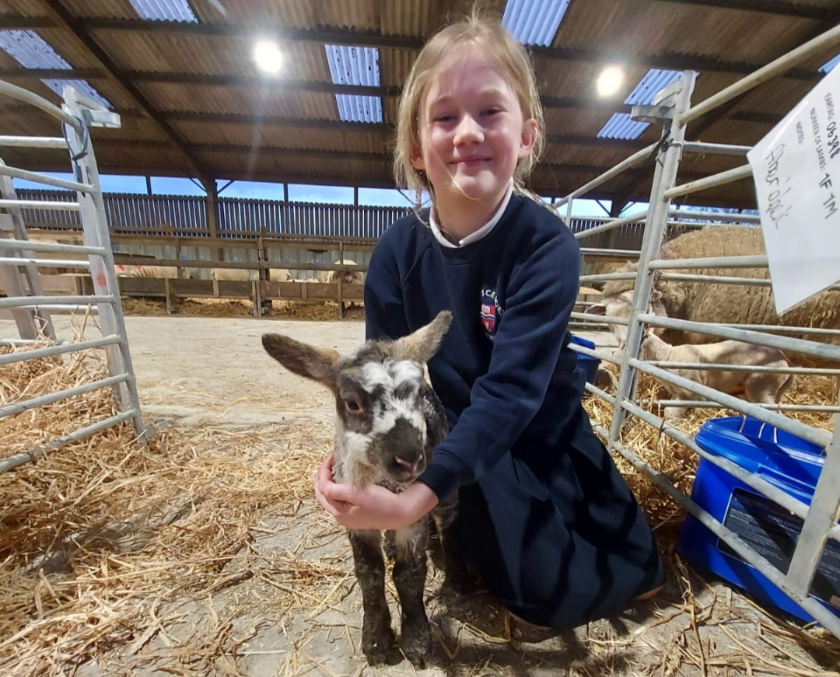
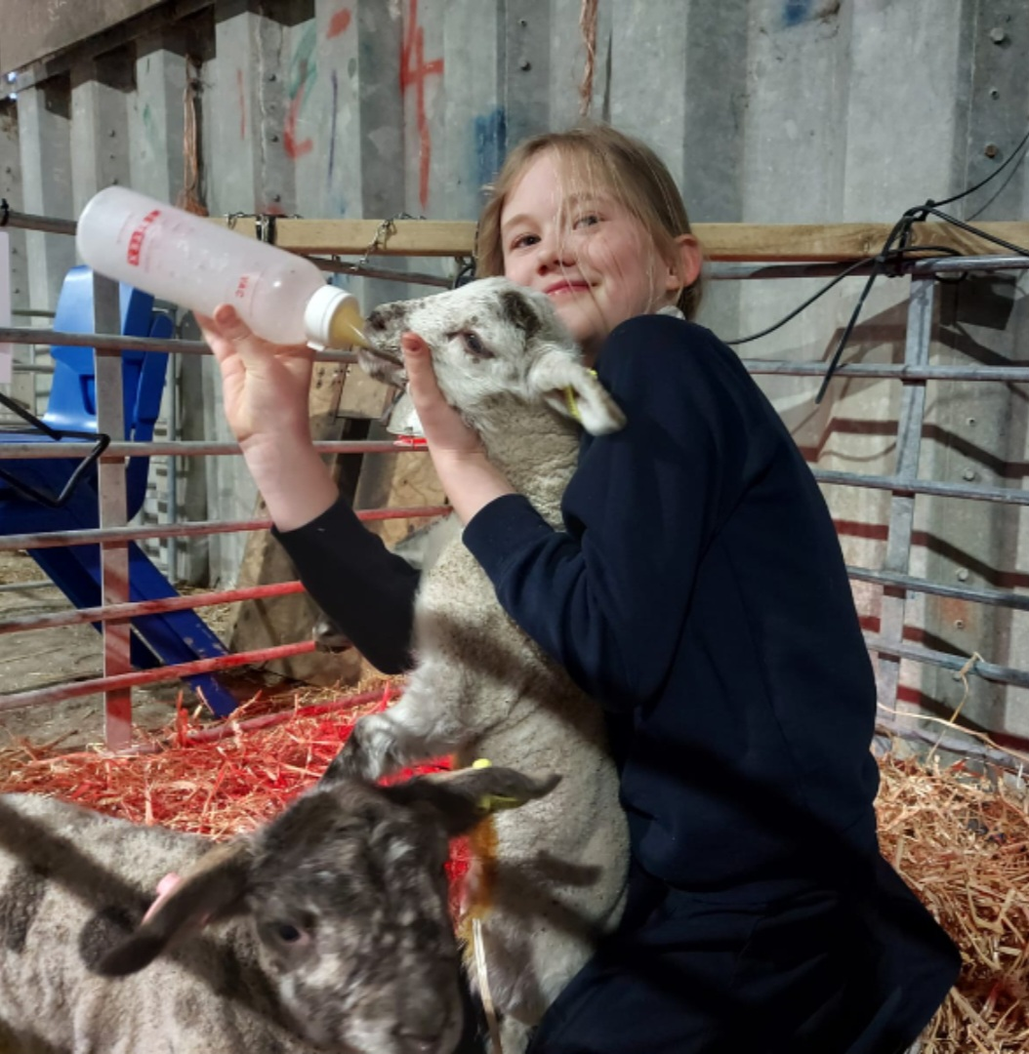
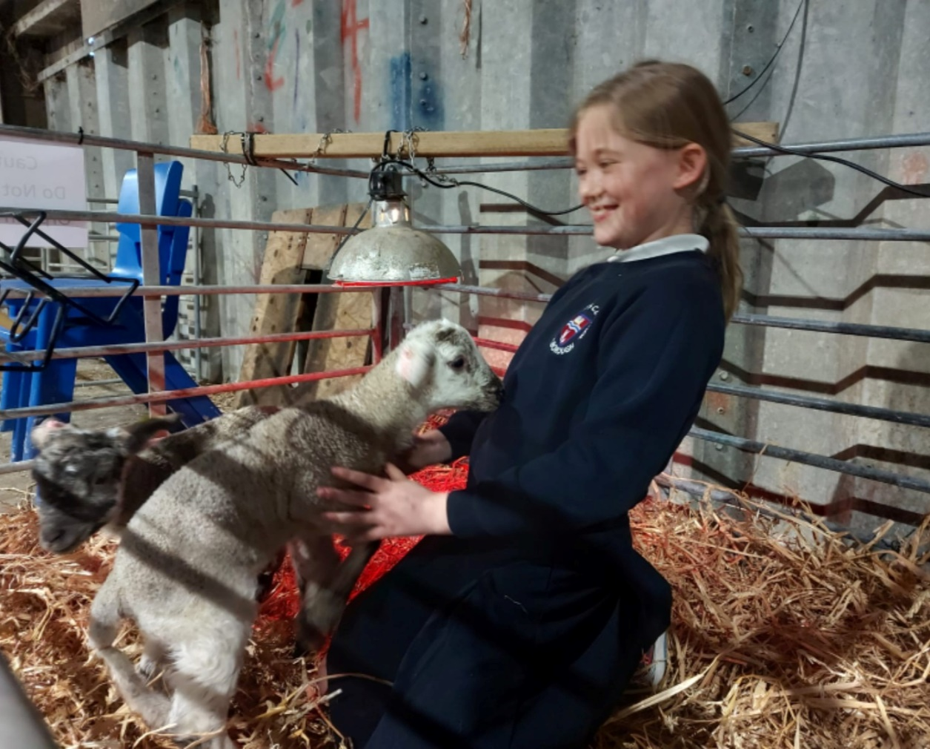
Indi Penfold
Sierra Leone

Slide 12
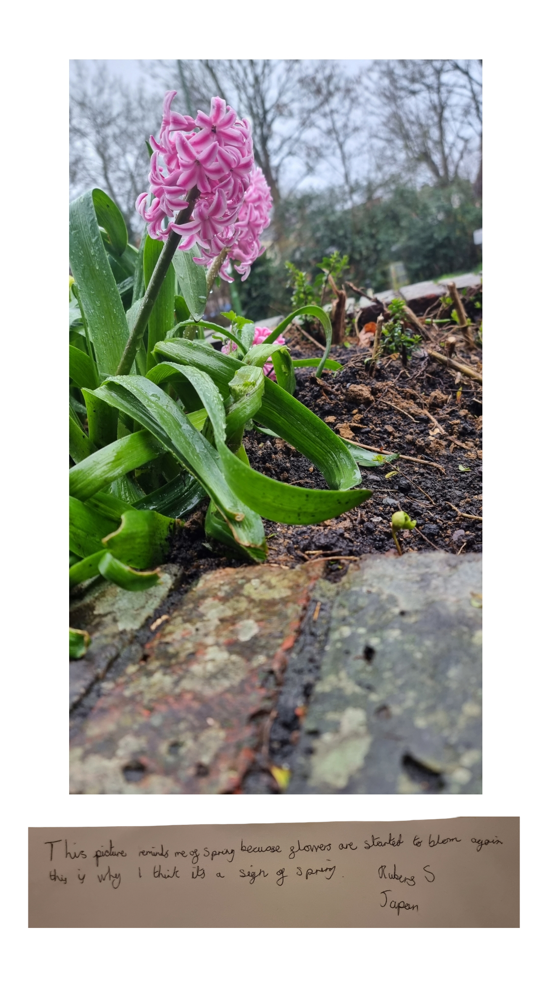
Ruben Sheppard
Japan Class

Slide 13
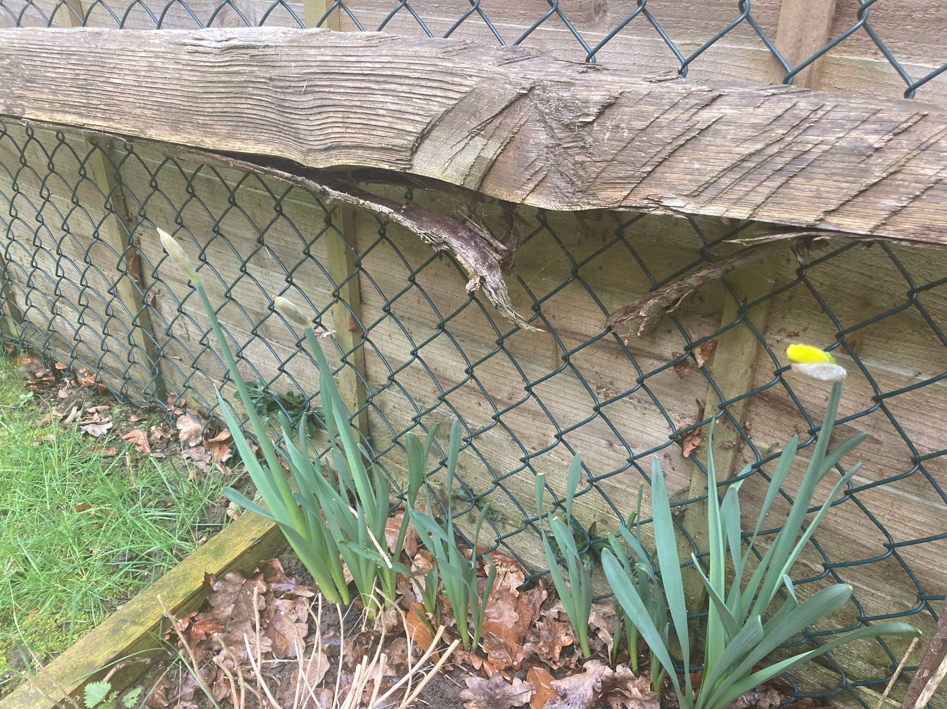
Gemma Bramley
USA Class
It reminds me of Spring because the daffodils are starting to bloom

Slide 14
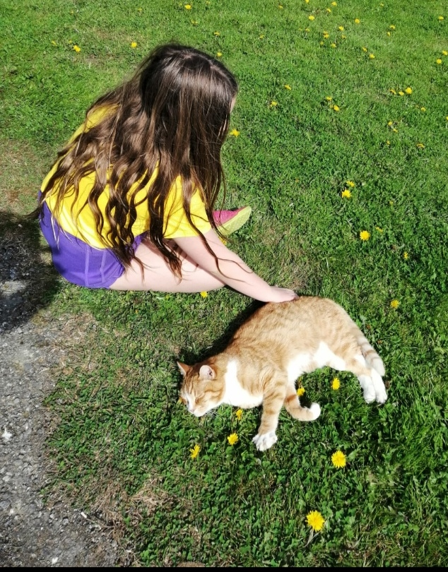
Felicity Green: 'It reminds me of Spring because there are lots of dandelions, sun and George the cat. I am wearing yellow as well’.
Mexico Class

Slide 15
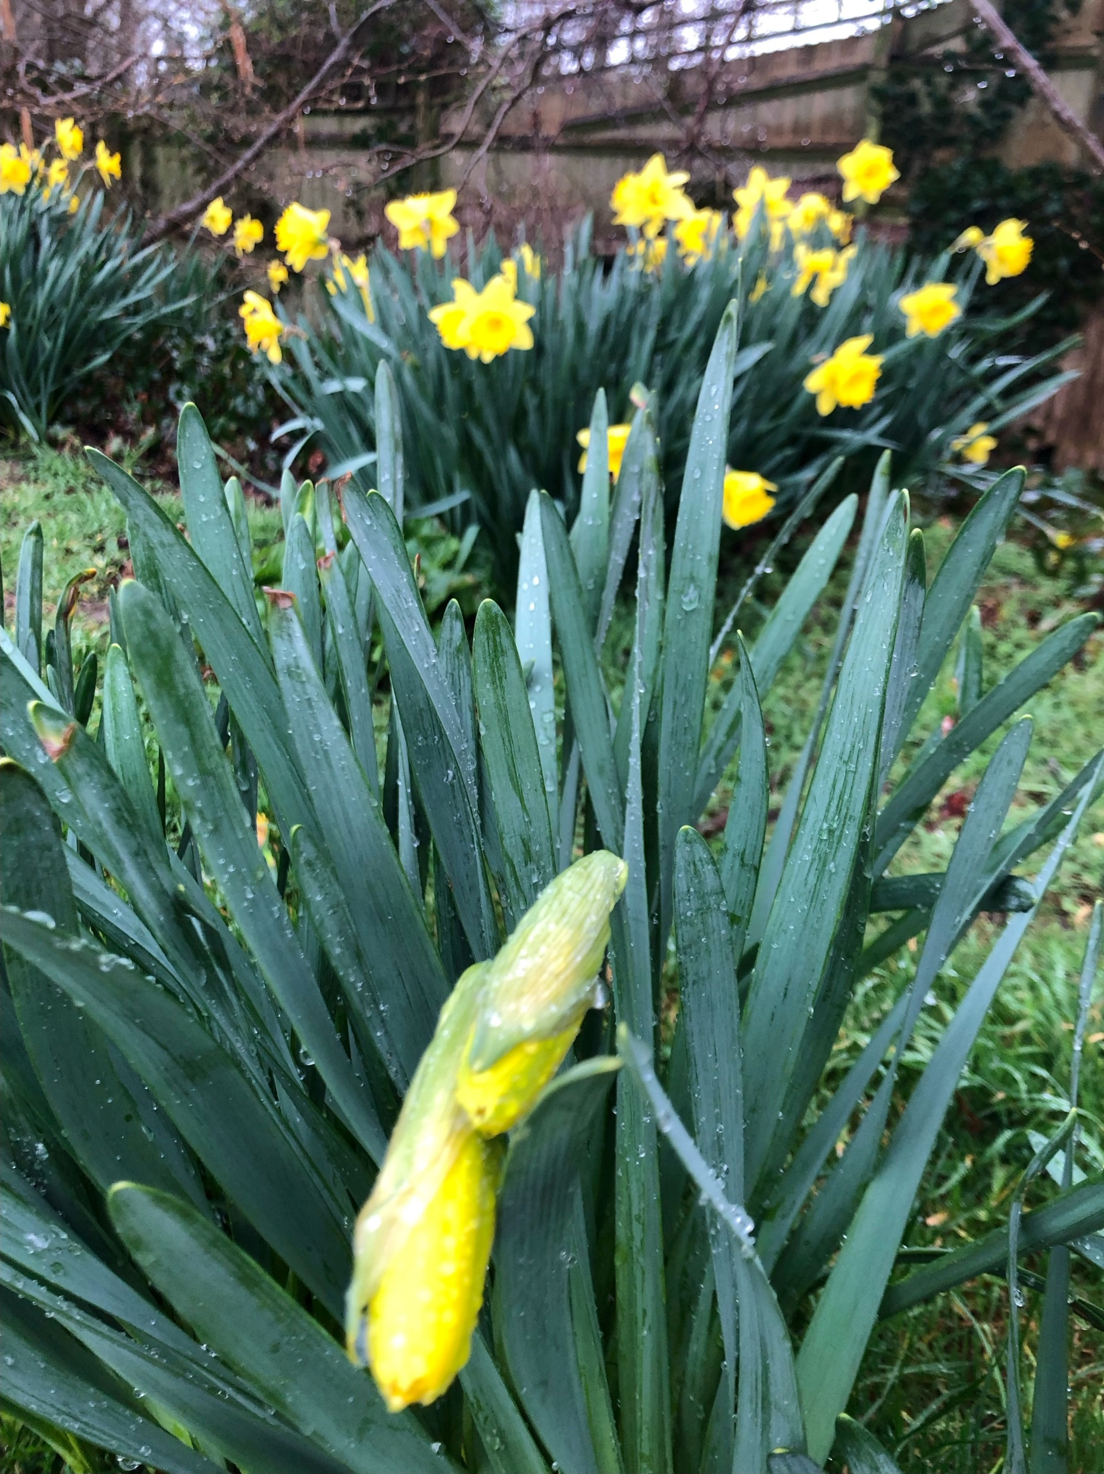
Joseph Stauss – KS 2
Spring is about transformations and new beginnings, which is why Joseph chose to photograph a daffodil not yet in bloom.

Slide 16
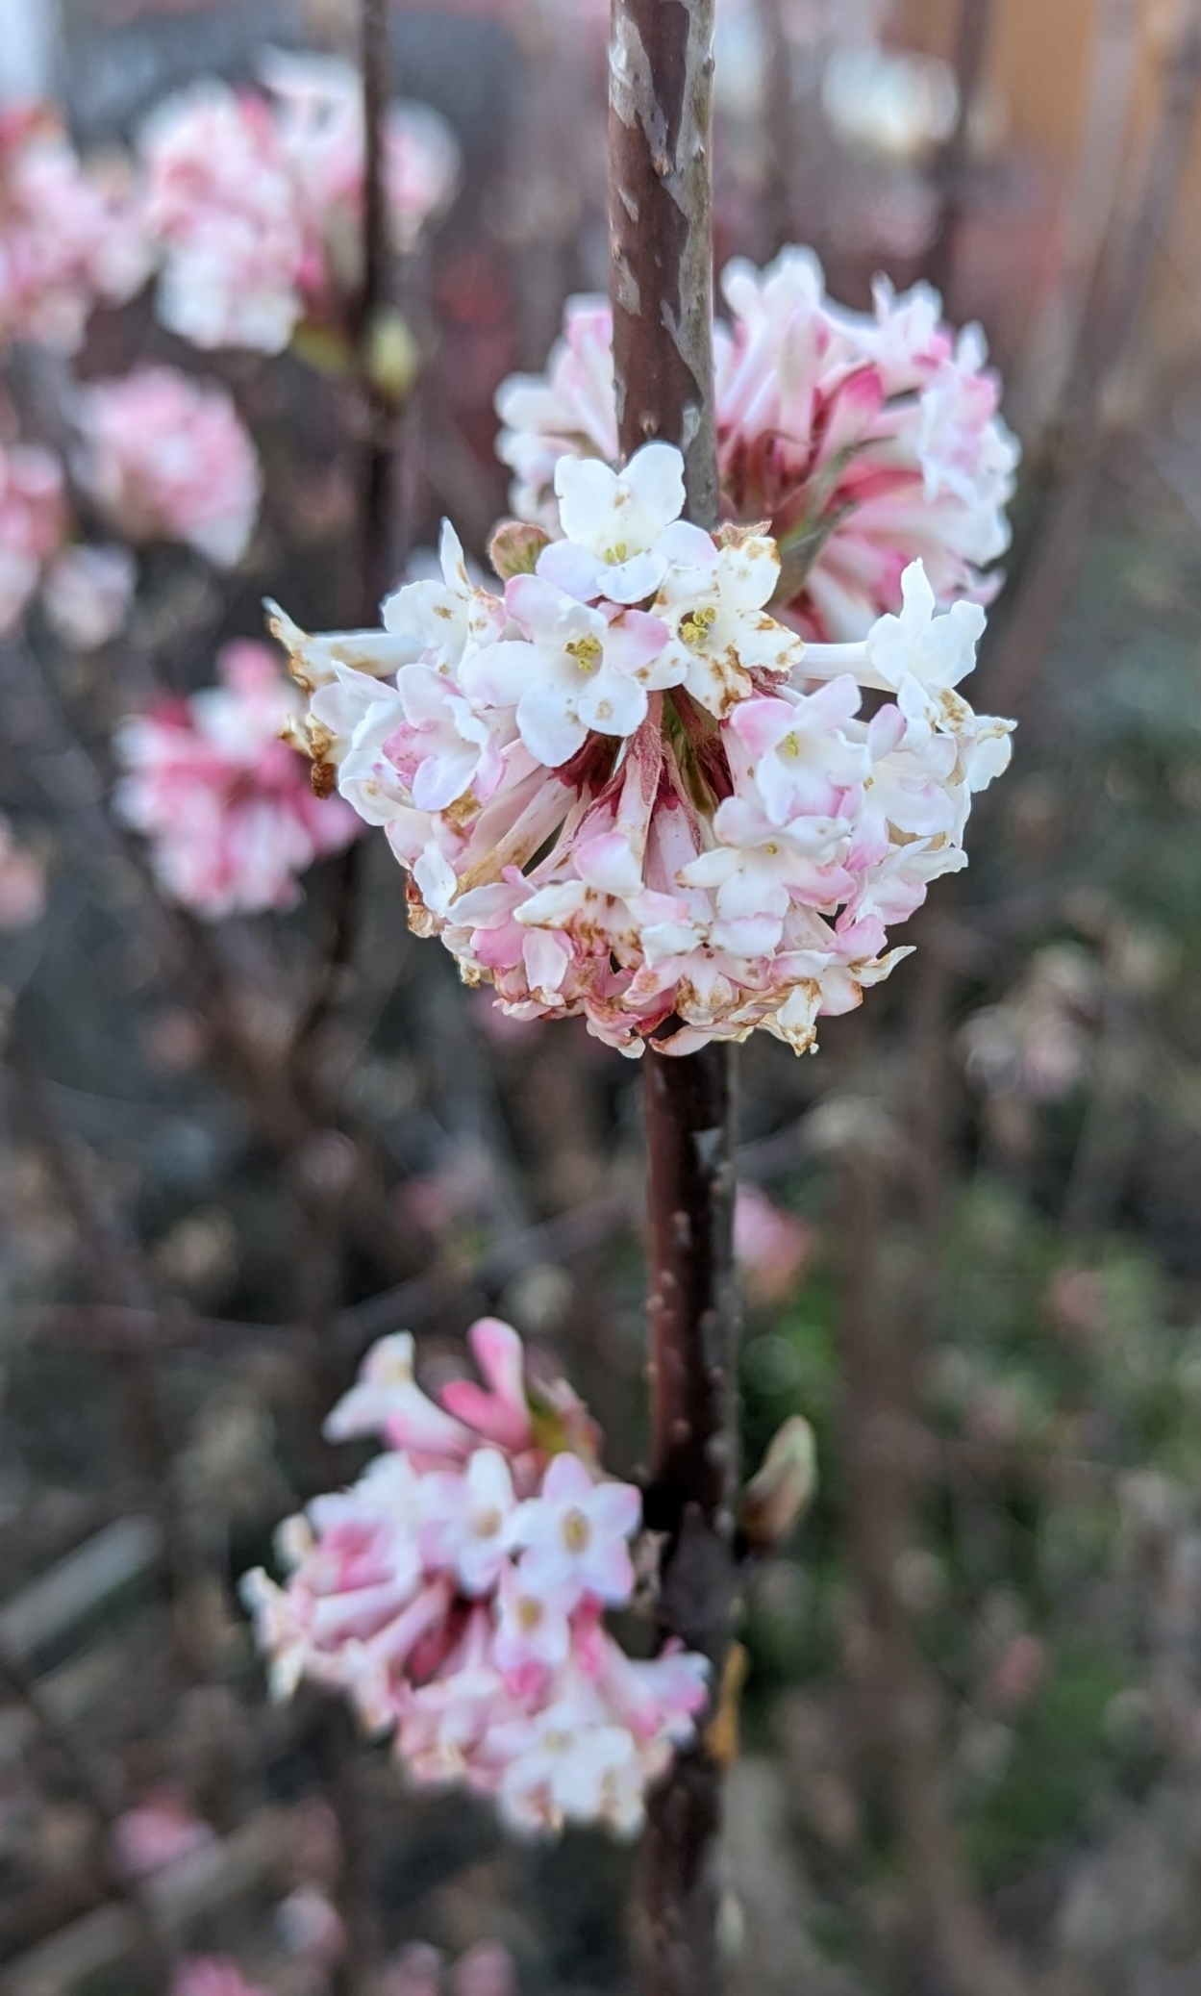
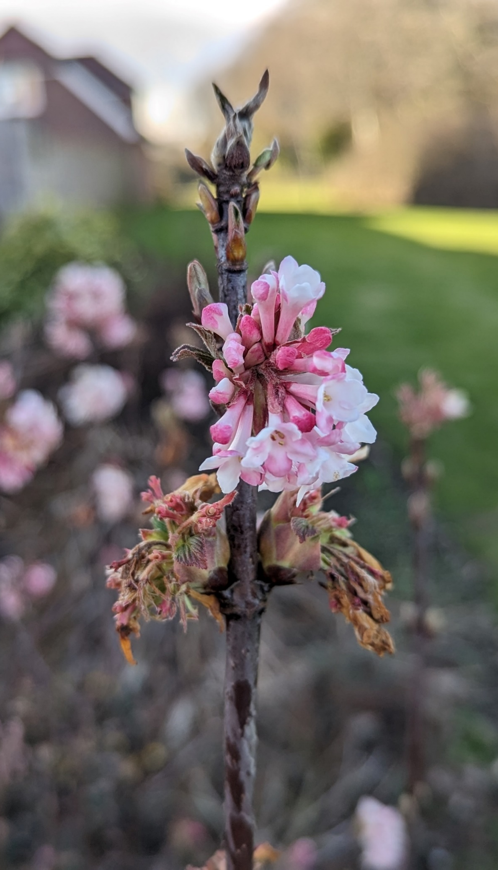
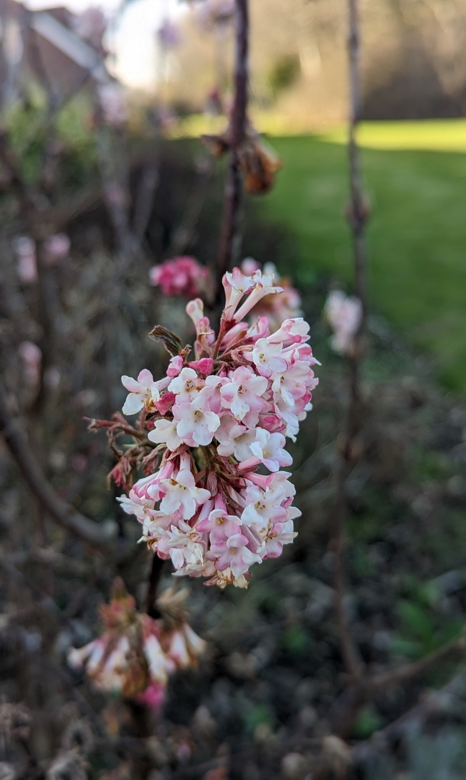
Judging comments - KS2 Second Place
The Viburnum is well-framed with good focus using a shallow depth of field to help accentuate the small delicate blooms.
Well done.
Dexter Richardson-Livesley (South Africa Class). A Viburnum Farreri which has just started to bloom.

