Slide 1

Welcome to New Zealand Class
2022-2023
Miss Heasman

Slide 2
Our Topics
Autumn 1 | Stone Age
Autumn 2 | Flow!
Spring 1 | Predators and Prey
Spring 2 | Urban Pioneers
Summer 1 | Tremors
Summer 2 | Romans

Slide 3
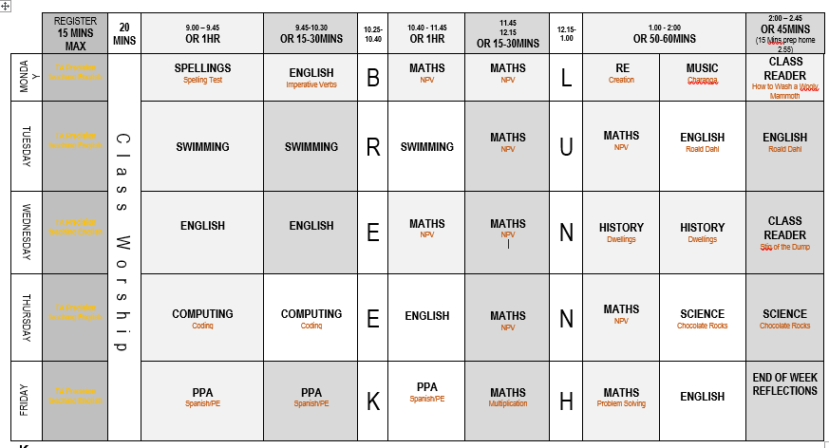
Typical NZ Class Time table

Slide 4
English – 1st half term: We will be writing instructions based on the book, ‘How to Wash a Woolly Mammoth’ Story-writing inspired by ‘Stone Age Boy’. 2nd half term: We will be adapting a familiar story into a play script. Our focus will be ‘Stick Man’. We will also study and analyse poetry about rivers. Finally, we will write our own pieces of poetry. | Maths – 1st half term: Place Value Addition and Subtraction 2nd half term: Addition and Subtraction Multiplication and Division | Science – 1st half term: We will be learning all about rocks. In our very first Science lesson, we made igneous and sedimentary chocolate rocks! 2nd half term: During the second half term we will be learning about Forces and Magnets.

Slide 5
PE – 1st half term: We will be swimming every Tuesday. Mrs Burbidge will take the children for Hockey on a Friday morning. 2nd half term: Dance will start in the hall, the day will be confirmed closer to the time. Mrs Burbidge will be teaching Netball. | Spanish – The children will be taught Spanish each week by Miss Bell. During the Autumn term, they will cover: Greetings, saying how we're feeling, numbers up to 12, saying our age, naming colours and finding out about Christmas in Spain. | History – 1st half term: Stone Age! We will learn all about life during the Stone Age. We will explore this through our history lessons, as well as through a range of texts; including, ‘Stig of the Dump’.
Geography – 2nd half term: Flow! During the second half term, we will be learning about rivers. This will include how rivers are formed and why rivers are so important to us. | Art – 1st half term: We will be exploring warm and cool colours. We will also investigate cave paintings, using ‘The First Drawing’ as a stimulus. | D&T – 2nd half term: We will be making water wheels during our Design and Technology lessons.

Slide 6
RE – 1st half term: We will be learning about the Creation Story, followed by Dharma. 2nd half term: We will be investigative Incarnation. | Music – 1st half term: We will be learning a song called ‘Let your Spirit Fly’. 2nd half term: We will be learning how to play the Glockenspiel. | Computing – 1st half term: We will be revisiting and extending our understanding of Coding. 2nd half term: We will be learning about how to be safe online. | RHE – 1st half term: We will be learning about Drugs and Tobacco. 2nd half term: We will be learning about bullying. Please note that all RHE lessons follow our curriculum and are age-appropriate

Slide 7



Routines
Times Tables | Spellings | Reading Logs
There will be an increased focus on times tables in Year 3. We will be testing the children each week on their understanding and will also be participating in daily maths fluency lessons, called Maths Flash. There are lots of ways to practise times tables at home. TT Rockstars. Online games – Bowling, Angry Andy must have Candy, Caterpillar carnage | Spellings will be handed out on a Monday and will be tested the following Monday. All spellings are adapted to suit the need of each individual child, providing familiarity and challenge. | Reading logs will be collected in and checked everyday. Dojos will be awarded for children who are reading at home. Please ensure that reading is recorded in logs. You child can write it in themselves if they wish.

Slide 8
Routines
Water Bottle Please ensure that your child has their named water bottle with them each day. | Snack Please ensure that your child comes to school with a piece of fruit or vegetable or a cereal bar. Please also note that we are a nut-free school. | Homework The homework grid will be available through Google Classroom. I have also sent out a hard copy. Please submit your child’s learning through GC or through the class email: nz@stmarysprimarypulborough.co.uk

Slide 9
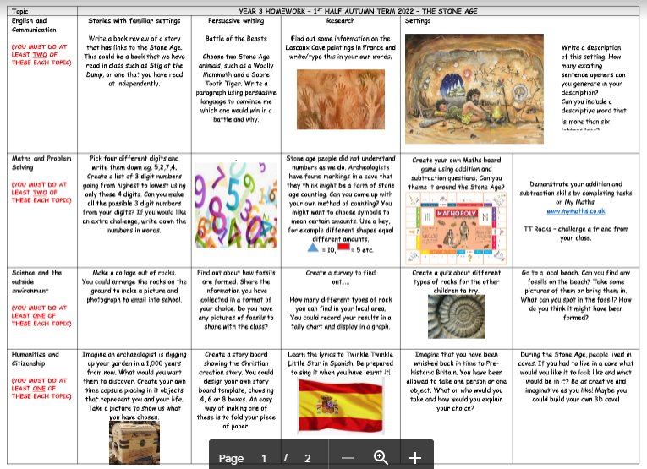
Homework

Slide 10
Behaviour
Positive behaviour management
Lots of praise! Verbal praise and rewards – dojos and stickers. | End of week certificates – Dojo champion Star of the week | Badges – Bronze, Silver and Gold. | Head teacher awards Recognition in newsletter – vine leaves

Slide 11
Behaviour continued
Behaviour management
We must follow our Golden Rules. These are up in the classroom and are often referred to. | If your child does not follow the Golden Rules, they will lose minutes from their break or lunch time. | This will result in a conversation with me in person or over the phone. | If your child continues to not follow the Golden Rules, there will be a meeting with me and a member of the senior leadership team.

Slide 12

Key dates and Questions?
Key dates:
29th September – In school poetry visit
30th September – Worship at Church
5th October – Flu Spray
6th October – National Poetry Day
10th October – Mental Health Day
21st October – Inset Day
24th-28th October – Half term
31st October – Return to school
8th November – Parents’ Evening (3:30-6:00)
10th November- Parents’ Evening (3:30-6:00)
14th November – 18th – Anti-bullying week.
2nd December – NZ Class Assembly
15th December – Christmas Lunch
16th December – Christmas Jumper Day and Eucharist
19th December – 2nd January – Christmas Break.

Slide 13
Queries and Questions?
I hope that you have found this meeting helpful.
If you have any concerns or queries, please contact me via the class email or make an appointment via the School Office.
nz@stmarysprimarypulborough.co.uk

