Slide 1

Year 2 SATs Information Meeting
Tuesday 2nd May 2023

Slide 2
Outline
The most important message is: Don’t panic!
‘Secret Agent Training’ (SATs!) is part of our normal classroom learning and helps us know where the children are in their learning as they progress to Year 3.
Department for Education SATs video:
https://www.youtube.com/watch?v=cuXJidYP7-0
What are SATS?
What do the tests look like?
What can you can do to help your child?

Slide 3
click to see all text
The SAT Assessments
At the end of Year 2, children will take assessments in:
Reading
Maths
We will complete the SATs papers throughout May, starting next week.
At the end of Year 2, children will take assessments in:
Reading
Maths
Your child’s school may also decide to administer the optional English: Grammar, Punctuation and Spelling SAT assessment in order to inform their teacher-assessed level in Writing.
All assessment are due to take place in May this year.
chapter
menu
next page

Slide 4
click to see all text
Reading
The Reading Test consists of two separate papers:
Paper 1 – consists of a combined reading prompt and answer booklet. The paper includes a list of useful words and some practice questions for teachers to use to introduce the contexts and question types to pupils. The test takes approximately 30 minutes to complete, but is not strictly timed.
Paper 2 – consists of an answer booklet and a separate reading booklet. There are no practice questions on this paper. Teachers can use their discretion to stop the test early if a pupil is struggling. The test takes approximately 40 minutes to complete, but is not strictly timed.
The texts will cover a range of poetry, fiction and non-fiction.
The Reading Test consists of two separate papers:
Paper 1 – consists of a combined reading prompt and answer booklet. The paper includes a list of useful words and some practice questions for teachers to use to introduce the contexts and question types to pupils. The test takes approximately 30 minutes to complete, but is not strictly timed.
Paper 2 – consists of an answer booklet and a separate reading booklet. There are no practice questions on this paper. Teachers can use their discretion to stop the test early if a pupil is struggling. The test takes approximately 40 minutes to complete, but is not strictly timed.
The texts will cover a range of poetry, fiction and non-fiction.
chapter
menu
next page

Slide 5
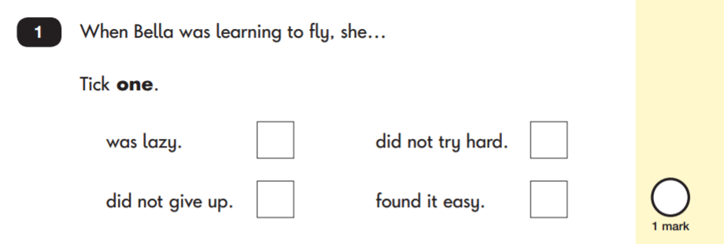
Reading: Sample Questions
Questions are designed to assess the comprehension and understanding of a child’s reading.
There are a variety of question types:
Multiple Choice
chapter
menu
next page

Slide 6
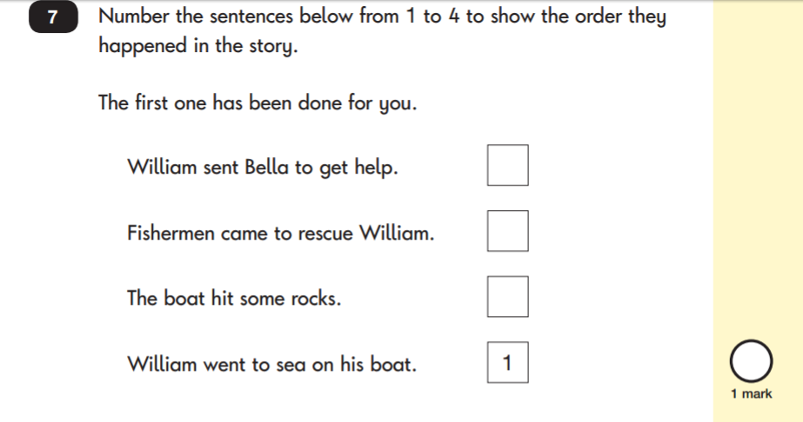
Reading: Sample Questions
Ranking/Ordering
chapter
menu
next page

Slide 7
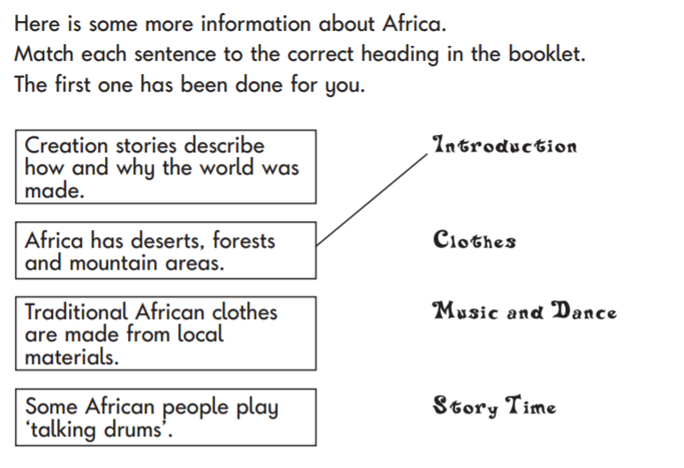
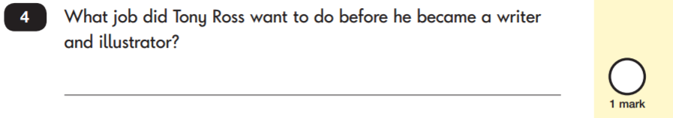
Reading: Sample Questions
Matching/Labelling
Short-Answer Questions
chapter
menu
next page

Slide 8
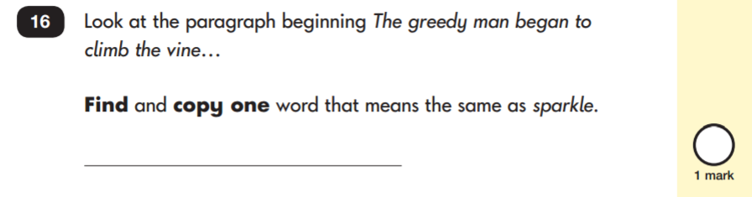
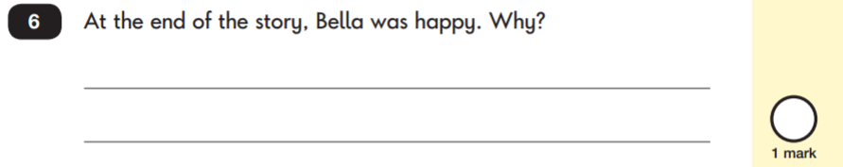
click to see all text
Reading: Sample Questions
Find and Copy Questions
Open-Ended Questions
chapter
menu
next page

Slide 9
Mathematics
Children will sit two tests: Paper 1 and Paper 2:
Paper 1: Arithmetic - lasts approximately 20 minutes (but this is not strictly timed). It covers calculation methods for all operations.
Paper 2: Reasoning - lasts for approximately 35 minutes, which includes time for five aural questions. Pupils will still require calculation skills and questions will be varied including multiple choice, matching, true/false, completing a chart or table or drawing a shape. Some questions will also require children to show or explain their working out.
chapter
menu
next page

Slide 10
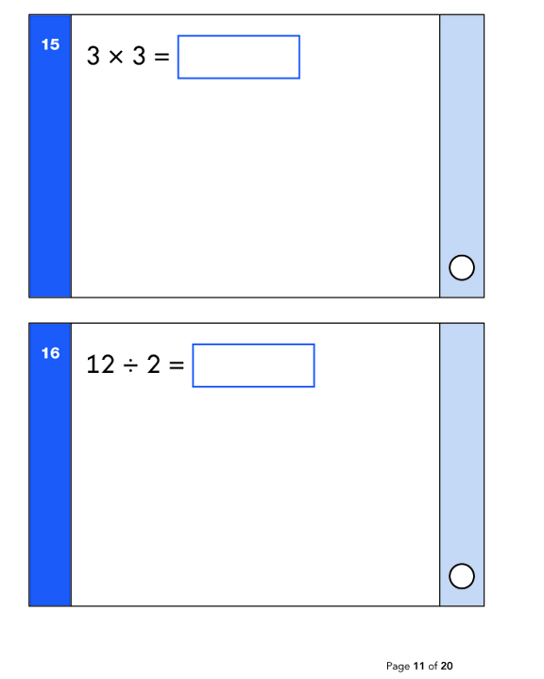
Maths: Sample Questions
Maths Paper 1: Arithmetic
chapter
menu
next page

Slide 11
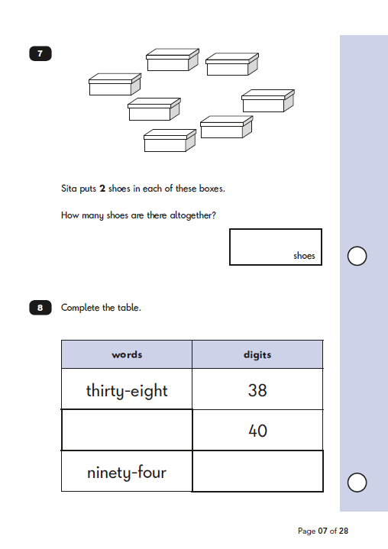
Maths: Sample Questions
Maths Paper 2: Reasoning
chapter
menu
next page

Slide 12
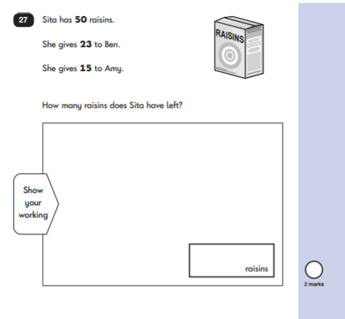
Maths: Sample Questions
Maths Paper 2: Reasoning
chapter
menu
next page

Slide 13
click to see all text
Scaled Scores
What is meant by ‘scaled scores’?
It is planned that 100 will always represent the ‘national standard’.
Each pupil’s raw test score will therefore be converted into a score on the scale, either at, above or below 100.
The scale will have a lower end point somewhere below 100 and an upper end point above 100.
A child who achieves the ‘national standard’ (a score of 100) will be judged to have demonstrated sufficient knowledge in the areas assessed by the tests.
What is meant by ‘scaled scores’?
It is planned that 100 will always represent the ‘national standard’.
Each pupil’s raw test score will therefore be converted into a score on the scale, either at, above or below 100.
The scale will have a lower end point somewhere below 100 and an upper end point above 100.
A child who achieves the ‘national standard’ (a score of 100) will be judged to have demonstrated sufficient knowledge in the areas assessed by the tests.
chapter
menu
next page

Slide 14
click to see all text
Scaled Score Examples
On publication of the test results in July:
A child awarded a scaled score of 100 is judged to have met the ‘national standard’ in the area judged by the test.
A child awarded a scaled score of more than 100 is judged to have exceeded the national standard and demonstrated a higher than expected knowledge of the curriculum for their age.
A child awarded a scaled score of less than 100 is judged to have not yet met the national standard and performed below expectation for their age.
Marking guidance for KS1 tests will include conversion tables. Teachers will use these to translate pupil’s raw scores into scaled scores to see whether each pupil has met the national standard. Teachers will use the scaled scores to inform their teacher assessment judgements.
On publication of the test results in July 2017:
A child awarded a scaled score of 100 is judged to have met the ‘national standard’ in the area judged by the test.
A child awarded a scaled score of more than 100 is judged to have exceeded the national standard and demonstrated a higher than expected knowledge of the curriculum for their age.
A child awarded a scaled score of less than 100 is judged to have not yet met the national standard and performed below expectation for their age.
Marking guidance for KS1 tests will include conversion tables. Teachers will use these to translate pupil’s raw scores into scaled scores to see whether each pupil has met the national standard. Teachers will use the scaled scores to inform their teacher assessment judgements.
chapter
menu
next page

Slide 15
click to see all text
How to Help Your Child
First and foremost, support and reassure your child that there is nothing to worry about and that they should always just try their best. Praise and encourage!
Ensure your child has the best possible attendance at school.
Support your child with any homework tasks.
Reading, spelling and arithmetic (e.g. times tables) are always good to practise.
Talk to your child about what they have learnt at school and what book(s) they are reading (the character, the plot, their opinion).
Make sure your child has a good sleep and healthy breakfast every morning!
First and foremost, support and reassure your child that there is nothing to worry about and that they should always just try their best. Praise and encourage!
Ensure your child has the best possible attendance at school.
Support your child with any homework tasks.
Reading, spelling and arithmetic (e.g. times tables) are always good to practise.
Talk to your child about what they have learnt at school and what book(s) they are reading (the character, the plot, their opinion).
Make sure your child has a good sleep and healthy breakfast every morning!
chapter
menu
next page

Slide 16
click to see all text
How to Help Your Child with Reading
Listening to your child read can take many forms:
First and foremost, focus developing an enjoyment and love of reading.
Enjoy stories together – reading stories to your child is equally as important as listening to your child read.
Read a little at a time but often, rather than rarely but for long periods of time!
Talk about the story before, during and afterwards – discuss the plot, the characters, their feelings and actions, how it makes you feel, predict what will happen and encourage your child to have their own opinions.
Look up definitions of words together – you could use a dictionary, the Internet or an app on a phone or tablet.
All reading is valuable – it doesn’t have to be just stories. Reading can involve anything from fiction and non-fiction, poetry, newspapers, magazines, football programmes, TV guides.
Visit the local library - it’s free!
Listening to your child read can take many forms:
First and foremost, focus developing an enjoyment and love of reading.
Enjoy stories together – reading stories to your child is equally as important as listening to your child read.
Read a little at a time but often, rather than rarely but for long periods of time!
Talk about the story before, during and afterwards – discuss the plot, the characters, their feelings and actions, how it makes you feel, predict what will happen and encourage your child to have their own opinions.
Look up definitions of words together – you could use a dictionary, the Internet or an app on a phone or tablet.
All reading is valuable – it doesn’t have to be just stories. Reading can involve anything from fiction and non-fiction, poetry, newspapers, magazines, football programmes, TV guides.
Visit the local library - it’s free!
chapter
menu
next page

Slide 17
click to see all text
How to Help Your Child with Writing
Practise and learn weekly spelling lists – make it fun!
Encourage opportunities for writing, such as letters to family or friends, shopping lists, notes or reminders, stories or poems.
Write together – be a good role model for writing.
Encourage use of a dictionary to check spelling.
Allow your child to use a computer for word processing, which will allow for editing and correcting of errors without lots of crossing out.
Remember that good readers become good writers! Identify good writing features when reading (e.g. vocabulary, sentence structure, punctuation).
Show your appreciation: praise and encourage, even for small successes!
Practise and learn weekly spelling lists – make it fun!
Encourage opportunities for writing, such as letters to family or friends, shopping lists, notes or reminders, stories or poems.
Write together – be a good role model for writing.
Encourage use of a dictionary to check spelling.
Allow your child to use a computer for word processing, which will allow for editing and correcting of errors without lots of crossing out.
Remember that good readers become good writers! Identify good writing features when reading (e.g. vocabulary, sentence structure, punctuation).
Show your appreciation: praise and encourage, even for small successes!
chapter
menu
next page

Slide 18
click to see all text
How to Help Your Child with Maths
Play times tables games.
Play mental maths games including counting in different amounts, forwards and backwards.
Encourage opportunities for telling the time.
Encourage opportunities for counting coins and money e.g. finding amounts or calculating change when shopping.
Look for numbers on street signs, car registrations and anywhere else.
Look for examples of 2D and 3D shapes around the home.
Identify, weigh or measure quantities and amounts in the kitchen or in recipes.
Play games involving numbers or logic, such as dominoes, card games,
draughts or chess.
Play times tables games.
Play mental maths games including counting in different amounts, forwards and backwards.
Encourage opportunities for telling the time.
Encourage opportunities for counting coins and money e.g. finding amounts or calculating change when shopping.
Look for numbers on street signs, car registrations and anywhere else.
Look for examples of 2D and 3D shapes around the home.
Identify, weigh or measure quantities and amounts in the kitchen or in recipes.
Play games involving numbers or logic, such as dominoes, card games,
draughts or chess.
chapter
menu
next page

Slide 19
Thank you for your time.
Any general questions?

