Slide 1
‘Meet the Teacher’ Hello and Welcome to India Class!
Miss Wilkins and Mrs Hatcher– Class Teachers
Mrs Tiller– Teaching Assistant

Slide 2
Curriculum
Mrs Hatcher and Miss Wilkins will talk you through our Curriculum:
Our Themes for this Year:
Core Subjects
Foundation Subjects
Mrs Dunstall will cover PPA in our class on a Tuesday.

Slide 3
India Class Timetable
PE will be on a Monday (outside) and a Wednesday (inside) each week. PE kits are required.
Spelling lists will be assigned on Google Classroom each week. The children will have a Spelling Quiz each Monday.
Homework this term is a list from which the children can choose. We would like the children to complete one piece of homework each week. Please upload onto Google Classroom or bring it in.
The timetable is flexible and will change each week depending on what we need to focus on, but Worship, Phonics, Maths and English will be covered daily.

Slide 4
In EYFS and Key Stage 1:
Our priority is meeting the needs of our children – whichever class they are in.
Your child will get the required ‘diet’ for their year group – but also a diet that is tailored to their need – this may look different for children in different classes.
Classes may work completely independently… sometimes.
Classes may work with the class next door… sometimes.
Children may do things with other children in their year group – thus mixing with other classes or doing similar activities… sometimes.
For example: at Christmas, UK will work with Thailand on a performance and India will work with Italy on a different performance – each child will be included.
You may hear that children who are in another class, but are in the same year group as your child, are doing something different from your child – don’t worry! Refer to point 1!
We will try our best to communicate clearly with you.
Please do use the India class email to contact us.
india@stmarysprimarypulborough.co.uk

Slide 5
India class - Reading
Reading Records will be checked every day. Your child will be read with at least once per week. This will generally be recorded in Reading Records.
Please read with your child every day, if at all possible. We will give the children 5 dojos for each time that they read. In the comments section of the Reading Log, please leave comments sharing anything that your child has struggled with and highlighting what they have done well. Please do write any direct quotes. Children who read daily at home make greater progress than those who don’t.
Reading books – To read with fluency, your child should be able to read 9/10 words. Please do re-read books to develop fluency and understanding! Summarise!
Please have a look at the ‘100 Books to Read in Year 2’ on our website.

Slide 6
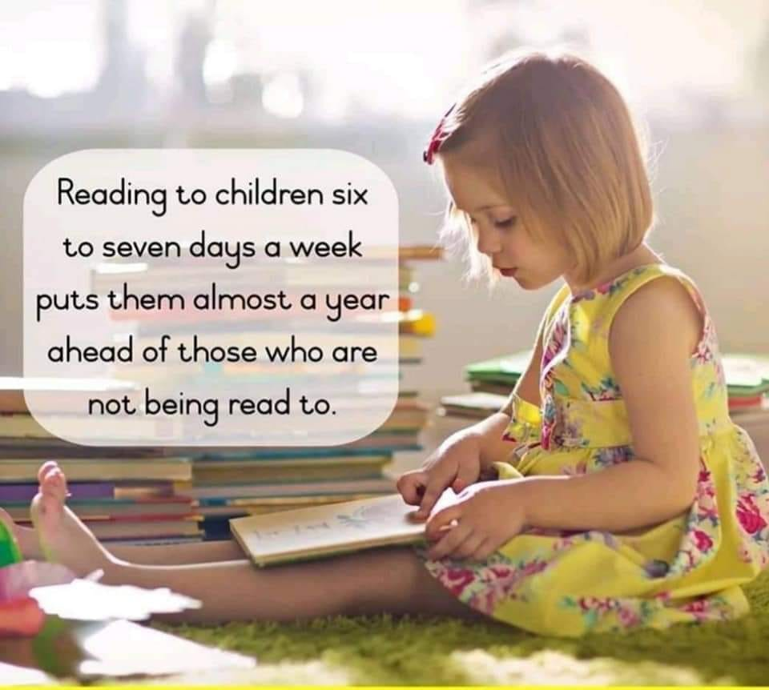

Slide 7
Handwriting
As a school we have developed our cursive handwriting policy, which has both lead ins and lead outs. We have all been learning this policy from Year 1 to Year 6.

Slide 8
School Uniform
Please make sure all uniform is labelled, including P.E. kits and coats.
If you notice the name is starting to wear off, please could you re-write it so we know to whom items belong.
Children should be wearing sensible black school shoes (no black trainers) at all times. If there is a problem and they need to wear trainers for medical reasons, please let us know.
Navy blue round neck (school) jumpers should be worn. Hoodies and tracksuit tops are not acceptable as school uniform.
Please make sure uniform follows school policy.

Slide 9
What to bring to school
PE kits should be brought in every Monday and taken home each Friday to be washed.
Book bags/rucksacks – the children bring home letters, books etc all week and need their bags to carry everything.
Current reading book and reading record should be in school everyday to allow them to be monitored.
Lunch.
Water bottle – named, please.

Slide 10
Our Behaviour Policy
In India class, we aim to follow both our Golden Rules and Class Charter every day.
Good behaviour, including good listening, is rewarded with dojo points. If a child reaches a weekly target 5 times in the year, they will receive a bronze badge. If they reach the target 15 times, they will receive a silver badge. If they reach the target 25 times, they will receive a gold badge.
Every week, the child with the most dojo points will be given a ’Dojo Champion’ certificate.
Gentle reminders and a restorative approach are undertaken to address any poor behaviour.

Slide 11
Health and Safety
Please can you check your child for head lice (nits) on a weekly basis. Catching head lice is very common among young children and can be easily treated using products purchased from your local chemist.
Ways to try to avoid catching them –Tying back long hair where possible.. Should your child contract head lice it is recommended the whole family are treated to prevent them spreading.
Girls MUST take earrings out for P.E. lessons and should hair tied back at all times. Staff are not permitted to help children remove earrings. Should you be thinking about having your child’s ears pierced, it is recommended you do this over the summer holidays so that they may be removed easily when they return to school in September.
P.E. is part of the National Curriculum and ALL children must participate. A doctor’s letter is required for exclusion from P.E.

Slide 12
Dates to Remember
Friday 30th September - Class Assembly

Slide 13
Any Questions?
If there is anything that you are curious or concerned about, please do email us on our class email address: india@stmarysprimarypulborough.co.uk
Thank you for listening! ☺

