Slide 1
Meet the Teacher
Wednesday 4th October
U.K. Class

Slide 2




U.K. Timetable
Forest School will be on a Wednesday, starting on
1st November.
Miss Dunstall will take U.K. class every Thursday
(alternate morning/afternoon).
Rhymes will be taken home weekly this term.
Purple books (Phonics) will be taken home weekly,
starting from this week.

Slide 3
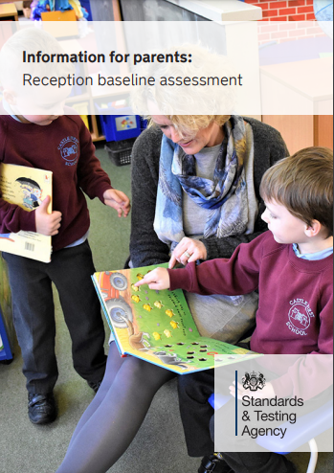
Baseline Assessments
https://assets.publishing.service.gov.uk/government/uploads/system/uploads/attachment_data/file/1182374/2023_Information_for_parents_reception_baseline_assessment_WEBHO.pdf

Slide 4

Phase 1
In order for children to be able to read and write well, they must be able to listen very carefully and discriminate between sounds. They should be taught to do this in a fun, exciting and active way with both planned and self-chosen activities.

Slide 5

Phase 1 – The 7 Aspects
Environmental Sounds
Instrumental Sounds
Body Percussion
Rhythm and Rhyme
Alliteration
Voice Sounds
Oral blending and Segmenting (short sounds)

Slide 6
Phase 2
Teach 19 letter graphemes (shapes) and
phonemes (sounds) (GPCs) all lower case
Move from oral blending and segmenting to doing
the same with letters
Learn to read and spell VC and CVC words using magnetic letters, whiteboards, phoneme fans
Introduced to reading two syllable words and simple captions.
Learn to read the tricky words – I, no, go, the, to

Slide 7
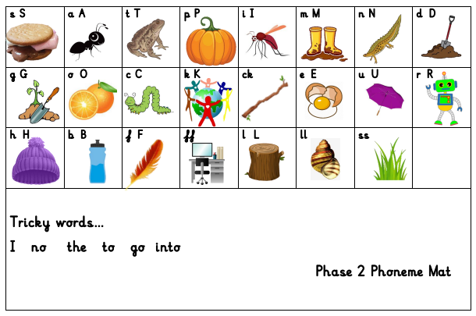
St. Mary’s phonics scheme….

Slide 8

Phase 2 - Writing
Until this point, the children have not been taught to form letters correctly.
We have been doing lots of work in Physical Development to get ourselves ready for writing.
They start by writing these in the air, in the salt, flour,
in paint, on each others backs and, if appropriate,
with a pencil.

Slide 9
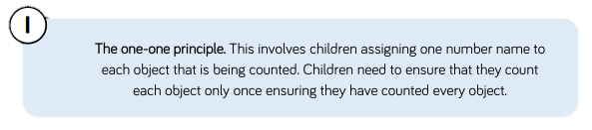


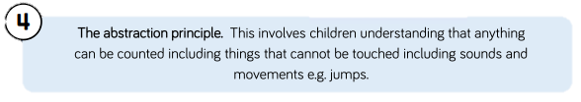

Maths Skills
Maths- the counting principles

Slide 10
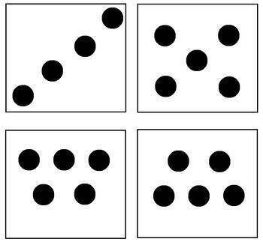
Maths Skills
Subitizing – being able to recognize how many in a set of objects (up to 6), recognizing different arrangements.
Sentence stems – 3 is one and one and one
3 is two and one

Slide 11
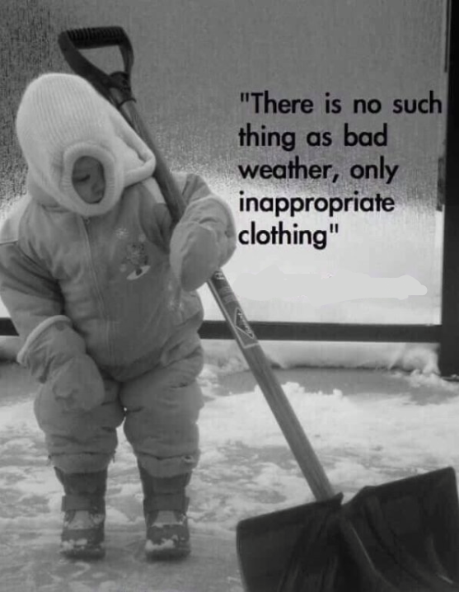
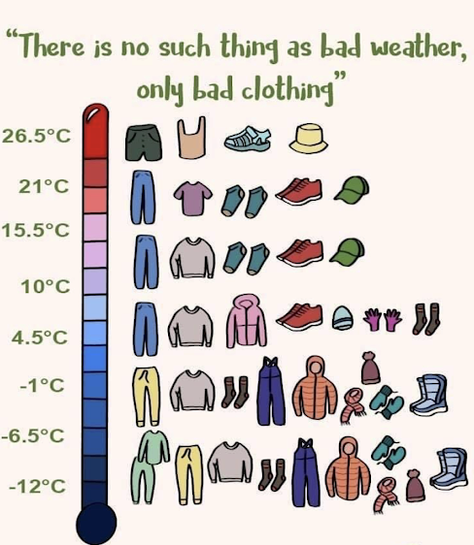
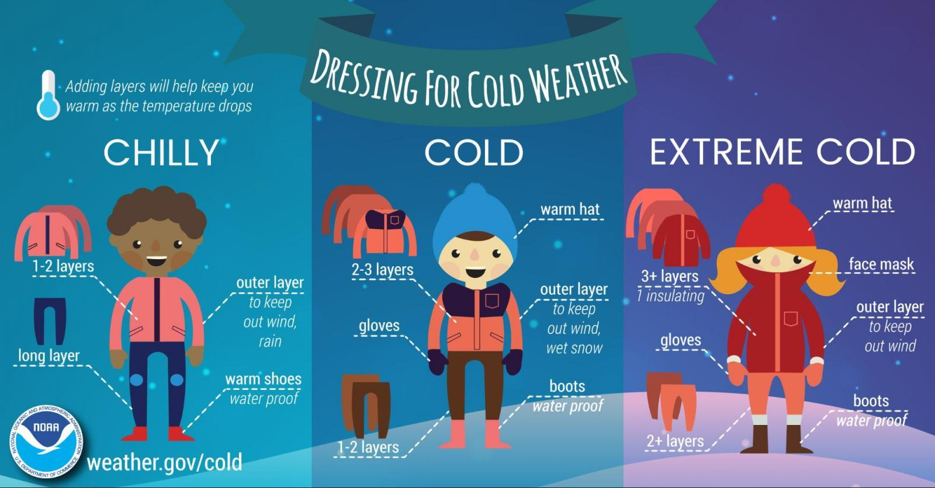
Clothing – Outdoor learning
We would like to make as most use of our Garden Areas and wider School Grounds as possible.
Please make sure your child has a named pair of welly boots on their outdoor pegs.
Splash suits or waterproof trousers/coats seem to be proving essential wear this year. If these could be clearly named and in a draw string bag on your child’s peg, that would be fantastic.

Slide 12
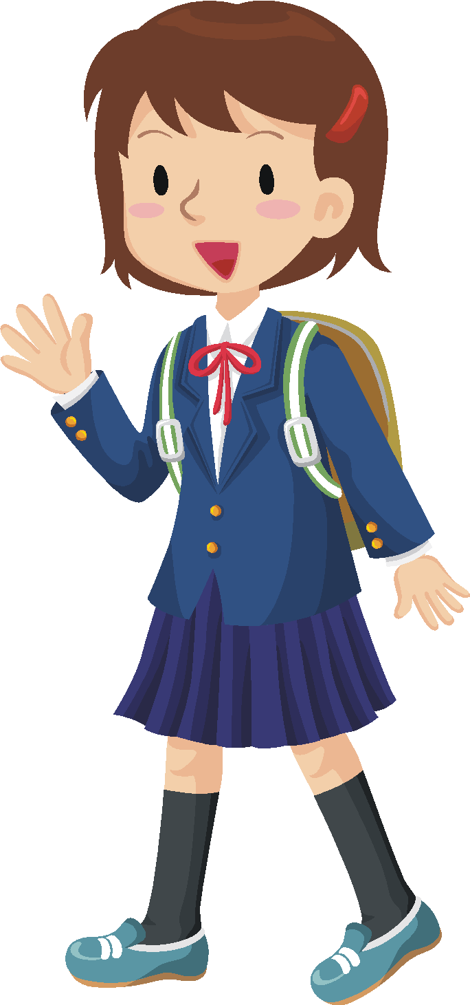

Encouraging Independence.
Please involve your child in packing their bag at home. That way they are more aware of what they have brought to school each day.
Shoes – if your child’s shoes have laces,
please ensure they can do these themselves.
Clothing – please support your child in learning how to dress/undress independently.
Toileting - please support your child in becoming as independent as possible with this.

Slide 13

Reading Books
The children will soon be bringing home a reading book from school.
Please read with your children as often as possible and write in their reading log.
They should also be encouraged to read ‘real’ books from home or the library. We are hoping to visit the village library in November. Please try and take your child down and have a look at the lovely children's section.

Slide 14
Reading Books
Reading books need to be sent back in in the book bag.
We read every day with the children in all subjects and will write in their reading logs once a week after whole class, individual or guided group reading. If you feel your child needs to change reading levels, please email us.
At this early stage when sharing picture books, the focus is on talking through the pictures and developing the use of ‘story book’ language. As their phonic skills develop they will bring home books linked to the sounds we have taught.
When reading the Phonic Reading Scheme Books, it is important that phonics is the first and main strategy used to decode the words. Books will be carefully matched to the phonemes they have been taught.

Slide 15
Book Bags
Please use them for books only.
Last year we lost several books because of water bottles leaking on them or fruit going rotten.
Please send them in everyday.

Slide 16

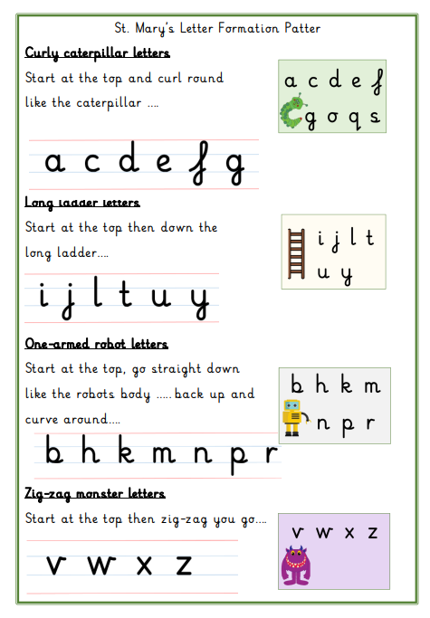

Slide 17
In EYFS and Key Stage 1:
Our priority is meeting the needs of our children – whichever class they are in.
Your child will get the required ‘diet’ for their year group – but also a diet that is tailored to their need – this may look different for children in different classes.
Classes may work completely independently… sometimes.
Classes may work with the class next door… sometimes.
Children may do things with other children in their year group – thus mixing with other classes or doing similar activities… sometimes.
For example: at Christmas, UK will work with Thailand on a performance and India will work with Italy on a different performance – each child will be included.
You may hear that children who are in another class, but are in the same year group as your child, are doing something different from your child – don’t worry! Refer to point 1!
We will try our best to communicate clearly with you.
Notes:
Teachers – please delete (for your notes) – EYFS trip to Two Woods coming up will be ONLY EYFS – because they’ve never been before! Dress up days may be different for different classes or groups – all children will get equal opps. Year 1 in BOTH Christmas performances will be the chorus/choir for example.
Ask parents to EMAIL as a general rule rather than using Dojo (because of GDPR)
17

Slide 18
School Uniform
Please ensure that all items of your children’s school uniform, including PE kits (when requested) and coats, are clearly labelled with their name.
Check this regularly. If you notice the name is starting to wear off, please could you re-write it in so we know who items belong to.
At the end of the day we try to collect all jumpers and cardigans, etc, from the cloakroom to give out; please check your children’s jumpers when they get home to ensure they are not wearing someone else’s. We can only return them if they are still clearly named.

Slide 19
Learning Journals
One of the ways in which your child is assessed in Reception is by collecting evidence of things they have said or done. These are put into a ‘Learning Journal’, which is simply a collection of your child’s achievements.
Throughout Reception this is used to work out your child’s learning and their next steps.

Slide 20
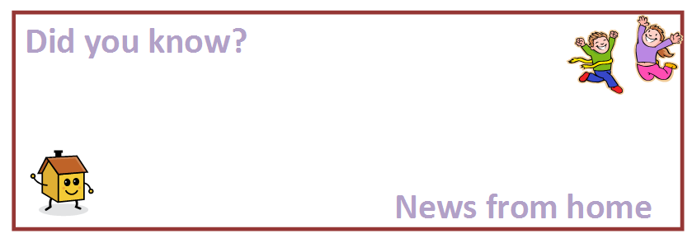
Learning Journals
One of the ways we ask you to help with this is through completing ‘Did you know?’ slips telling us of their achievements and providing evidence of things they have said or done outside of school.
Alternatively you can email us photos to illustrate these achievements; ehuntleyhart@stmarysprimarypulborough.co.uk

Slide 21
Behaviour
We follow the school Golden Rules at all times in U.K. class and we have linked these to Mr Potato!
We also follow the school behaviour code in lessons and have high expectations of how we should behave in order to learn.
Good behaviour is reinforced through our PSHE lessons and class assemblies.
We like to focus on positive behavior; if wevsend your child to share their work with Mrs Copus or Mrs Hatcher, they will also get a special Headteacher sticker!

Slide 22

Helpers
All help much appreciated!
Reading
Craft Activities
Forest Schools
Weeding the garden!
Walks around the village.
Please book a DBS check with the Office if you wish to help at school

Slide 23




Water bottles and Fruit
All children should have a water bottle to keep in class should they be thirsty during our Busy Bee sessions. We keep water bottles over by the sink. Children are also provided with a drink with their hot lunches.
At morning break, the children are encouraged to take a piece of fruit for a snack. Children may bring fruit from home or have a piece of school fruit. We discourage fruit winders, fruit flakes, etc, at break times in preference for a piece of fresh fruit. Please bring an extra piece of fruit or wholemeal biscuit for the afternoons.

Slide 24

Free School Milk
Milk is completely free for all children aged under 5.
Milk is subsidised for children aged 5 or over.
Please register at www.coolmilk.com

Slide 25
Other bits……
Learning Journals from Nursery
Pupil Premium
Boxes, tubes, etc for the making trolley
DBS checks
WhatsApp, Class Dojo, Google Classroom
Early Birds and Roosters

Slide 26
Dates:
Six Weeks in Meeting, Wednesday 18th October, 9am
INSET Friday 20th October
Flu Nasal Spray, Monday 30th October– FORMs asap
Parents’ Evenings, 7th and 9th November, 3.30-6pm
Library Visit - TBC (this will be on a Thursday Afternoon in November)

Slide 27
Things to look forward to;
Walks to the library and St. Mary’s Church.
Trips to Two Woods SITE for Forest School.

Slide 28
Thank you for coming.
Car parking
Website – dates, newsletters, etc

