Slide 10
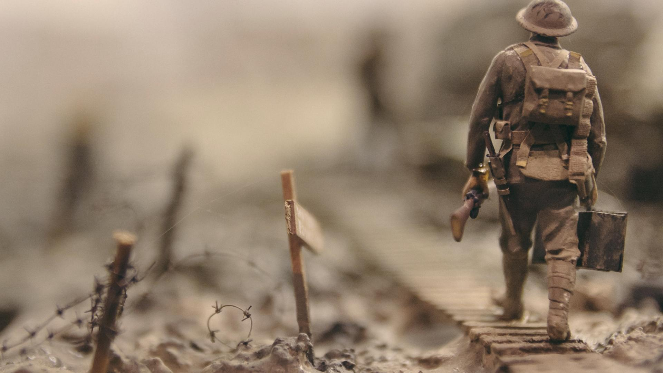
Peace I leave with you; my peace I give to you. I do not give to you as the world gives. Do not let your hearts be troubled, and do not let them be afraid. John 14:27

Slide 11
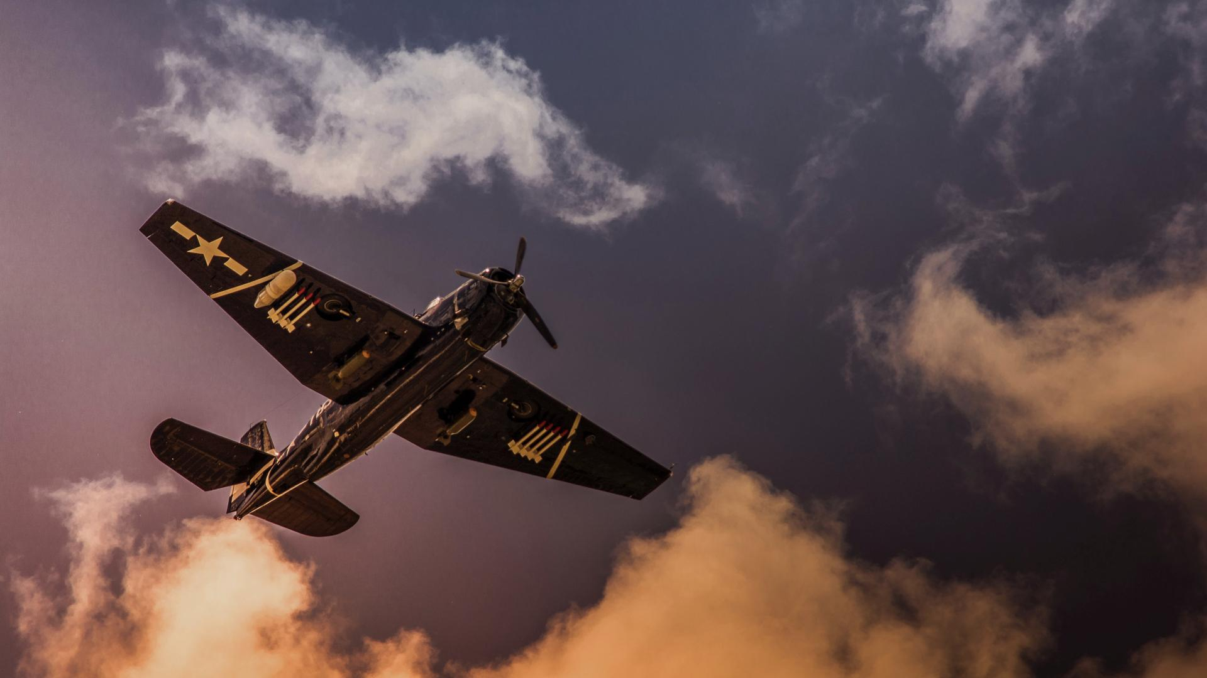
This is the message we have heard from him and proclaim to you, that God is light and in him there is no darkness at all. 1 John 1:5

Slide 12
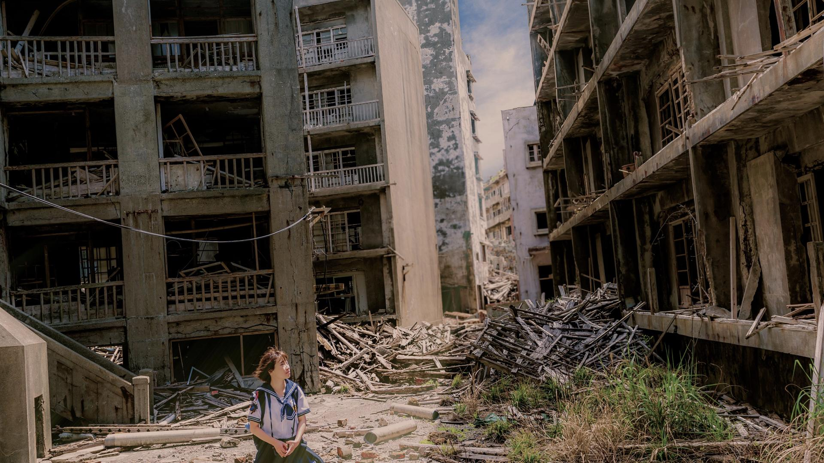

Slide 13
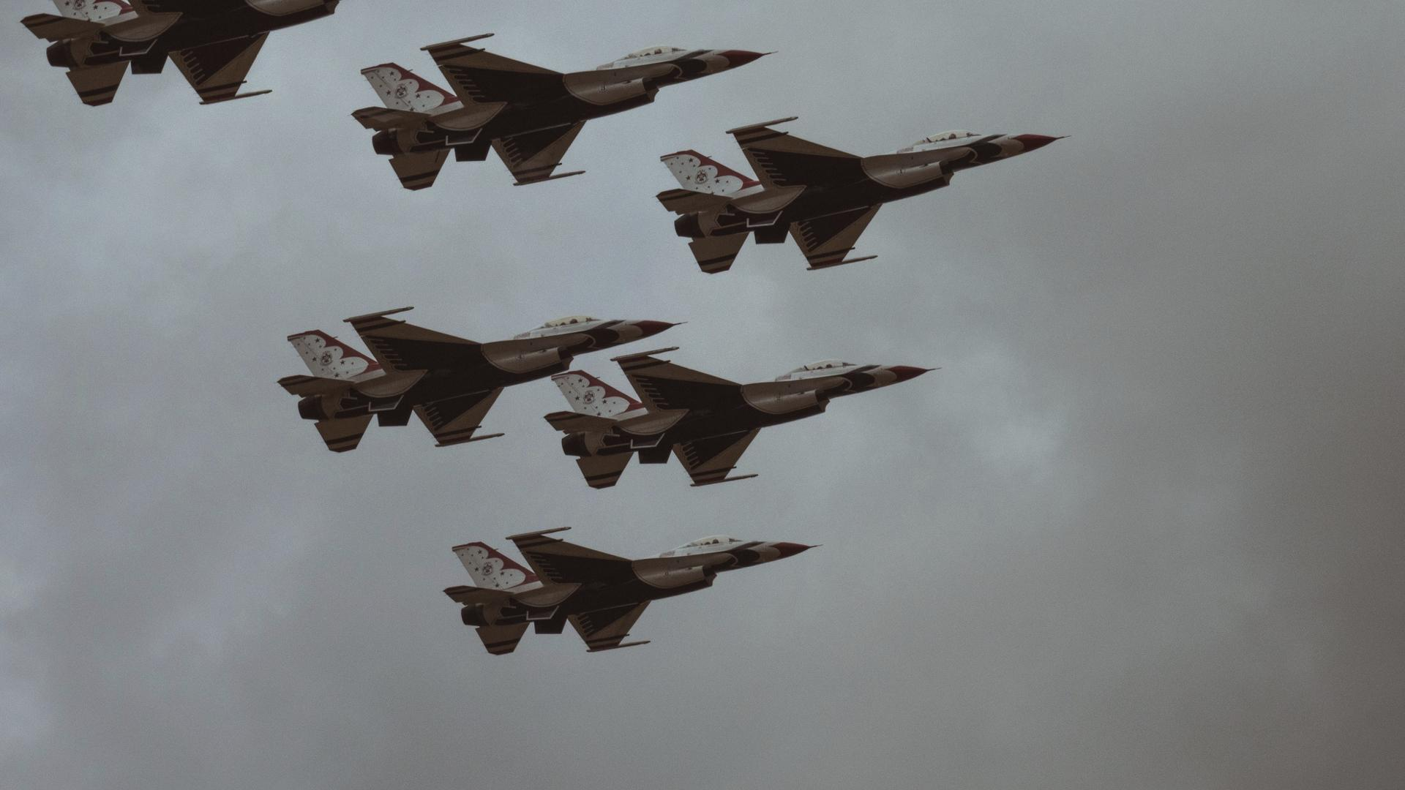

Slide 15
They shall grow not old, as we that are left grow old; Age shall not weary them, nor the years condemn. At the going down of the sun and in the morning … we will remember them

Slide 17
Children to read their poems

Slide 18
We will remember Turn your thoughts on this occasion To those who fought and died in the war. Years have passed and time has forgotten, But we will remember the soldiers once more. Instrumental Repeat

Slide 19
God save The King God save our gracious King! Long live our noble King! God save the King! Send him victorious, Happy and glorious, Long to reign over us, God save the King. Thy choicest gifts in store On him be pleased to pour, Long may he reign. May he defend our laws, And ever give us cause, To sing with heart and voice, God save the King.

Slide 20
Ever-living God we remember those whom you have gathered from the storm of war into the peace of your presence; may that same peace calm our fears, bring justice to all peoples and establish harmony among the nations, through Jesus Christ our Lord. Amen.

Slide 21
All join together in the Lord’s Prayer: Our Father, who art in heaven, hallowed be thy name. Thy Kingdom come; thy will be done on earth as it is in heaven. Give us this day our daily bread and forgive us our trespasses as we forgive those who trespass against us. And lead us not into temptation but deliver us from evil For thine is the kingdom, the power, and the glory for ever and ever. Amen

Slide 22
