Slide 1

New Parents’
Information

Slide 2
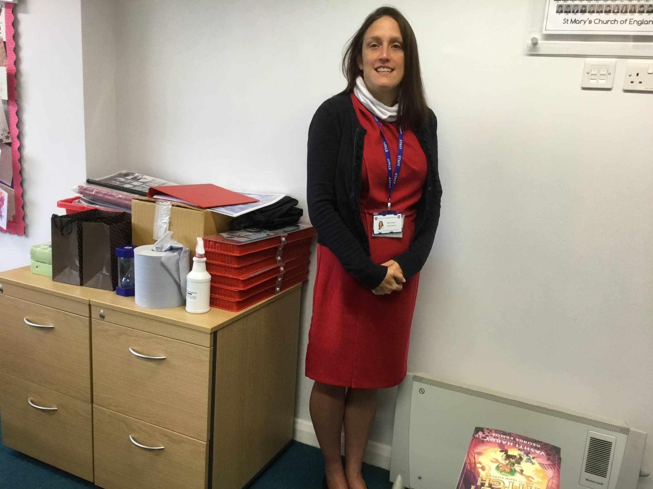
Headteacher – Mrs. Copus

Slide 3
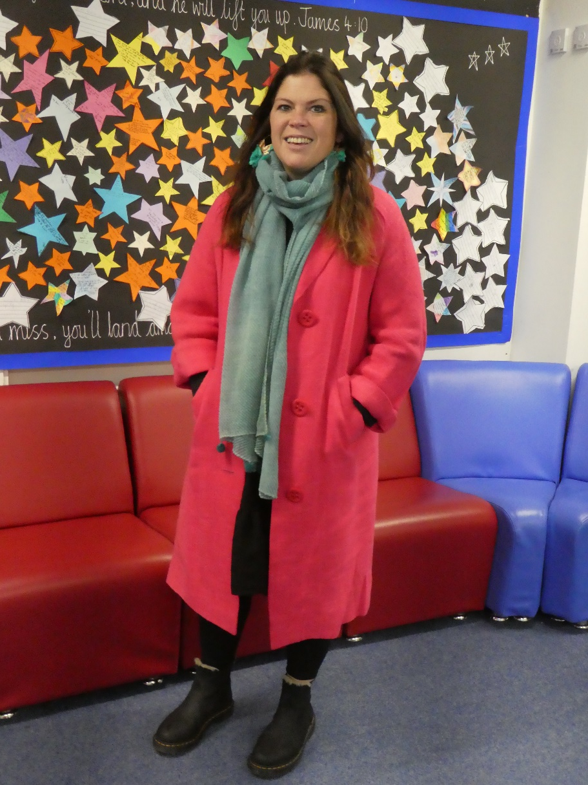
Mrs Hatcher – Deputy Headteacher

Slide 4
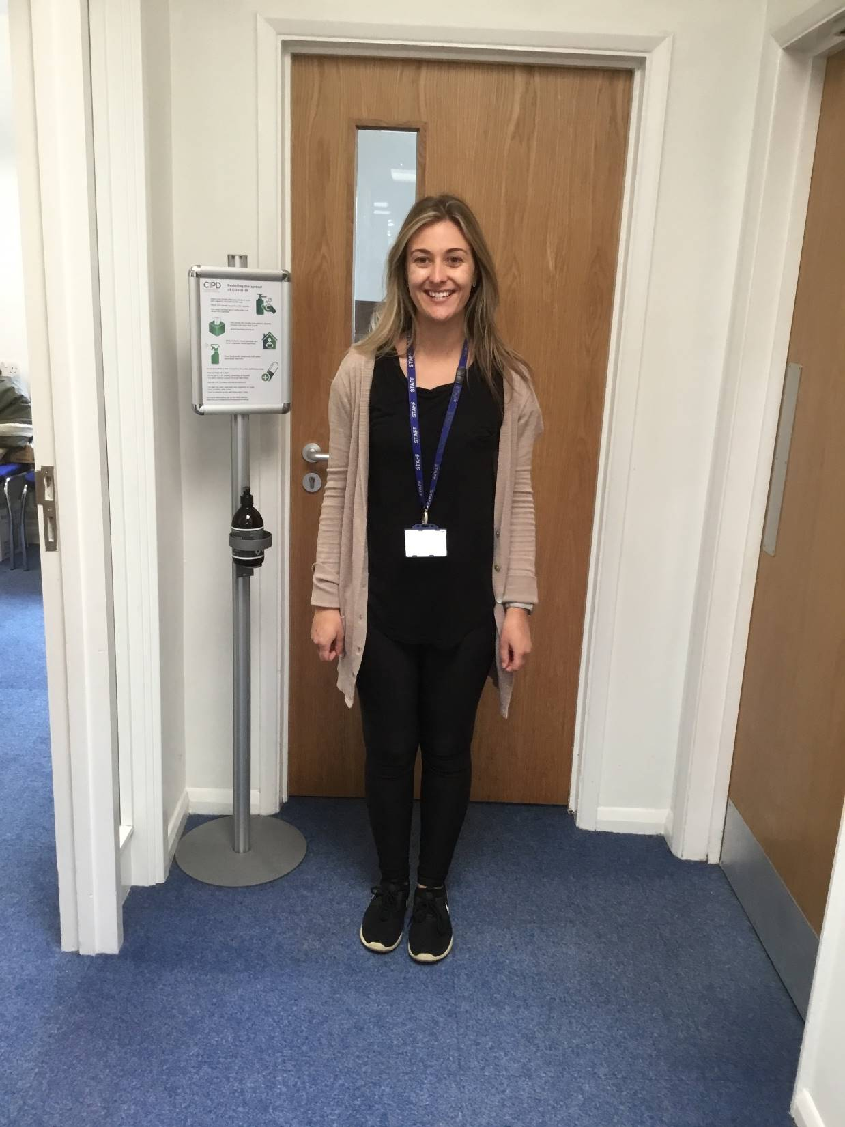
Miss Wilkins - Special Educational Needs Coordinator

Slide 5
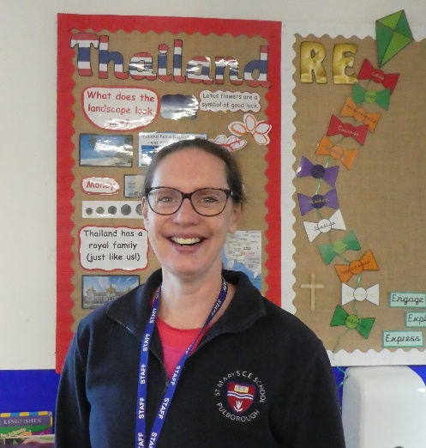
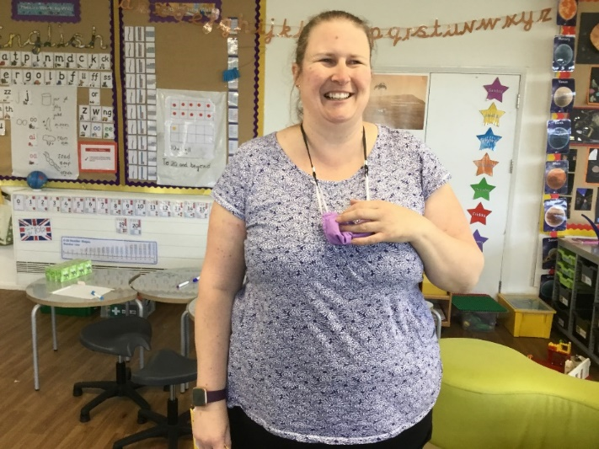
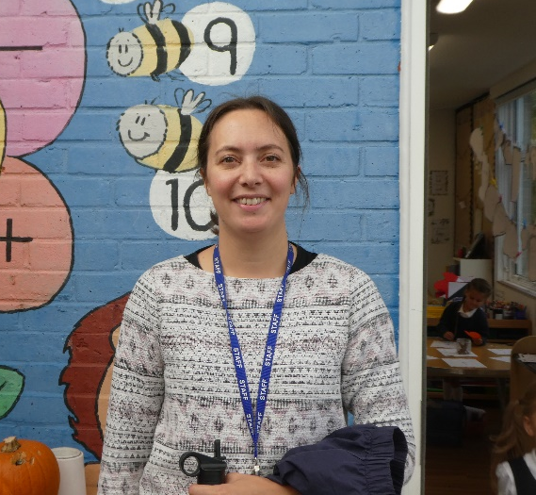
Early Years Teachers
Thailand Class
U.K. Class
Mrs Gowland
Mrs Huntley-Hart
Mrs
Martin-Wells

Slide 6
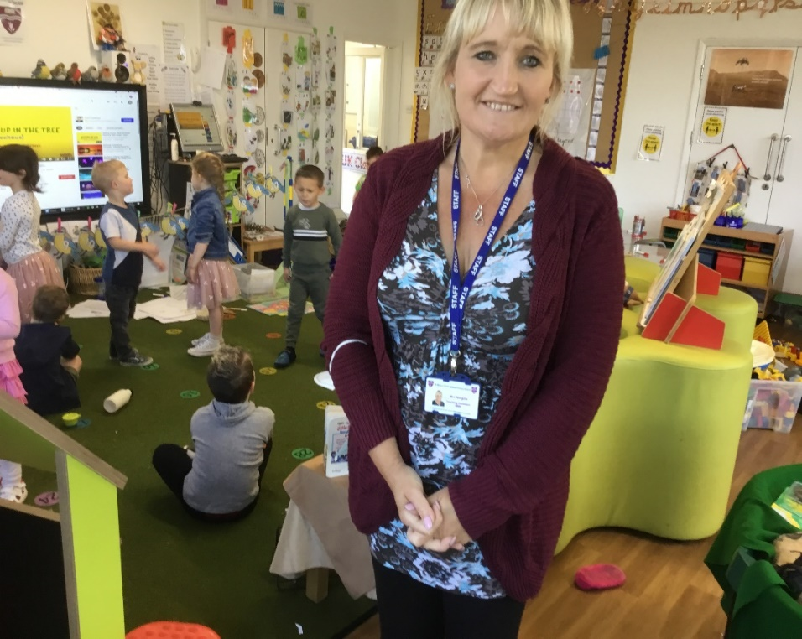
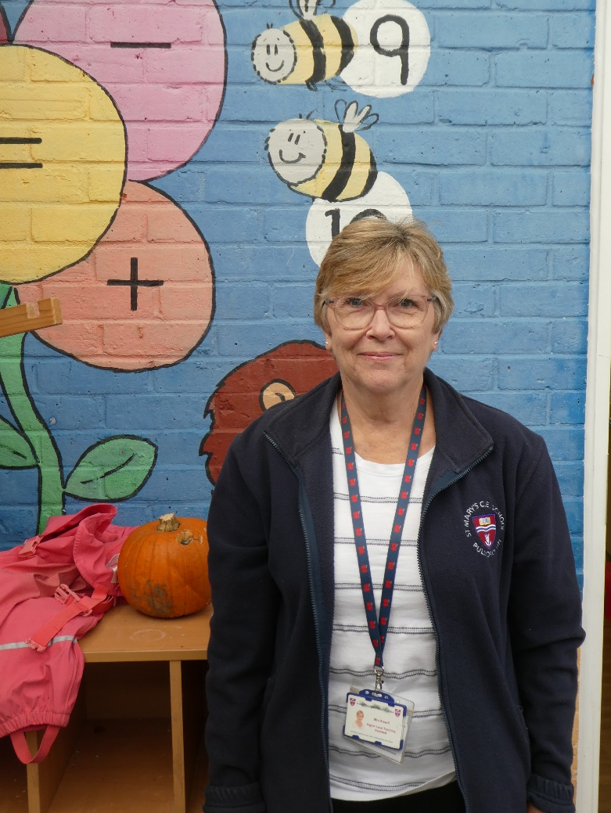
Thailand T.A. - Mrs. Ansell
U.K. T. A. – Mrs. Norgate

Slide 7
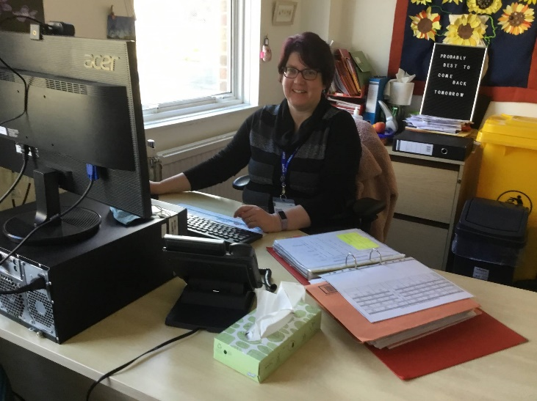
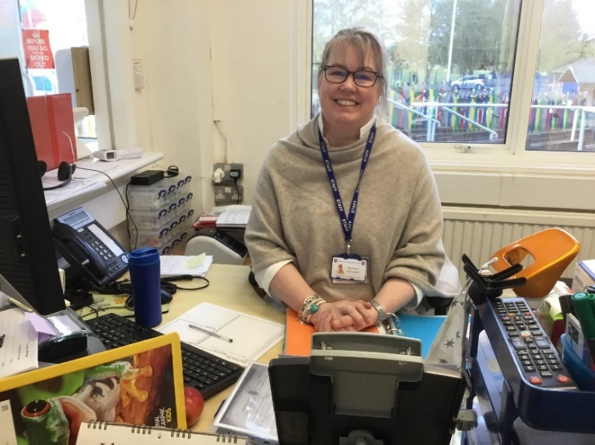
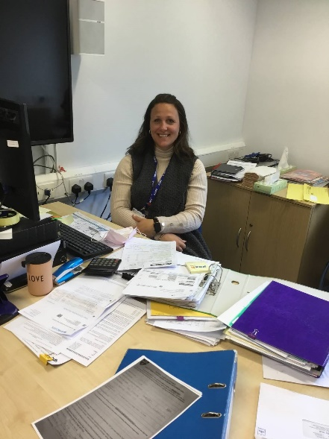
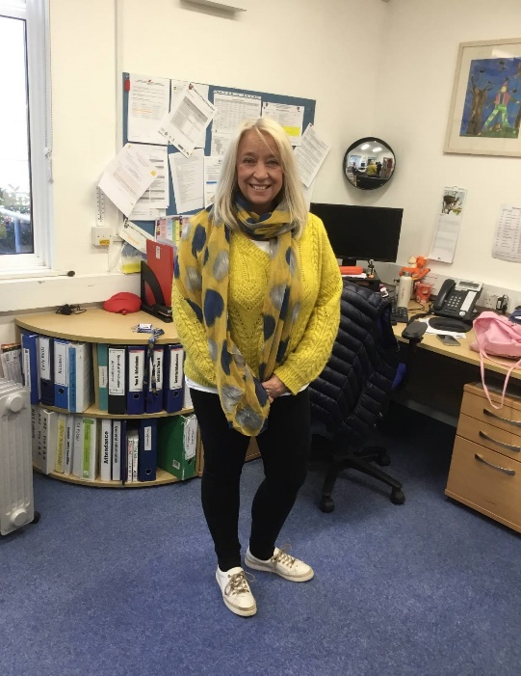
Administration Team
Mrs. Lees
Business
Manager
Mrs. Russell
Mrs. Gabriel
Mrs. Andrews

Slide 8
How you can help prepare your child for school
Talk enthusiastically about school with your child.
Practise the school run, this can get them excited about starting and also used to travelling to and from school.
Develop your child’s independence and self-help skills, this is really important in helping them prepare as they are soon to become 1 of 20.
Try on the school uniform and encourage your child to dress on their own (buttons, zips, shoes, coat, etc.)
Practise toileting without help.
Practise eating using a knife and fork.
Work on recognising their name;
Share stories together.

Slide 9
Language and Communication skills are really fundamental.
Top Tips – Lockdown has limited children’s experiences and learning opportunities.
Talk to your child when they are playing about something that interests them.
Read information books, fairy tales, picture books. They are all jam-packed
with vocabulary.
3. Give your child lots of experiences – go to the park, play with them in the
garden.
Ask questions, make comments, expand their vocabulary.
Sing with your child and enjoy rhymes together.
The Nuffield Early Language Intervention is designed to improve the spoken language ability of children and we are fortunate to be able to take part
in this scheme.

Slide 10
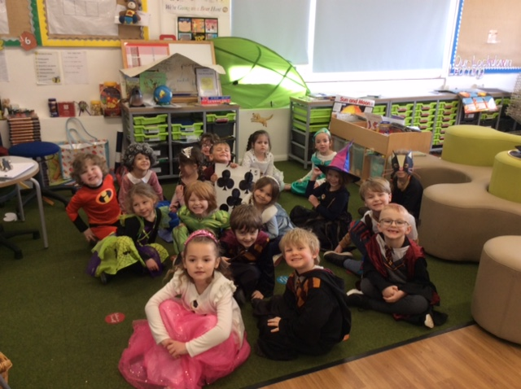
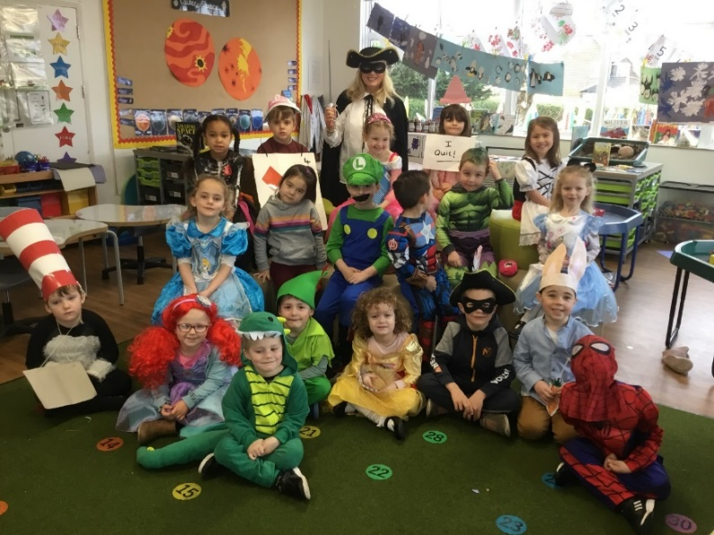
Our Educational Journey Begins!
The clue is in the name – ‘Foundation Stage’
Young children learn best when learning is pleasurable.
We give learning opportunities through play, ensuring activities are open-ended and encouraging independence. These are the basic building blocks of a solid foundation to lifelong learning.
We need to create resilience in our children. If they do not get things right, they can try again and do better.

Slide 11
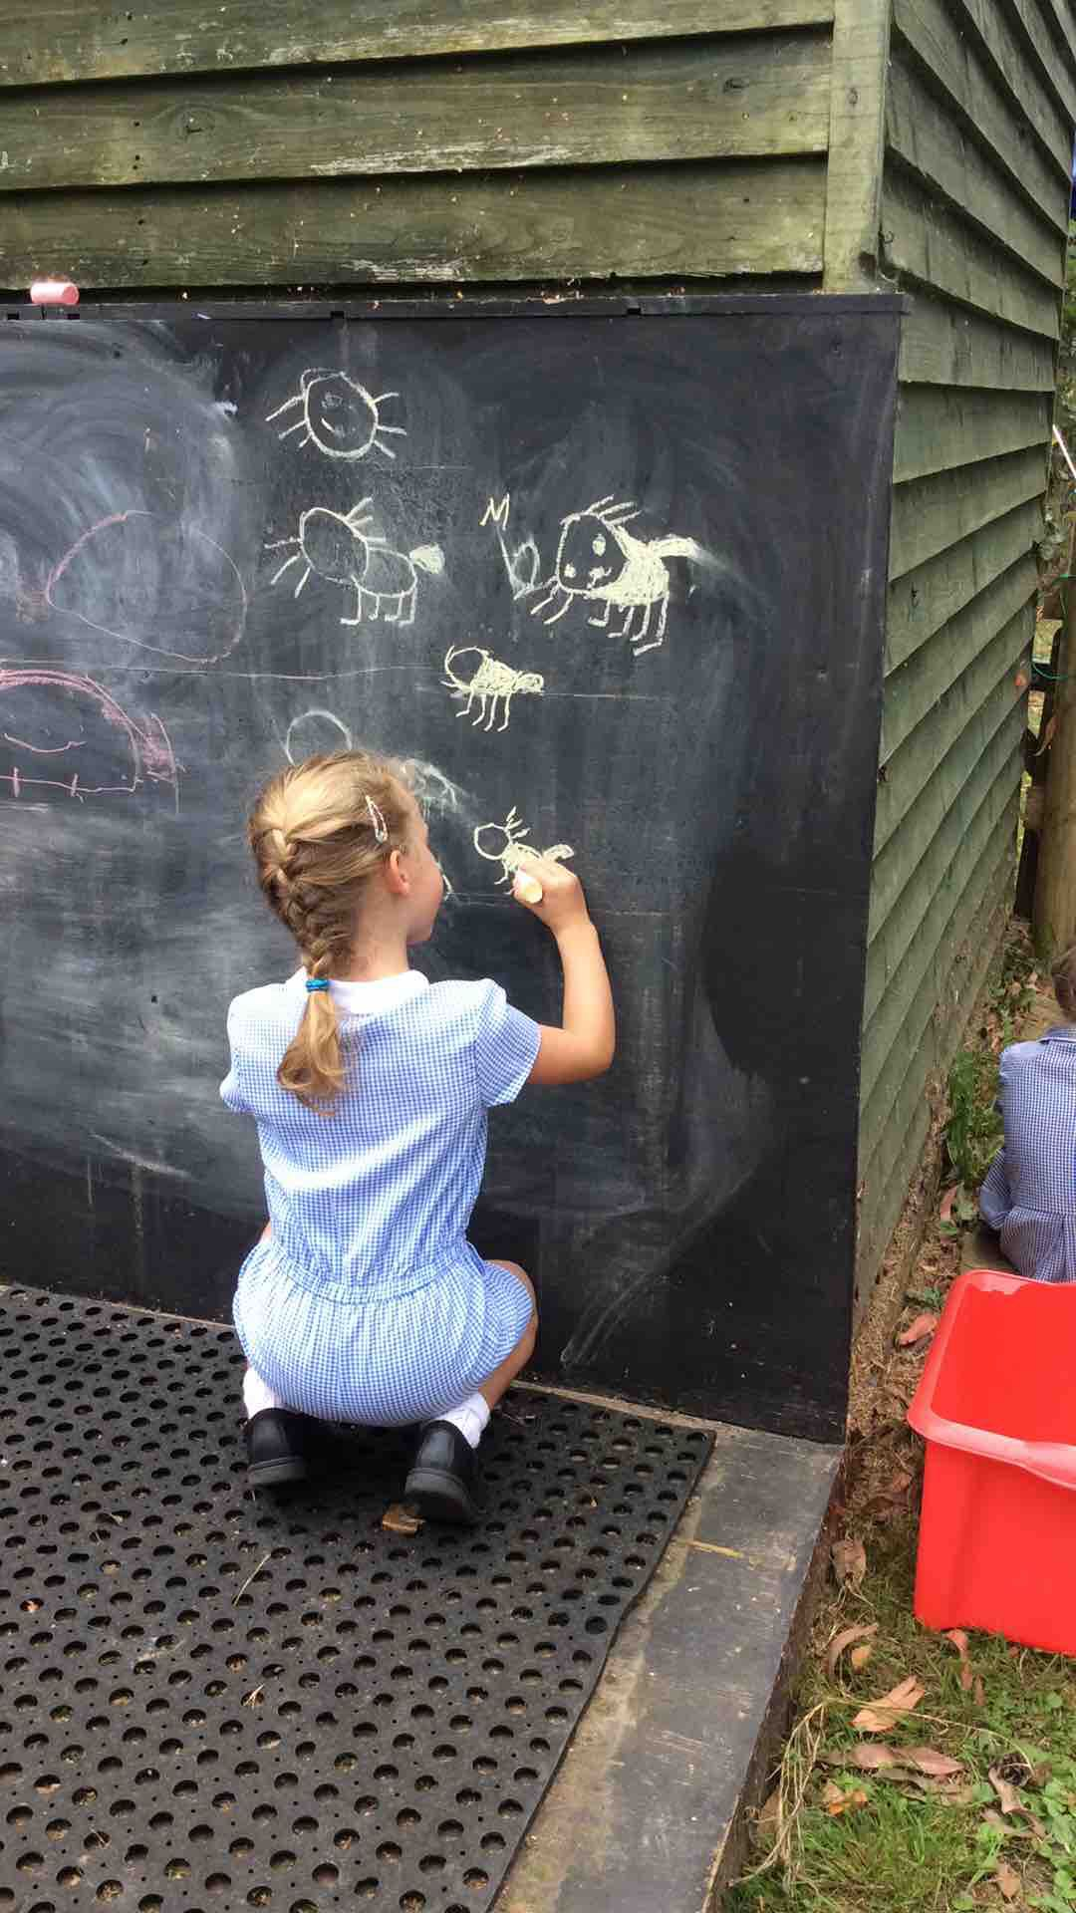
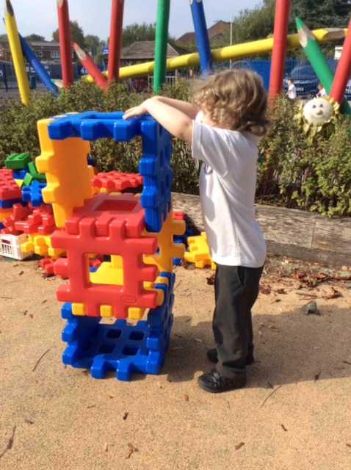
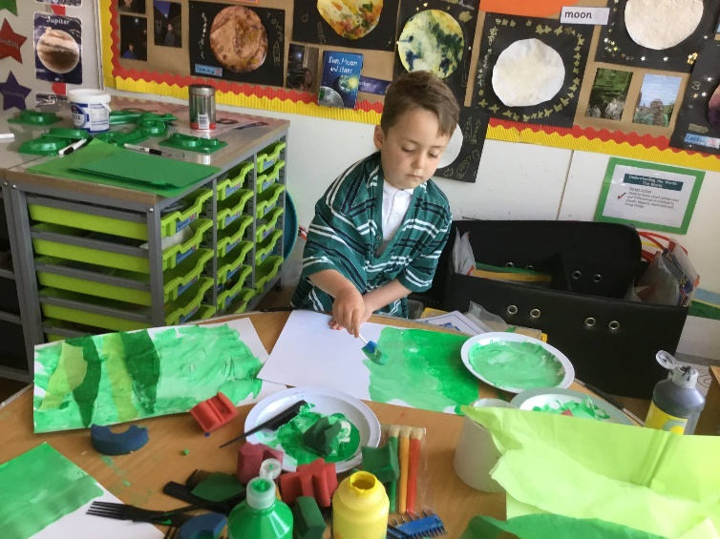
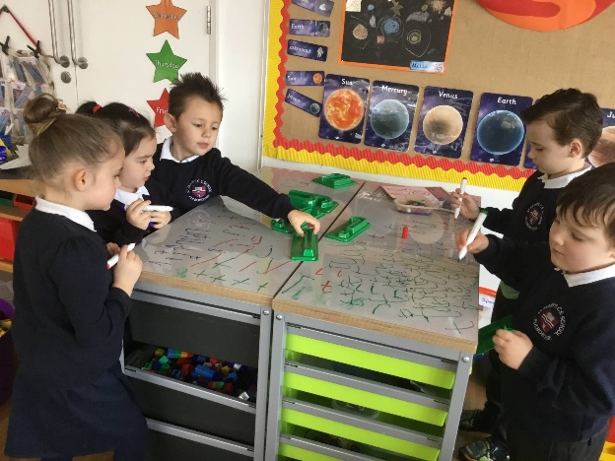
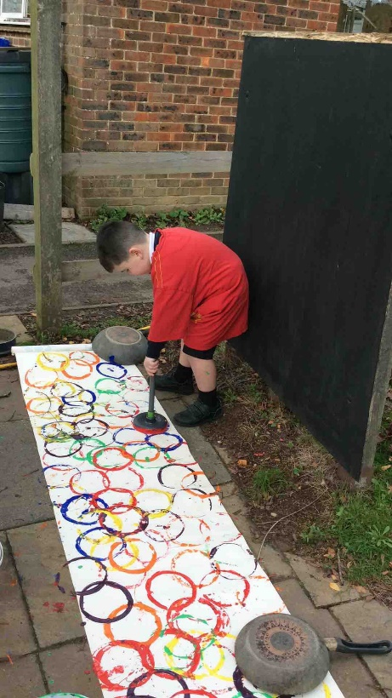
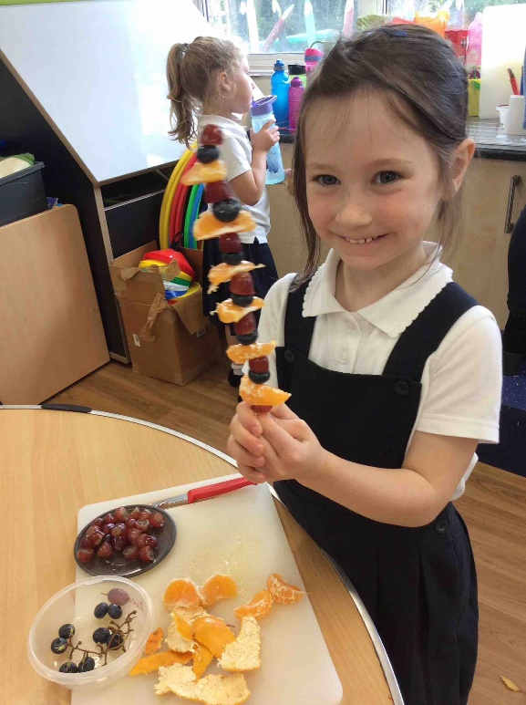
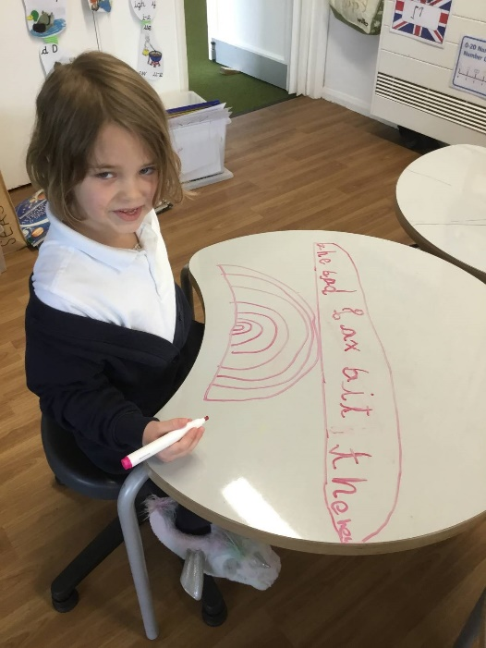

Slide 12
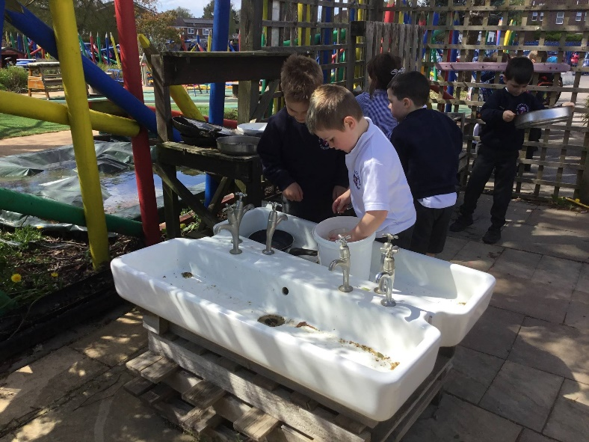
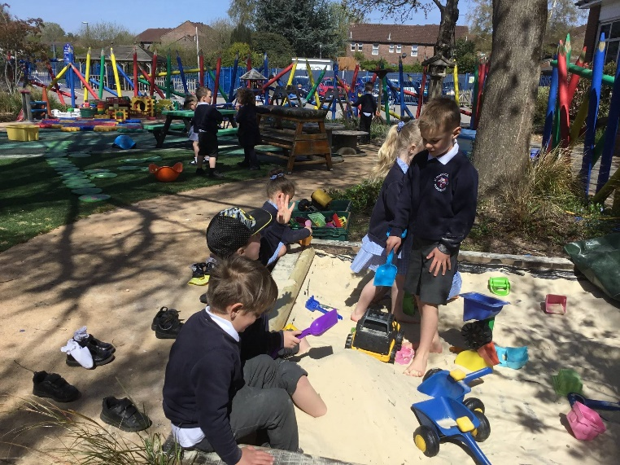
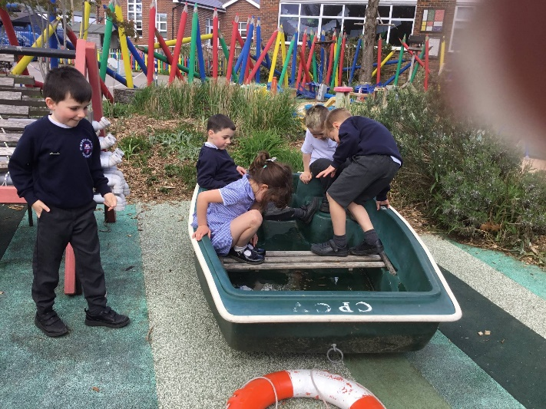
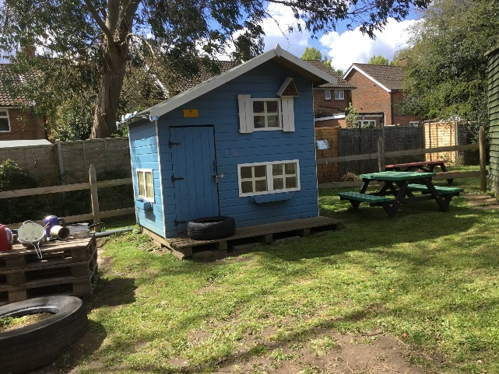
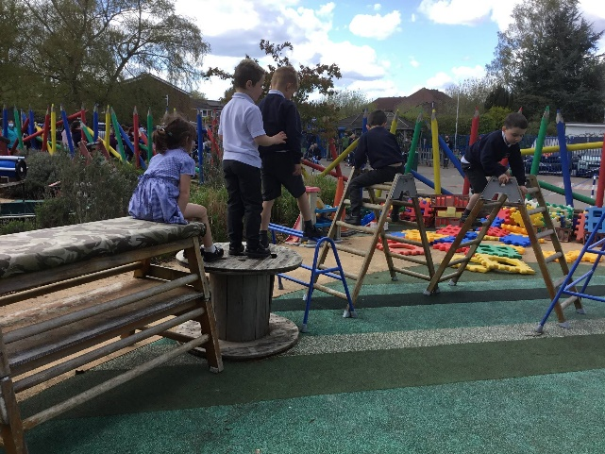
Our Garden
All areas of learning are provided for in the outdoor area and we spend 50% of our time outside. The children need to be equipped with coats and wellies in the winter and sun hats and sun cream in the summer.

Slide 13
Assessments and Observations
As a school we carry out a baseline assessment which will take place during the first half term.
Judgements will be made through observations by the class teacher and teaching assistant.
Assessments are made continuously throughout the year and recorded in a variety of ways:
– Electronic Learning Journey.
– Individual Learning Journal.
You will receive a report during the Spring term about your child's progress.

Slide 14
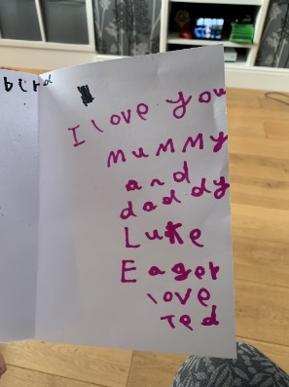
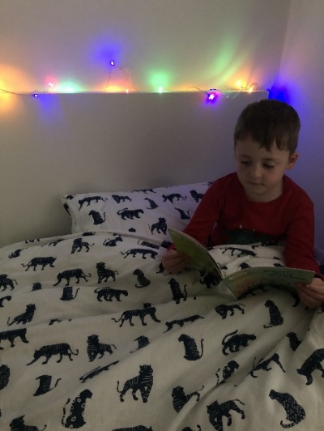
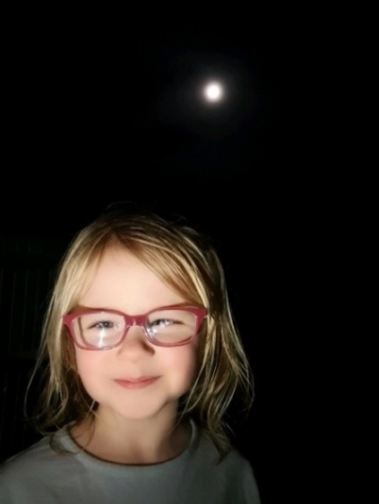
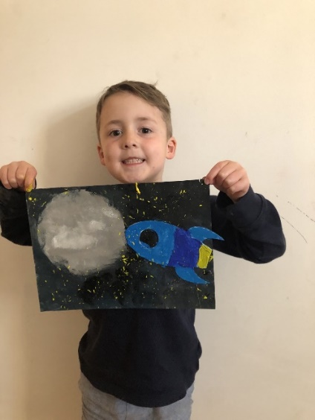
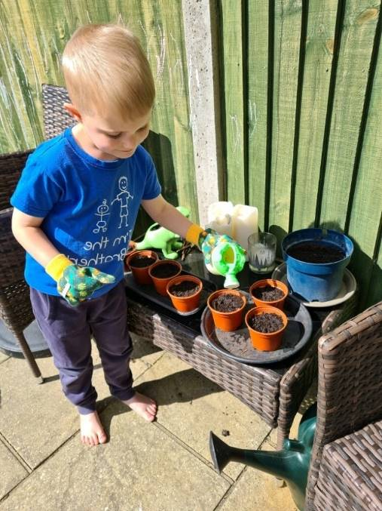
Parental Involvement
You are an important partner in your child’s learning and we value your knowledge and input. Therefore we encourage parents to be involved as much as possible.
We have many ways of keeping in touch including:
Information meetings
Newsletters
Learning Journals – contributions
Class Dojo
Google classroom/remote learning which Reception and the school used for Lockdown learning
and will continue to use for home learning tasks.

Slide 15
Food and Drink
We ask that all children bring a named bottle filled with water to school each day. Children have access to this water throughout the day.
At lunch children may have:
A packed lunch and drink: brought to school in a named lunchbox – no chocolate bars or sweets.
A free school lunch – please inform Chartwells of any specific dietary needs, e.g. allergies.
We are a NUT-FREE school – please do not send foods containing nuts, sesame seeds, etc

Slide 16

What will your child need?
A school uniform (all items named).
A pair of wellies to be kept in school.
A pair of slippers to be kept in school.
A waterproof coat – we go outside in all weathers.
A reading bag which will be provided.
A water bottle for use in the classroom.
Old clothes for Forest School.
Waterproof trousers for Forest School.

Slide 17
7 Areas of Learning
There are seven areas of learning within the Foundation curriculum and all areas of development are important and inter-connected. They are divided in to the Prime Areas and Specific Areas.
3 Prime Areas
Communication and Language
Physical Development
Personal, Social and Emotional
Development
These areas are crucial for igniting children’s curiosity and enthusiasm for learning, and for building their capacity to learn, form relationships and thrive.
4 Specific areas
Literacy
Mathematics
Understanding the world
Expressive Arts and Design
The development of children’s spoken language underpins all seven areas of learning and development. Children’s back-and-forth interactions from an early age form the foundations for language and cognitive development.

Slide 18
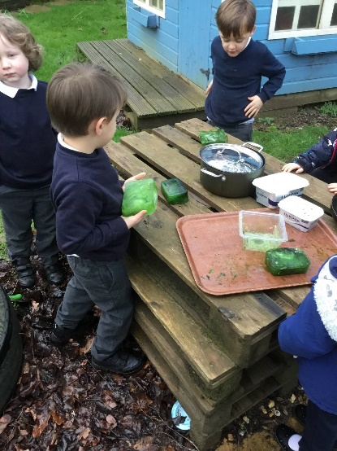
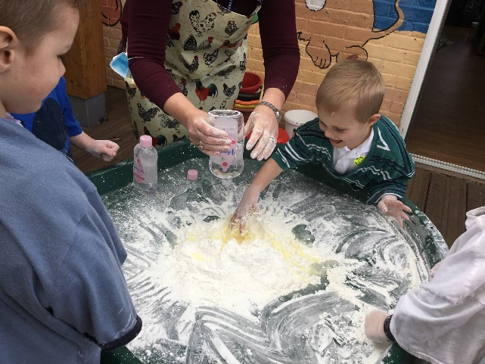
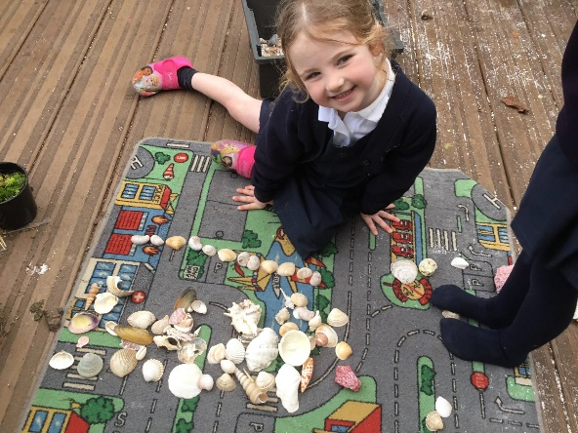

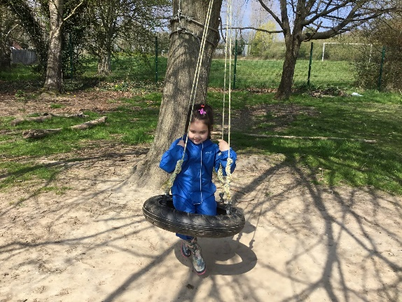
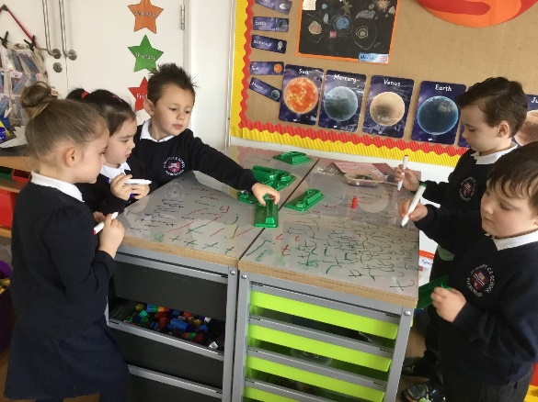
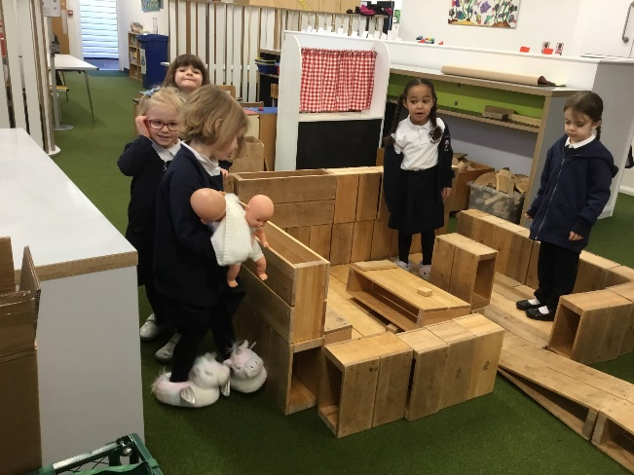
Physical Development
Children love to be active and we provide lots of opportunities for them to develop their co-ordination and control in both large and small movements
We provide a range of activities in our classroom for the development of fine motor
skills

Slide 19
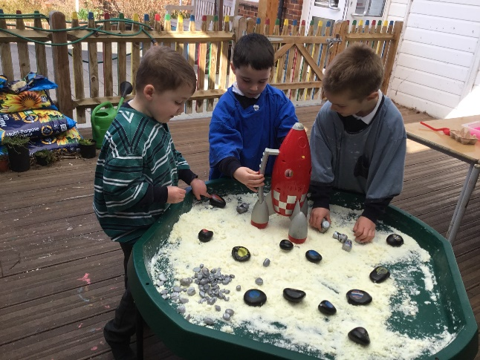
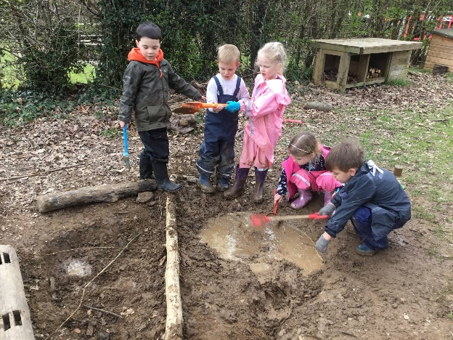
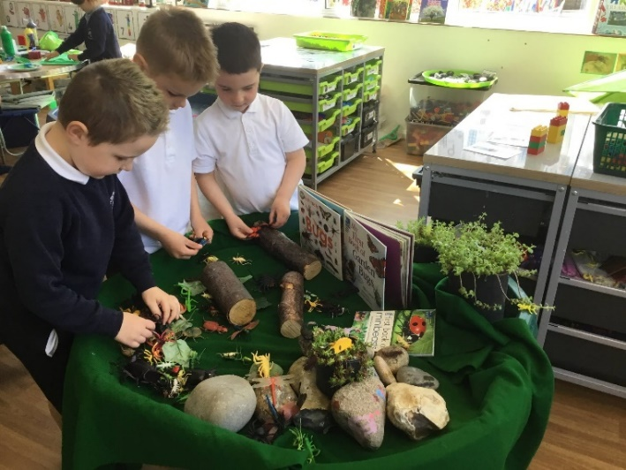
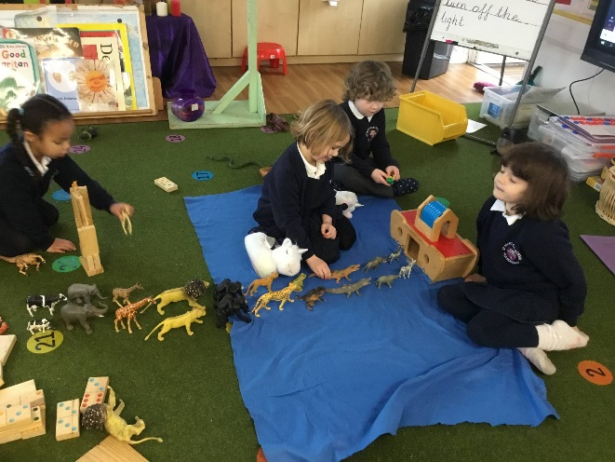
Language and Communication
The development of children’s communication skills is covered continually throughout the curriculum and we work hard to provide opportunities for the children to experience a rich language environment
Through these experiences the children develop their confidence and skills in expressing themselves and learn to speak and listen in a range of situations

Slide 20
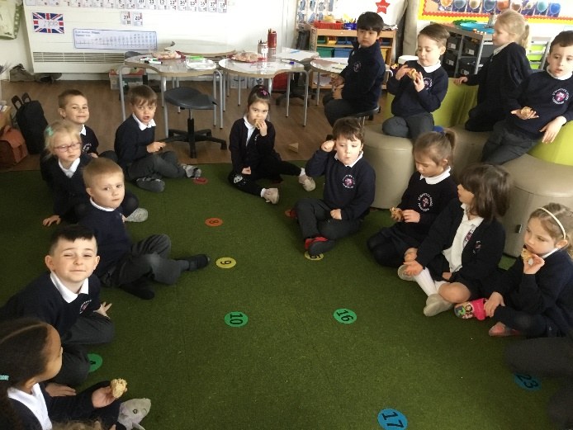
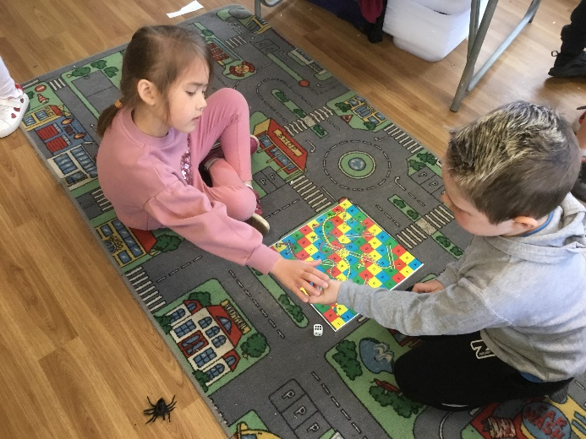
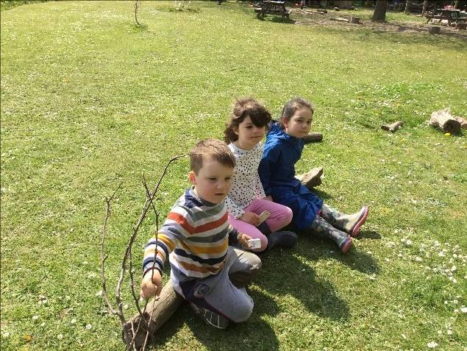
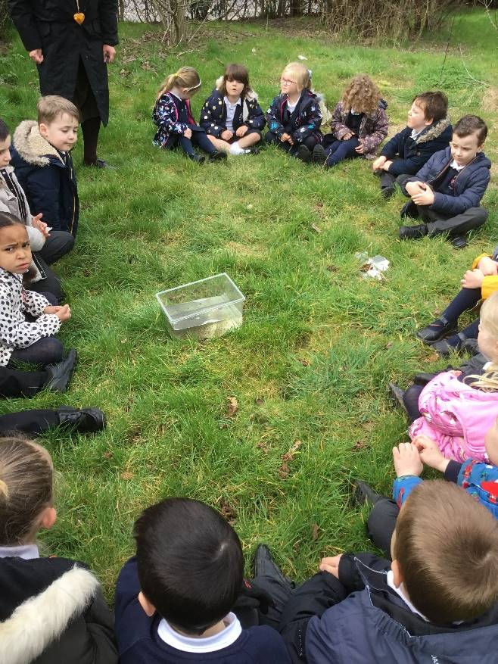
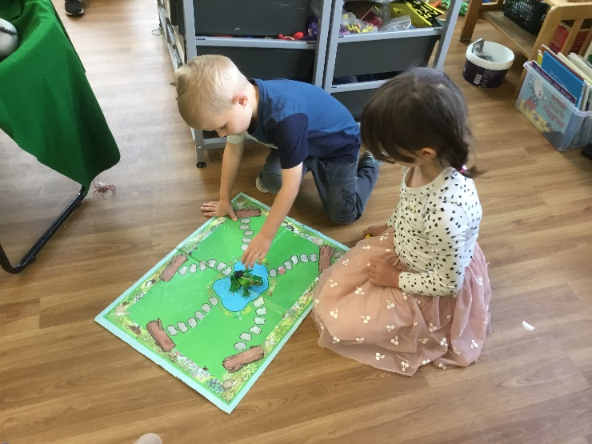
Personal, Social & Emotional Development
Personal, social and emotional development (PSED) supports children in developing a positive sense of themselves and having confidence in their own abilities. It helps them to form positive relationships, develop social skills and learn how to manage their feelings.
We cover this continually through their play. We also have a specific PSED lesson once a week and the focus for this changes each term

Slide 21
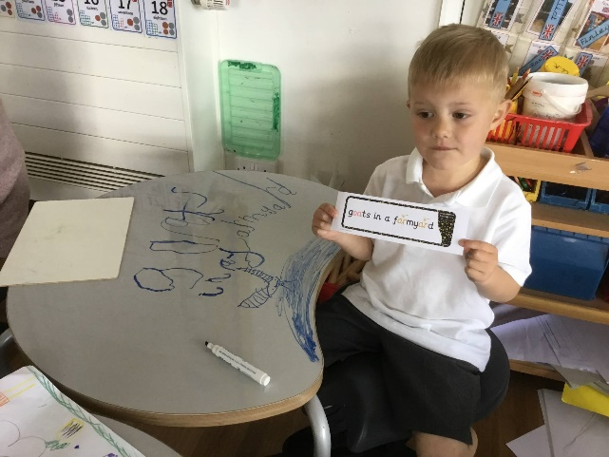
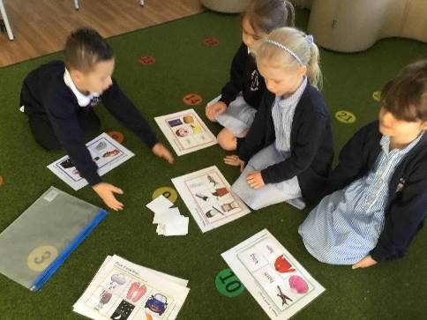
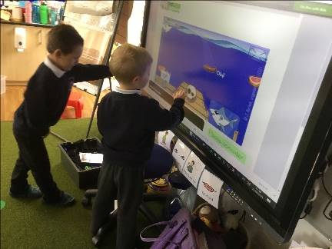
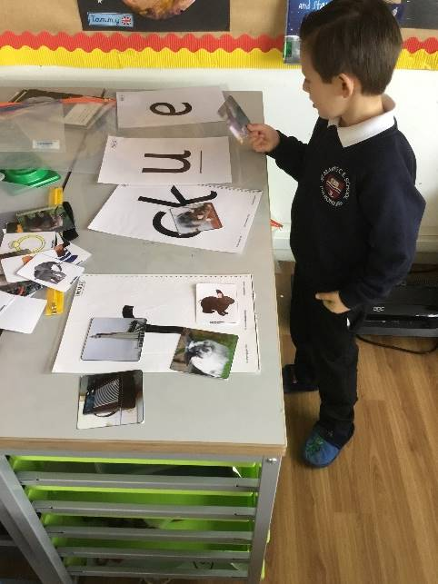


Literacy
We use a multi-sensory approach to teaching writing and reading and provide lots of experiences for children to link sounds and letters to enable them to begin to read and write.
Literacy lessons link to our topic and we introduce writing for a range of purposes. We also have a daily Phonics lesson and the children learn 3 sounds a week, as well as focussing on developing their sight vocabulary.
We hear children read once a week.

Slide 22



Our Library

Slide 23











Mathematics
We try to make Mathematics as practical as possible and relate concepts to real life experiences.
Initially we focus on developing their skills in counting, understanding and using numbers as well as shape, space and measure.
Later in the year, we progress to calculating simple addition and subtraction problems.

Slide 24







Understanding the World
We provide a range of experiences for the children to make sense of their physical world and their community. Through different topics each term the children learn about the world. They explore, investigate and observe people, places and the environment. We take them on trips to Dell Quay and Pulborough Brooks.

Slide 25






Expressive Art and Design
This area of the curriculum supports children’s curiosity and play. They are able to explore and share their thinking, ideas and feelings through art, music, movement, dance, role-play, and design and technology.
Children have access to creative tools and materials both inside and outside the classroom which allows them to
take ownership of their own creative development.

Slide 26
Forest School
We all know that screen time is a real danger to cutting this generation from the natural world.
Our best memories of our own childhoods happened outdoors – den building, climbing trees, lighting bonfires, making mud-pies and toasting marshmallows.
We need to let our children have the same freedom to engage with nature.

Slide 27







Forest School focuses our senses on what is around us. It helps reduce
stress and creates a sense of awe and wonder. Children learn new skills,
such as using tools and fire craft. Children make their own choices about
their learning.

Slide 28
Thank you for watching this presentation.

