Slide 1

Welcome to Ireland Class
2023-2024
Miss Taylor

Slide 2
Our Topics
Autumn 1 | Stone Age
Autumn 2 | Flow!
Spring 1 | Predators and Prey
Spring 2 | Urban Pioneers
Summer 1 | Tremors
Summer 2 | Romans

Slide 3
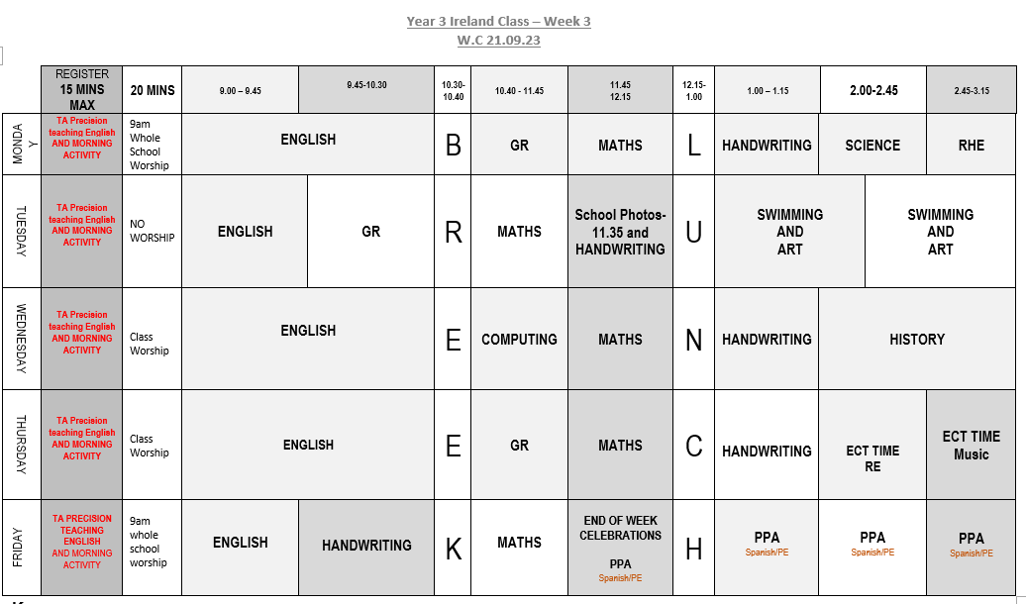
Typical Ireland Class Timetable

Slide 4
English – 1st half term: Writing instructions based on ‘How to Wash a Woolly Mammoth’ - Story writing inspired by ‘Stone Age Boy’. 2nd half term: Script writing based on ‘Stick Man’. Poetry writing on rivers. | Maths – 1st half term: Place Value Addition and Subtraction 2nd half term: Addition and Subtraction Multiplication and Division | Science – 1st half term: - Rocks 2nd half term: - Forces and Magnets.

Slide 5
PE – 1st half term: -Swimming every Tuesday. Hockey every Friday. 2nd half term: Dance every Wednesday Netball every Friday | Spanish – The children will be taught Spanish each week by Miss Bell. During the Autumn term, they will cover: Greetings, saying how we're feeling, numbers up to 12, saying our age, naming colours and finding out about Christmas in Spain. | History – 1st half term: Stone Age! We will learn all about life during the Stone Age. We will explore this through our history lessons, as well as through a range of texts; including, ‘The Stolen Spear’.
Geography – 2nd half term: Flow! During the second half term, we will be learning about rivers. This will include how rivers are formed and why rivers are so important to us. | Art – 1st half term: We will be exploring warm and cool colours. We will also investigate cave paintings, using ‘The First Drawing’ as a stimulus. | D&T – 2nd half term: We will be making water wheels during our Design and Technology lessons.

Slide 6
RE – 1st half term: We will be learning about the Creation Story, followed by Dharma. 2nd half term: We will be investigating Incarnation. | Music – 1st half term: We will be learning a song called ‘Let your Spirit Fly’. 2nd half term: We will be learning how to play the Glockenspiel. | Computing – 1st half term: We will be learning about how to be safe online. 2nd half term: We will be revisiting and extending our understanding of Coding. | RHE – 1st half term: We will be learning about Drugs and Tobacco. 2nd half term: We will be learning about bullying. Please note that all RHE lessons follow our curriculum and are age-appropriate

Slide 7



Routines
Times Tables | Spellings | Reading Logs
We will be testing the children each week on their understanding and will also be participating in daily maths fluency lessons, called Maths Flash. There are lots of ways to practise times tables at home. TT Rockstars. Online games – Bowling, Angry Andy must have Candy, Caterpillar carnage | Spellings will be handed out on a Tuesday and will be tested the following Tuesday. All spellings are adapted to suit the need of each individual child, providing familiarity and challenge. | Reading logs will be collected in and checked everyday. Dojos will be awarded for children who are reading at home. Please ensure that reading is recorded in logs. Your child can write it in themselves if they wish.

Slide 8
Routines
Water Bottle Please ensure that your child has their water bottle with them each day. | Snack Please ensure that your child comes to school with a piece of fruit or vegetable or a cereal bar. Please also note that we are a nut-free school. | Homework The homework grid will be available through Google Classroom. I have also sent out a hard copy. Please submit your child’s learning through GC or through the class email: ireland@stmarysprimarypulborough.co.uk

Slide 9
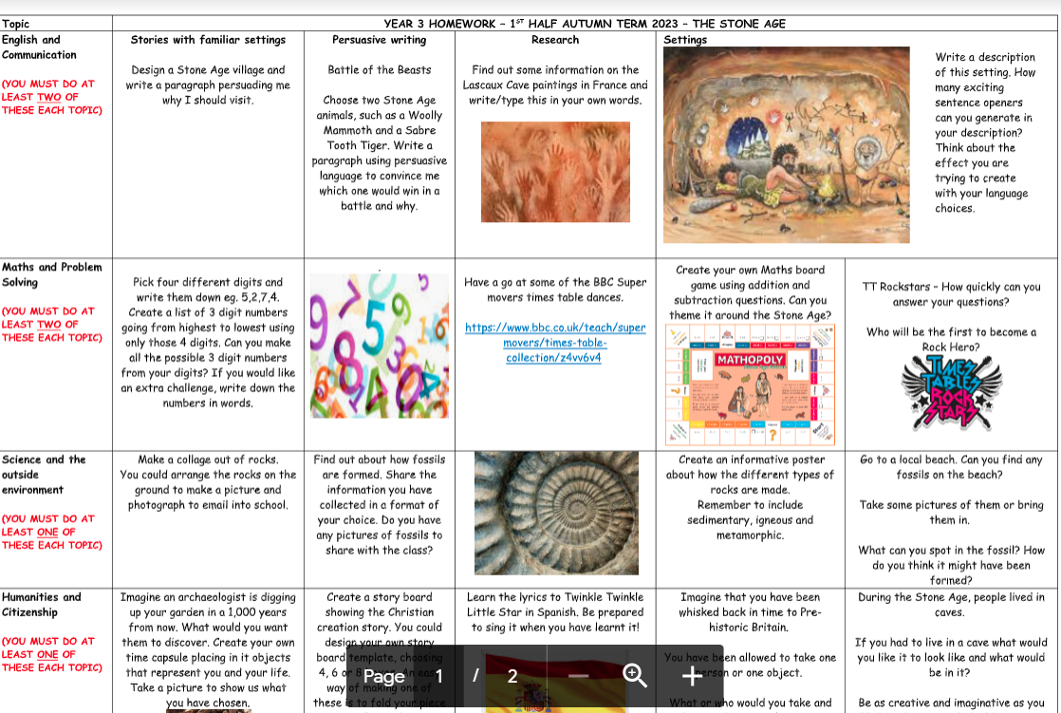
Homework

Slide 10
Behaviour
Positive behaviour management
Lots of praise! Verbal and rewards – dojos and stickers. | End of week certificates – Dojo champion Star of the week | Badges – Bronze, Silver and Gold. | Head teacher awards Recognition in newsletter – vine leaves

Slide 11
Behaviour continued
Behaviour management
We must follow our Golden Rules. These are up in the classroom and are often referred to. | If your child does not follow the Golden Rules, they will lose minutes from their break or lunch time. | This will result in a conversation with me in person or over the phone. | If your child continues to ignore the Golden Rules, there will be a meeting with me and a member of the senior leadership team.

Slide 12

Key dates and Questions?
Key dates:
18th October- Trip to Arundel Wetlands
20th October- INSET DAY
7th and 9th November- Parents’ Evenings
23rd November- Ireland class celebration assembly
15th December- Class Party and end of term
Any queries or concerns, please email on
ireland@stmarysprimarypulborough.co.uk

