Slide 1

‘Meet the Teacher’
Hello and Welcome to Italy Class!
Mrs Hubble – class teacher
Mr Barrett-Garlick – teaching assistant

Slide 2

Curriculum
Mrs Hubble will talk you through our Curriculum:
Our Themes for this Year:
Core Subjects
Foundation Subjects
Mrs Dunstall will cover PPA in our class on a Tuesday for half the day.

Slide 3
Italy Class Timetable
PE will be on a Monday and a Thursday every week.
Spelling lists will be posted on the class stream on Google Classroom each week and pupils will be asked to recall them in an informal quiz.
Homework Grid – available on the Google Classroom stream each week. We would like the children to complete one piece of homework each week. Please upload onto Google Classroom or bring it in.
The timetable is flexible and will change each week depending on what we need to focus on, but Worship,
Phonics, Maths and English will be covered
daily.

Slide 4
In EYFS and Key Stage 1:
Our priority is meeting the needs of our children – whichever class they are in.
Your child will get the required ‘diet’ for their year group – but also a diet that is tailored to their need – this may look different for children in different classes.
Classes may work completely independently… sometimes.
Classes may work with the class next door… sometimes.
Children may do things with other children in their year group – thus mixing with other classes or doing similar activities… sometimes.
For example: at Christmas, UK will work with Thailand on a performance and India will work with Italy on a different performance – each child will be included.
You may hear that children who are in another class, but are in the same year group as your child, are doing something different from your child – don’t worry! Refer to point 1!
We will try our best to communicate clearly with you.
Please do use the Italy class email to contact us.
italy@stmarysprimarypulborough.co.uk

Slide 5
Italy class - Reading
As the timetable is flexible, so too is the schedule for hearing readers and how we hear them (we do group guided reading too). This is why it is important that Reading Records are always available for classroom use every day of the week.
Pupils are learning to take their reading log and book out of their bags first thing in the morning to put in their named slot in the class library. We will give the children one dojo each for each time that they bring a book in and another for whenever they read at home.
Please read with your child every day if at all possible. Leave comments sharing anything that your child has struggled with and highlighting what they have done well. Please do write any direct quotes.
To read with fluency, your child should be able to read 9 out of 10 words. It is okay to re-read books to develop fluency and understanding!

Slide 6
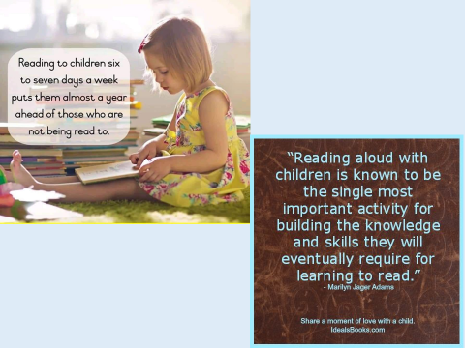

Slide 7

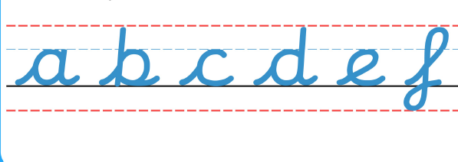
Handwriting
As a school we have been developing our cursive handwriting policy, which has both lead ins and lead outs. We all continue to learn this new policy from Reception to Year 6.

Slide 8
School Uniform
Please make sure all uniform is labelled, including P.E. kits and coats.
If you notice the name is starting to wear off, please could you re-write it so we know to whom items belong.
Children should be wearing sensible black school shoes (no black trainers) at all times. If there is a problem and they need to wear trainers for medical reasons, please let us know.
Navy blue round neck (school) jumpers should be worn. Hoodies and tracksuit tops are not acceptable as school uniform.
Please make sure uniform follows school policy.

Slide 9
What to bring to school
PE kits should be brought in every Monday and taken home each Friday to be washed.
Book bags/rucksacks – the children bring home letters, books, etc, all week and need their bags to carry everything.
Current reading book and reading record should be in school everyday to allow them to be monitored.
Lunch.
Water bottle – named, please.

Slide 10
Our Behaviour Policy
In Italy class, we aim to follow both our Golden Rules and Class Charter every day.
Good behaviour, including good listening, is rewarded with dojo points. If a child reaches a weekly target 5 times in the year, they will receive a bronze badge. If they reach the target 15 times, they will receive a silver badge. If they reach the target 25 times, they will receive a gold badge.
Every week, the child with the most dojo points will be given a ’Dojo Champion’ certificate.
Gentle reminders and a restorative approach
is undertaken to address any poor behaviour.

Slide 11
Health and Safety
Please can you check your child for head lice (nits) on a weekly basis. Catching head lice is very common among young children and can be easily treated using products purchased from your local chemist.
Ways to try to avoid catching them –Tying back long hair where possible.. Should your child contract head lice it is recommended the whole family are treated to prevent them spreading.
Girls MUST take earrings out for P.E. lessons and should hair tied back at all times. Staff are not permitted to help children remove earrings. Should you be thinking about having your child’s ears pierced, it is recommended you do this over the summer holidays so that they may be removed easily when they return to school in September.
P.E. is part of the National Curriculum and ALL children must participate. A doctor’s letter is required for exclusion from P.E.

Slide 12
Any Questions?
If there is anything that you are curious or concerned about, please do email me on our class email address.
italy@stmarysprimarypulborough.co.uk
Thank you for listening! ☺

Slide 13
Dates to Remember
Forest School – all day every other Thursday, for Year 1 pupils only until Christmas, then it will be the turn of Year 2 pupils.
Class Assembly – TBC, but on a Friday before Christmas

