Slide 1

Meet the Teacher
Mexico Class – October 2023
Mr Coomber – Mexico Class
mexico@stmarysprimarypulborough.co.uk
TA: Mrs Parsons – all day
TA: Mrs Metalliaj- afternoons
PPA Teachers (Thursday)
Mrs Callender – Outdoor PE (Games/Athletics)
Miss Bell – Spanish

Slide 2
Curriculum
The topics above provide a focus for our
learning and have important links with areas
the children have studied and will study next
year.

Slide 3
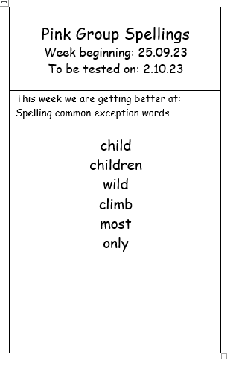
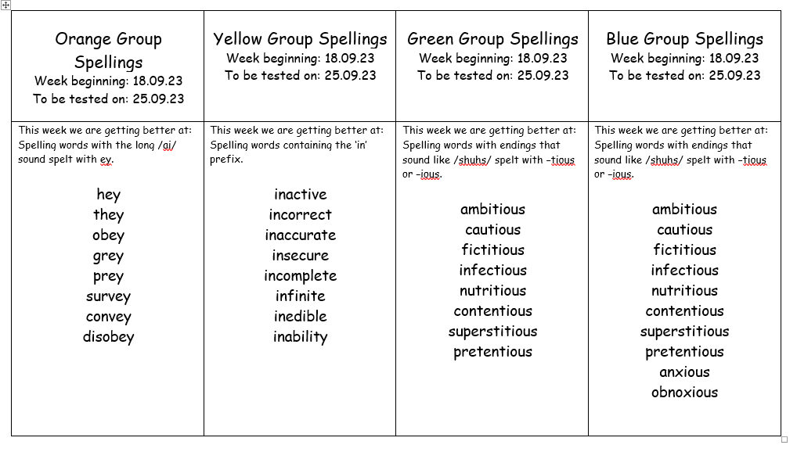
Spellings
We have five spelling groups in total. Spellings will
be handed out every Monday and then tested again
the following Monday.

Slide 4
Reading
Reading logs are collected at the beginning
of every day and then taken home by the
children at the end of the day.
We expect to see at least three entries per
week.
Read 20 minutes a day and you’ll read
1,800,000 words per year.
Children who read 1,000,000 words per
year are in the top 2% for reading achievement

Slide 5
Homework
Homework grids
TT Rockstars
Accelerated Reader
MyOn

Slide 6
Snacks and Water
- Fruit/healthy snack can be brought in for break times.
- Please note that we are a nut-free school.
- Water bottles are kept in the classroom and can be accessed at all times

Slide 7
Rewards and Sanctions
- Dojo points: gold, silver and bronze badges
- School Celebrations – Happy Book awards, vine leaves, TT Rockstars leaderboard
- Class Certificates – Star of the Week, Dojo Champion

Slide 8
Rewards and Sanctions
Move tables
Minutes off break time
Timeout

Slide 9
Behaviour Policy
This is underpinned by our school Golden Rules and can be found on the school website.
E-safety will be covered in school as part of the Computing curriculum, but please be aware of (and monitor) your children’s use of devices at home.

Slide 10
General
- Uniform – Trainers are not part of school uniform
- Home time - Please send a letter or an email to provide consent if you would like your child to walk home independently
- Photography permission slips (internet/website)
- Parents’ Evenings will take place via School Cloud.
- Please ensure that all equipment and uniform is labelled clearly
- Children are permitted to bring in their own pencil cases if they wish
- PE: Outdoor Games – Thursdays (hockey and netball)
- Swimming – Wednesdays and Thursdays until half term (weather permitting) before changing to gymnastics in November.

Slide 11
Autumn Diary Dates
Mexico Class Assembly – Thursday 19th October
INSET Day – Friday 20th October
Residentials:
Year 5: Cobnor – Wednesday 8th – Friday 10th May 2024

Slide 12
Any questions?
Please feel free to email me using the class email address:
mexico@stmarysprimarypulborough.co.uk

