Slide 1
Welcome to New Zealand Class
2023-2024
Miss Heasman

Slide 2
Our Topics
Autumn 1 | Stone Age
Autumn 2 | Flow!
Spring 1 | Predators and Prey
Spring 2 | Urban Pioneers
Summer 1 | Tremors
Summer 2 | Romans

Slide 3
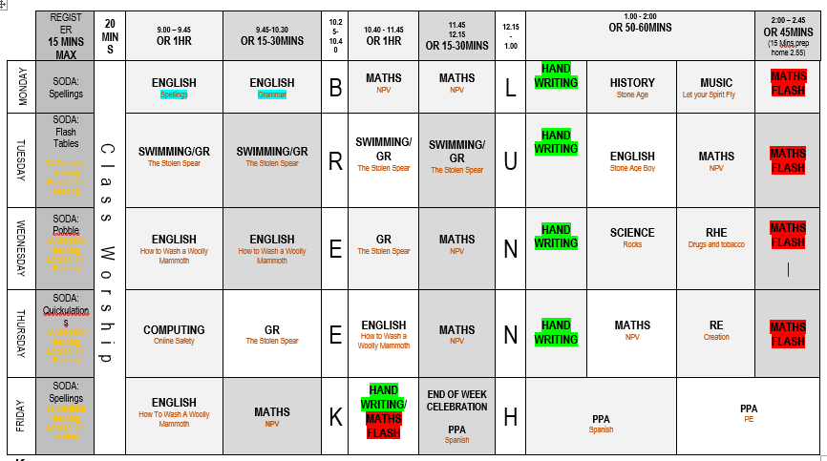
Typical NZ Class Timetable

Slide 4
English – 1st half term: ‘How to wash a woolly mammoth’ – Instructional writing ‘Stone Age Boy’ - Narrative 2nd half term: ‘Stick Man’ – Play scripts Poetry about rivers. Poetry about Christmas | Maths – 1st half term: Place Value Addition and Subtraction 2nd half term: Addition and Subtraction Multiplication and Division | Science – 1st half term: Rocks - Formation of rocks – Starburst rocks! - Uses of rocks - Classifying and grouping rocks - Investigations 2nd half term: Forces and Magnets - Poles – attract and repel - Pushing and pulling - Investigations

Slide 5
PE – 1st half term: Swimming – Tuesday Hockey - Friday 2nd half term: Dance – Wednesday Netball - Friday | Spanish – The children will be taught Spanish each week by Miss Bell. Greetings numbers up to 12, naming colours finding out about Christmas in Spain. | History – 1st half term: Stone Age! Archaeologists and primary sources Skara Brae Dwellings Diets Monuments Cheddar Man
Geography – 2nd half term: Flow! River systems Local rivers Famous rivers | Art – 1st half term: ‘The First Drawing’ Warm and cool colours Cave paintings | D&T – 2nd half term: Water wheels

Slide 6
RE – 1st half term: Christianity – The Creation Story Hinduism - Dharma 2nd half term: Christianity - Incarnation | Music – 1st half term: We will be learning a song called ‘Let your Spirit Fly’. 2nd half term: We will be learning how to play the glockenspiel. | Computing – 1st half term: Online safety 2nd half term: Coding | RHE – 1st half term: Drugs and Tobacco. 2nd half term: Bullying. Please note that all RHE lessons follow our curriculum and are age-appropriate

Slide 7
Routines
Times Tables | Spellings | Reading Logs
There will be an increased focus on times tables in Year 3. We will be testing the children each week on their understanding and will also be participating in daily Maths fluency lessons, called Maths Flash. There are lots of ways to practise times tables at home. TT Rockstars. Online games – Bowling, Angry Andy must have Candy, Caterpillar carnage | Spellings will be handed out on a Monday and will be tested the following Monday. All spellings are adapted to suit the need of each individual child, providing familiarity and challenge. | Reading logs will be collected in and checked everyday. Dojos will be awarded for children who are reading at home. Please ensure that reading is recorded in logs. Your child can write it in themselves if they wish.

Slide 8
Routines
Water Bottle Please ensure that your child has their water bottle with them each day. | Snack Please ensure that your child comes to school with a piece of fruit or vegetable or a cereal bar. Please also note that we are a nut-free school. | Homework The homework grid will be available through Google Classroom. I have also sent out a hard copy. Please submit your child’s learning through GC or through the class email: nz@stmarysprimarypulborough.co.uk

Slide 9
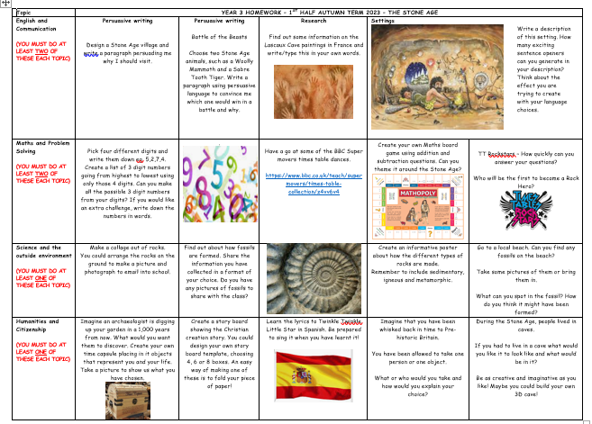
Homework

Slide 10
Behaviour
Positive behaviour management
Lots of praise! Verbal and rewards – dojos and stickers. | End of week certificates – Dojo champion Star of the week | Badges – Bronze, Silver and Gold. | Head teacher awards Recognition in newsletter – vine leaves

Slide 11
Behaviour continued
Behaviour management
We must follow our Golden Rules. These are up in the classroom and are often referred to. | If your child does not follow the Golden Rules, they will lose minutes from their break or lunch time. | This will result in a conversation with me in person or over the phone. | If your child continues to ignore the Golden Rules, there will be a meeting with me and a member of the Senior Leadership Team.

Slide 12
Key dates and Questions?
Key dates:
October 4th – Meet the teacher 18th – Trip to Arundel Wetlands 20th – INSET Day 23rd – 26th – Half Term 30th – Return to school 30th – Flu Sprays | November 7th – Parents’ Evening 9th – Parents’ Evening 10th – Firework display W/c.13th –Anti-bullying week 17th – Children in Need non-uniform day | December 14th – Pantomime 14th – Christmas meal 15th – Christmas Eucharist 15th – Class Party
Any queries or concerns, please email me on the
class email:
nz@stmarysprimarypulborough.co.uk

