Slide 1

Welcome to Ireland Class
2022-2023
Mrs Benson

Slide 2
Our Topics
Autumn 1 | Stone Age
Autumn 2 | Flow!
Spring 1 | Predators and Prey
Spring 2 | Urban Pioneers
Summer 1 | Tremors
Summer 2 | Romans

Slide 3
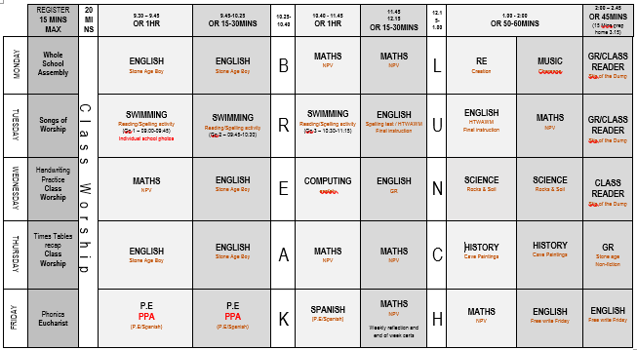
Typical Ireland Class Time table

Slide 4
Timetable continued
P.E. – the children will be doing P.E. on a Friday each week. The Friday outdoor games session will be taught by Mrs Burbidge.
Correct and seasonal kit is to be in school at ALL times, please. (please make sure your child has removable earrings!) We are not permitted to place tape over ears any longer.
PE kit is a school logo T-shirt (or plain white T-Shirt), black/navy sports shorts, black or navy tracksuit bottoms. Trainers.
No kit should have fashion logos. Trainers should be suitable for PE. If your child is unable to tie their shoe-laces, please do not send them to school with trainers that need to be tied.
Spellings will be handed given out on a Monday and tested on the following Monday. The children have been placed in spelling groups based on their ability and spelling age. These groups will be reviewed throughout the year. I have added a list of common exception words which the children are expected to know by the end of Year 4, and a list of statutory words. Spellings has been uploaded to Google Classrooms along with ideas on how to learn your spellings and the statutory word list for Year 3 & 4.
Please hand Reading logs in every day. The children are expected to read outside of school at least four times during the week for 10 minutes and use their reading log to write comments about what they have been reading. Please try to add comments about new words they may have learned, or who their favourite character may have been, instead of just page numbers. Rewards will be in place for children who regularly do this. Books borrowed from the school can be read at home. Children will have a second book to read in school at all times.

Slide 5
Timetable continued
Mental Arithmetic – Times Tables
  There will be more of a focus on learning times tables and these will be tested regularly. If the curriculum remains unaltered, the children would normally be set a times tables test at the end of Year 4. This is known as the Multiplication Tables Check and has been implemented by the Department of Education. They will be tested on their times tables up to the 12 times tables. Focus is on quick recall. We are using TT Rockstars to help the children build their recall knowledge and confidence. You should all have your child’s login ID and PW for this App.
  Learning their times tables is key to their Maths. Please help as much as you can at home.
On a Friday the children will be taught Spanish by Señorita Bell and P.E. by Mrs Burbidge.
Children are supported in class by; Mrs Castle, an experienced Higher Level Teaching Assistant.

Slide 6
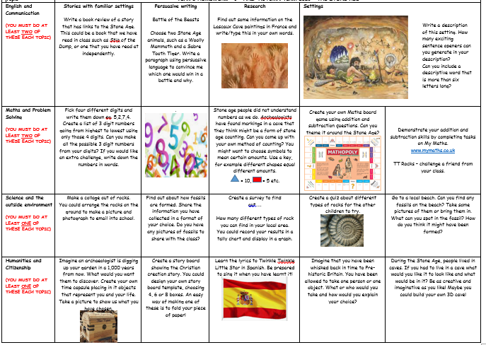
Home work
Home work is in the form of a ‘homework grid’ available via Google Classrooms.

Slide 7
Homework
Children are expected to submit six pieces of homework this half term via Google Classrooom.
A copy of the homework grid is also on the school website under Ireland’s class page.
Two English, two Maths, one Science and one Humanities-based assignment.
They can choose which one they want to submit.
Homework will be reviewed weekly and shared with the class.
Please do not bring homework into school. You may send photographs of completed work.

Slide 8
Ireland Class Routine
All children are expected to come into the classroom independently at the start of day, and at the end of play and lunchtime after the whistle has been blown. They should hang their coats, and bags on their designated pegs in the cloakroom outside the classroom. Lunch boxes are placed on the cloakroom shelves and water bottles are placed in the designated box in the classroom. Please make sure your children come to school with a water bottle daily.
The children are encouraged to have a piece of fruit or a cereal bar as a healthy snack at break time. No crisps or chocolate. Please note we are a NUT FREE school, this includes sesame seeds.
During lesson input, the children are given the opportunity to talk about their learning and share ideas with each other. They are encouraged to share with as many children as possible.

Slide 9
Ireland Class Routine continued
The children are sometimes placed in groups for Literacy and Maths based on ability so that they can receive work that is differentiated to suit their needs.
These groups are not rigid and may change throughout the course of the year!
The children are given activities to help cement their learning. Theyare encouraged to work through the activities and progress onto thenext level of work, meaning there should not be a ceiling to their learning.

Slide 10
Well Being
The new OFSTED framework released in September 2019 highlights children’s physical and emotional well-being as being at the top of their agenda. It is now a statutory requirement that we educate the children about relationships and health.
We will be having RHE lessons (Relationship and Health Education). These lessons will focus on the well-being of the children. We follow a scheme of work specifically designed for Year 3.
I will inform you in the termly newsletter of the areas we will be discussing in RHE.
Please do inform me of anything that you think may affect your child and their learning.

Slide 11
School Uniform
Please ensure that all of your child’s school uniform, including PE kits and coats are clearly labelled with their name.
Children should be wearing sensible black school shoes (no black trainers)at all times.
Please note that school regulation is that children wear navy or black hair bands, clips and bows. Large sparkly and floral hair accessories are not recommended to be worn to school.
Hair longer than shoulder length is to be tied up for safety and hygiene reasons.
Please also remove nail polish and ensure sensible ear studs are worn. Any long or large hooped earrings will be removed during school and returned at the end of the day. No other jewellery is permitted with the exception of a wrist watch.
Navy blue round neck (school) jumpers should be worn. Hoodies and tracksuit tops are not acceptable as school uniform.
We take pride in our appearance and like to encourage the children do as well.

Slide 12
What to bring to school
PE kits are to be left at school. We will send them home at the end of the week for a good wash!
Book bags/rucksacks.
A current reading book will remain in school which, when finished, they can change for a new one from a selection of books in the school library. A second book may be taken home, but must be bought back to school when completed.
Lunch – please ensure the children have items they can access themselves.
Water bottle – again, please ensure your child can open their own water bottles.
Reading log every day.
Homework – is to be completed weekly as usual and an account/photo emailed to me using the class email address.

Slide 13
Behaviour
We aim to follow the St Mary’s Golden Rules at all times in Ireland class.
There is a new school Behaviour Policy. Should the children continue to misbehave then we will speak with them immediately regarding their behaviour using restorative language. A discussion will be had as to why they are misbehaving and what they can do to make it better. The children will be given 15 minutes ‘Time Out’. During this session they will make amends. We will contact you explaining what has happened and a log is made so we can track their behaviour. Should behaviour continue to be disruptive we will arrange a meeting with you and your child to discuss how we may move forward together.
We have also established our own Class charter which can be found in our classroom. This is where the children decide their own rules. For example, they have the right to an education. They have the right to be heard.
If children do not complete work in lesson times due to poor behaviour, or they hand in work that shows a lack of effort, they may be asked to finish it or do it again at break times.

Slide 14
Behaviour continued
Good behaviour and work is rewarded with team dojo points. These are given for good work, effort and displaying the Christian values to other children.
You should already have had invitations to class dojo, on which I will post work and photographs every so often so that you can see what is happening in class.
Any urgent messages to me should still go via the School Office as they will send me a note during the day.
At the end of the week the child with the most dojo points will be awarded a Dojo Champion Certificate.
Please submit any achievement gained by the children outside the school. We will submit these to Mrs Copus who will endeavour to recognise in their successes in the weekly newsletter.
We like to focus on positive behaviour and I will advise Mrs Copus or other members of our leadership team of special work and so your child will receive even more recognition!
Every week I will decide on a Star of the Week – this may be awarded to a child who has worked consistently hard or who has been exceptional in following our Golden Rules or demonstrating one of our Christian values.

Slide 15
Health and Safety
Please continue to follow the school’s new guidelines in relation to COVID-19. It is important that you continue to remind your children to socially distance, wash their hands, etc. We want to protect you and your families as much as we can.
Should your child suffer from diarrhoea or vomiting they are required to remain off school until 48 hours following their last episode.
Please can you check your child for head lice (nits) on a weekly basis. Catching head lice is very common among young children and can be easily treated using products purchased from your local chemist!
Ways to try to avoid catching them –Tying back long hair where possible. Should your child contract head lice it is recommended the whole family are treated to prevent them spreading.
Children MUST take earrings out for P.E. and swimming lessons and should have long hair tied back at all times. Staff are not permitted to help children remove earrings. Should you be thinking about having your child’s ears pierced, it is recommended you do this early in the summer holidays so that they may be removed easily when they return to school in September.
P.E. is part of the National Curriculum and ALL children must participate. A doctor’s letter is required for exclusion from P.E.

Slide 16
Questions?
If there is anything that you are curious or concerned about, please feel free to contact me on the class email or make an appointment with the office and we can arrange to have a meeting.
ireland@stmarysprimarypulborough.co.uk
Thank you for coming along this evening. It has been a pleasure to meet you.

