Slide 1

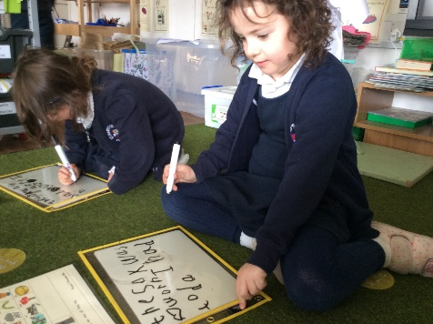
Year One
Phonics Screening Check
A Guide for Parents

Slide 2
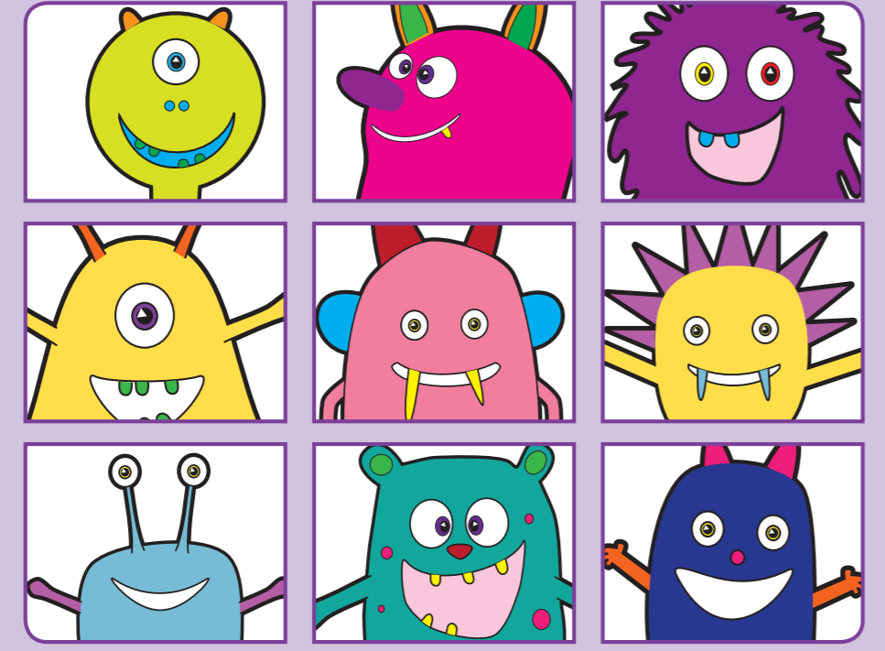
Welcome to our Phonics Screening Check meeting

Slide 3
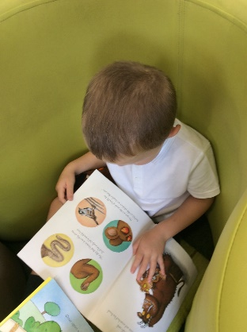
1
What is Phonics?
2
What is the Phonics Screening Check?
3
Contents of the Phonics Screening Check.
4
What Happens During the Screening?
5
Pseudo Words (Nonsense/alien words)
6
Reporting to Parents
7
How Are the Results Used?
8
How Can I Help My Child at Home?
next page

Slide 4
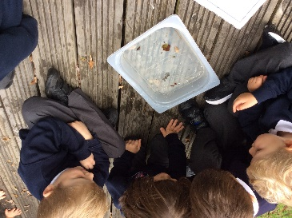
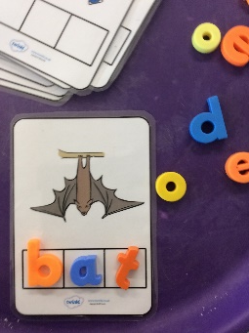
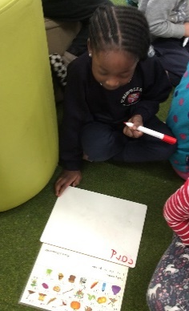
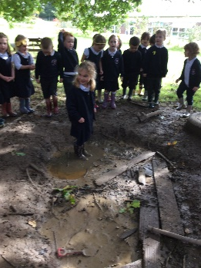

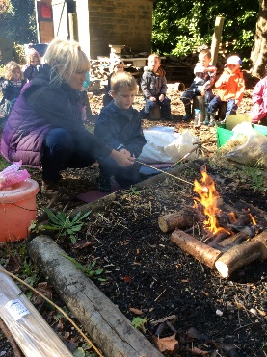

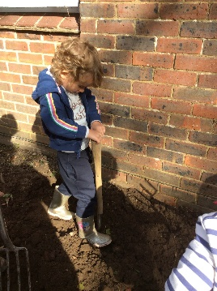
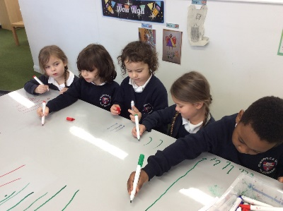


What is Phonics?
Children begin to learn phonics (sounds) in early years, discriminating between sounds in nursery and linking these to letters in reception.
Once children begin learning sounds, these sounds are used orally to identify and make words. They will then begin to learn the letters which make each of the sounds and these are used to read and spell words.
St. Mary’s Phonic Scheme – songs, actions, images.
menu
next page

Slide 5
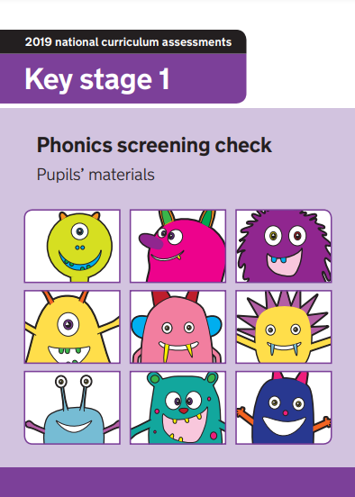
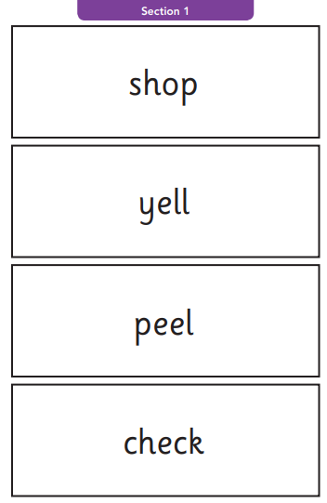
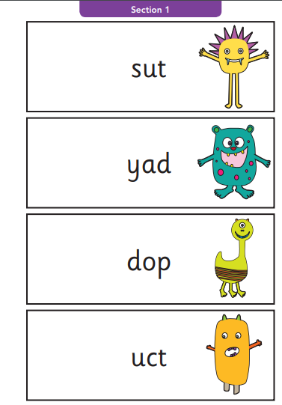
What is the Phonics Screening Check?
Children in Year 1 throughout the country will all be taking part in a phonics screening check during the same week in June. This year it will take place during the week beginning 12th June. Children in Year 2 will also take the check if they did not achieve the required result when in Year 1 or they have not taken the test before.
The Year 1 phonics screening check is a statutory national test and a way for teachers to ensure that children are making sufficient progress with their phonics skills to read words. It supports teachers in understanding whether children are on track to become fluent readers who can enjoy reading for pleasure and for learning.
menu
next page

Slide 6
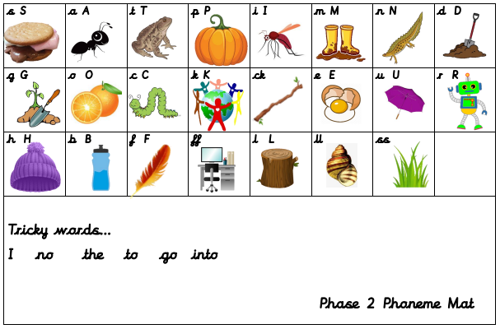
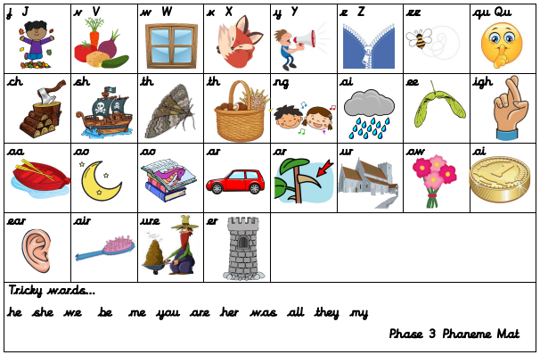
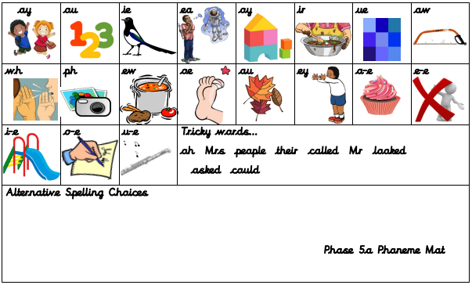
Content of the Phonics Screening Check.
Section 1 – phases 2 and 3
The words in section 1 will have a variety of simple word structures (for example CVC, VCC, CCVC and CVCC) using:
single letters (a, b, c, d, e, f, g, h, I, j, k, l, m, n, o, p, q(u), r, s, t, u, v, w, x, y, z)
some consonant digraphs (ch, ck, ff, ll, ng, sh, ss, th, zz)
frequent and consistent vowel digraphs (ar, ee, oi, oo,or)
Section 2 – phase 5a
The words in section 2 will have a variety of more complex word structures (for example CCVCC, CCCVC, CCCVCC and two syllable words) with some:
additional consonant digraphs (ph, wh)
less frequent and consistent vowel digraphs, including split digraphs (a-e, ai, au, aw, ay, ea, e-e, er, ew, i-e, ie, ir, oa, o-e, ou, ow, oy, ue, u-e, ur)
trigraphs (air, igh).
menu
next page

Slide 10
To note…
Children will sound out and blend sounds to read real and nonsense/alien words.
Children do not need to blend sounds internally.
If necessary, they can spot digraphs and trigraphs and sound them out first.
Words can be one syllable, e.g. ‘cat’, ‘sand’ or two-syllable, e.g. bucket, windmill.

Slide 11

What Happens During the Test?
The test contains 40 words. Each child will sit one-to-one and read each word aloud to a teacher. The test will take approximately 10 minutes per child, although all children are different and will complete the check at their own pace. The list of words the children read is a combination of 20 real words and 20 pseudo words (nonsense/alien words).
These are words that are phonically decodable, but are not actual words with an associated meaning e.g. brip, snorb. Pseudo/alien words are included in the check specifically to assess whether your child can decode a word using phonics skills and not their memory.
menu
next page

Slide 12
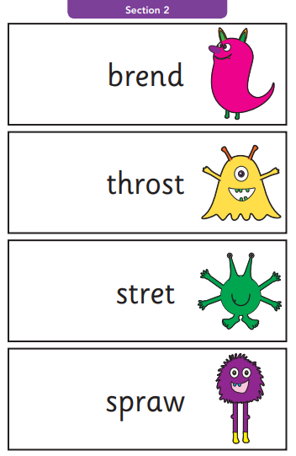
Pseudo Words (Nonsense or Alien Words)
The pseudo words are written next to a picture of an alien and we pretend that they spell the alien’s name. This provides the children with a context for the pseudo word which is independent from any existing vocabulary they may have.
Pseudo words are included because they will be new to all pupils; they assess whether your child is using phonics rather than their memory.
menu
next page

Slide 13
Reporting to Parents – is there a pass mark?
The PSC is to check appropriate progress is being made. If children do not reach the required standard, then the class teacher will be in touch to discuss plans and offer additional, tailored support for your child.
The national standard against which children are judged is 32/40.
Children progress at different speeds so not reaching the threshold score does not necessarily mean there is a serious problem. Your child will re-sit the check the following summer term.
By the end of the summer term all schools must report each child's results to their parents. They will also confirm if the child has met the standard threshold. Children who do not achieve the expected level will retake the test when they are in Year 2.
Your Year 1 child will re-sit the check in June 2024 if they do not reach this threshold this summer. Some of our current Year 2 pupils will also re-sit the check.
menu
next page

Slide 14

How Are the Results Used?
We will report your child’s results to you, to the local authority and discuss them with their next class teacher.
menu
next page

Slide 15
How Can I Help My Child at Home?
Play lots of sound and listening games with your child.
Read as much as possible to and with your child – additional information sheet on ‘Moving through the new Phonics Reading Scheme’ available on the school website (Curriculum: Phonics)
Encourage and praise – talk about the phonemes they have blended correctly, have another look at the other phonemes together.
Be detectives – hunt for digraphs and trigraphs in words before reading them.
If your child is struggling to decode a word, help them by encouraging them to say each sound in the word from left to right. Use the chop and blend action as you do this.
Syllables – additional information sheet about the importance of these and how to identify them, available on the school website (Curriculum: Phonics)
Blend the sounds by pointing to each one, e.g. /c/ in cat, /p/ in pat, /ng/ in sing, /ee/ in been. Next move your finger under the whole word as you say it.
Discuss the meaning of words if your child does not know what they have read.
menu
next page

Slide 16

Digraph and Trigraph spotting
The biggest challenge is to spot digraphs and trigraphs in words.
sh ch nk or igh air oi
When practising reading words, get them to look for any digraphs or trigraphs first.
Say:
“Can you spot any digraphs or trigraphs?”
e.g. “or…s t or m…storm”.

Slide 17
Split digraphs
a-e bake a cake
e-e complete don’t delete
i-e glide down the slide
o-e wrote a note
u-e tune on a flute

Slide 18
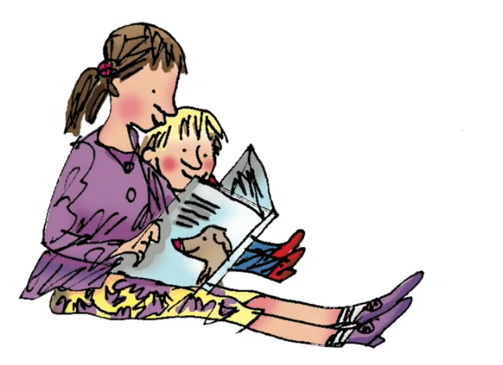
Word reading
Share your child’s Book Bag Books regularly.

Slide 19
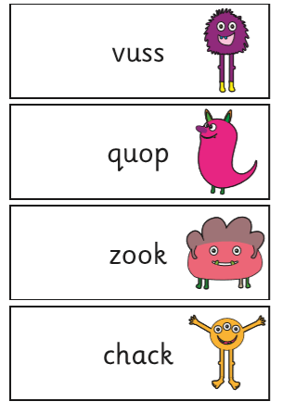
Have a go at these!

Slide 20
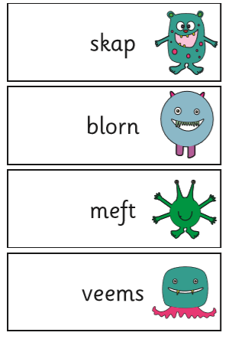

Slide 21
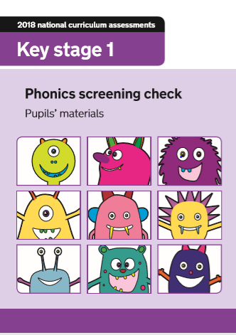
Online resources:
Past papers:
https://www.gov.uk/government/collections/
national-curriculum-assessments-practice-materials
#phonics-screening-check-resources

Slide 22
Here is a video about alien words from ‘Letters and Sounds’ if you would like more information on how to help your child with them. https://youtu.be/h-o3cQKjU18

